Slide 1

Promoting Resilience

Slide 2



Housekeeping
Respect - help us to create a safe space
Confidentiality
Any other boundaries we would like to set?
Disclaimer:
The tools and suggestions we speak about are not a one-size-fits-all.
All children, young people, and families are unique, and we need to try to use a person-centred approach to find the best solution.

Slide 3

Who Am I?
Beth Cullen
Senior Practitioner
Hertsmere Mental Health Support Team

Slide 4
The MHST service has three core functions:
What is the Mental Health Support Team (MHST)?
One to One Support
Groups, Workshops, Staff Training
Whole School or College Approach
To deliver evidence-based interventions in an educational setting for mild-to-moderate mental health issues
Support the Mental Health Lead in each school or college to introduce or develop whole school or college approach
Give timely advice to education staff and liaise with external specialist services to help children and young people to get the right support and stay in education.

Slide 5

Agenda
understanding resilience
7 tips for promoting resilience in children
signposting
feedback

Slide 6

Resilience
“positive adaptation and development in the context of significant adversity”
BPS
ability to cope with and bounce back from challenging times
inner strength
able to manage stressful situations

Slide 7



What contributes to resilience?
hopefulness
strong social support networks
presence of at least one unconditionally supportive parent/carer
positive school/educational experiences
sense of autonomy & belief that they can make a difference
participation in a range of activities/interests
ability to reframe adversity

Slide 8

How can parents encourage resilience?

Slide 9
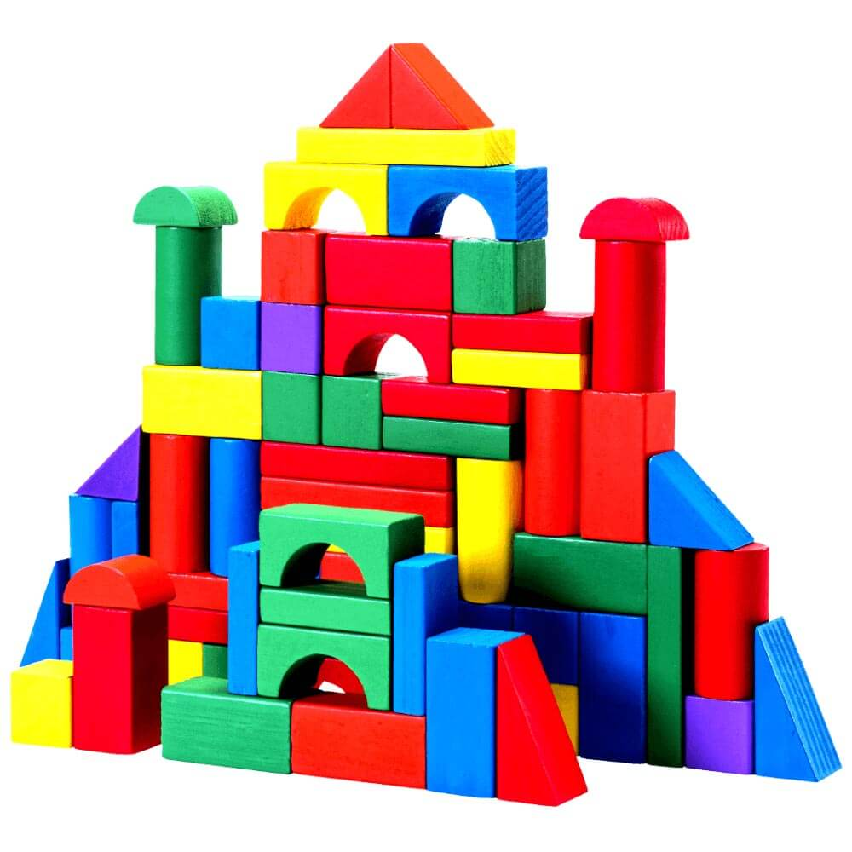
Tip 1: Child-led Play
Strong social support networks are a key contributor to resilience; development of positive relationships between parent and child can be supported by child-led play. This creates:
a safe-base where children know they can always return to for help when challenges arise
a space to practise and learn about the world and relationships
a sense of autonomy
can be for 10-15 minutes a day
space where the child selects what you are going to be doing
limited questioning from parent – just going along with play
clear guidelines for when play time will be ending with a 5-minute warning

Slide 10

It can be helpful to reflect with your child on other members of their support network, to remind them of all the individuals who care for them. Remember, support comes in many forms:
practical
emotional
fun
educational
professional

Slide 11


Tip 2: Praise
Praise the effort that led to an outcome.
This supports children to understand that they can grow, develop and learn from their mistakes rather than seeing intelligence or ability as fixed and innate.
Focus on their actions rather than who they are.
Labelling children as ‘smart’ or a ‘helper’ can lead to children opting for easier routes to ensure success.

Slide 12
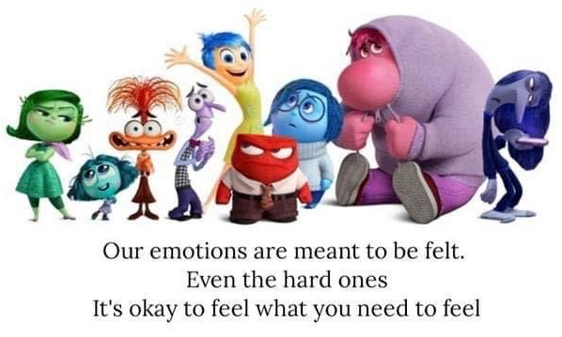
Tip 3: Name it, Model it, Validate it
Emotions and resilience are linked.
emotional literacy can be developed by discussing emotions
name emotions you are experiencing and positive ways you can manage them
when your child experiences difficulties explore their emotions with them and how they could manage them
I can see that you are looking tense and hot – perhaps you are feeling angry?
I can understand you feeling angry when someone takes something from you… how can we help you feel better?

Slide 13
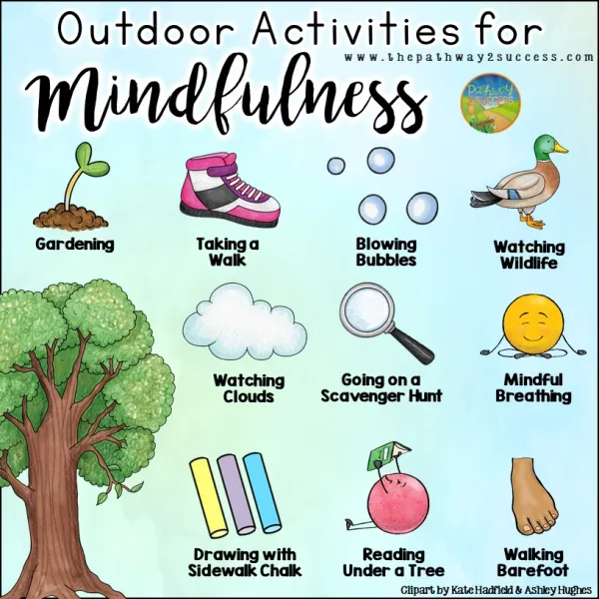
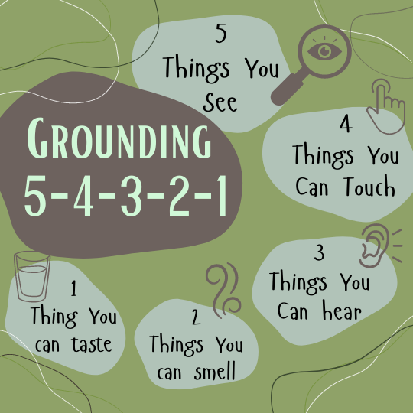
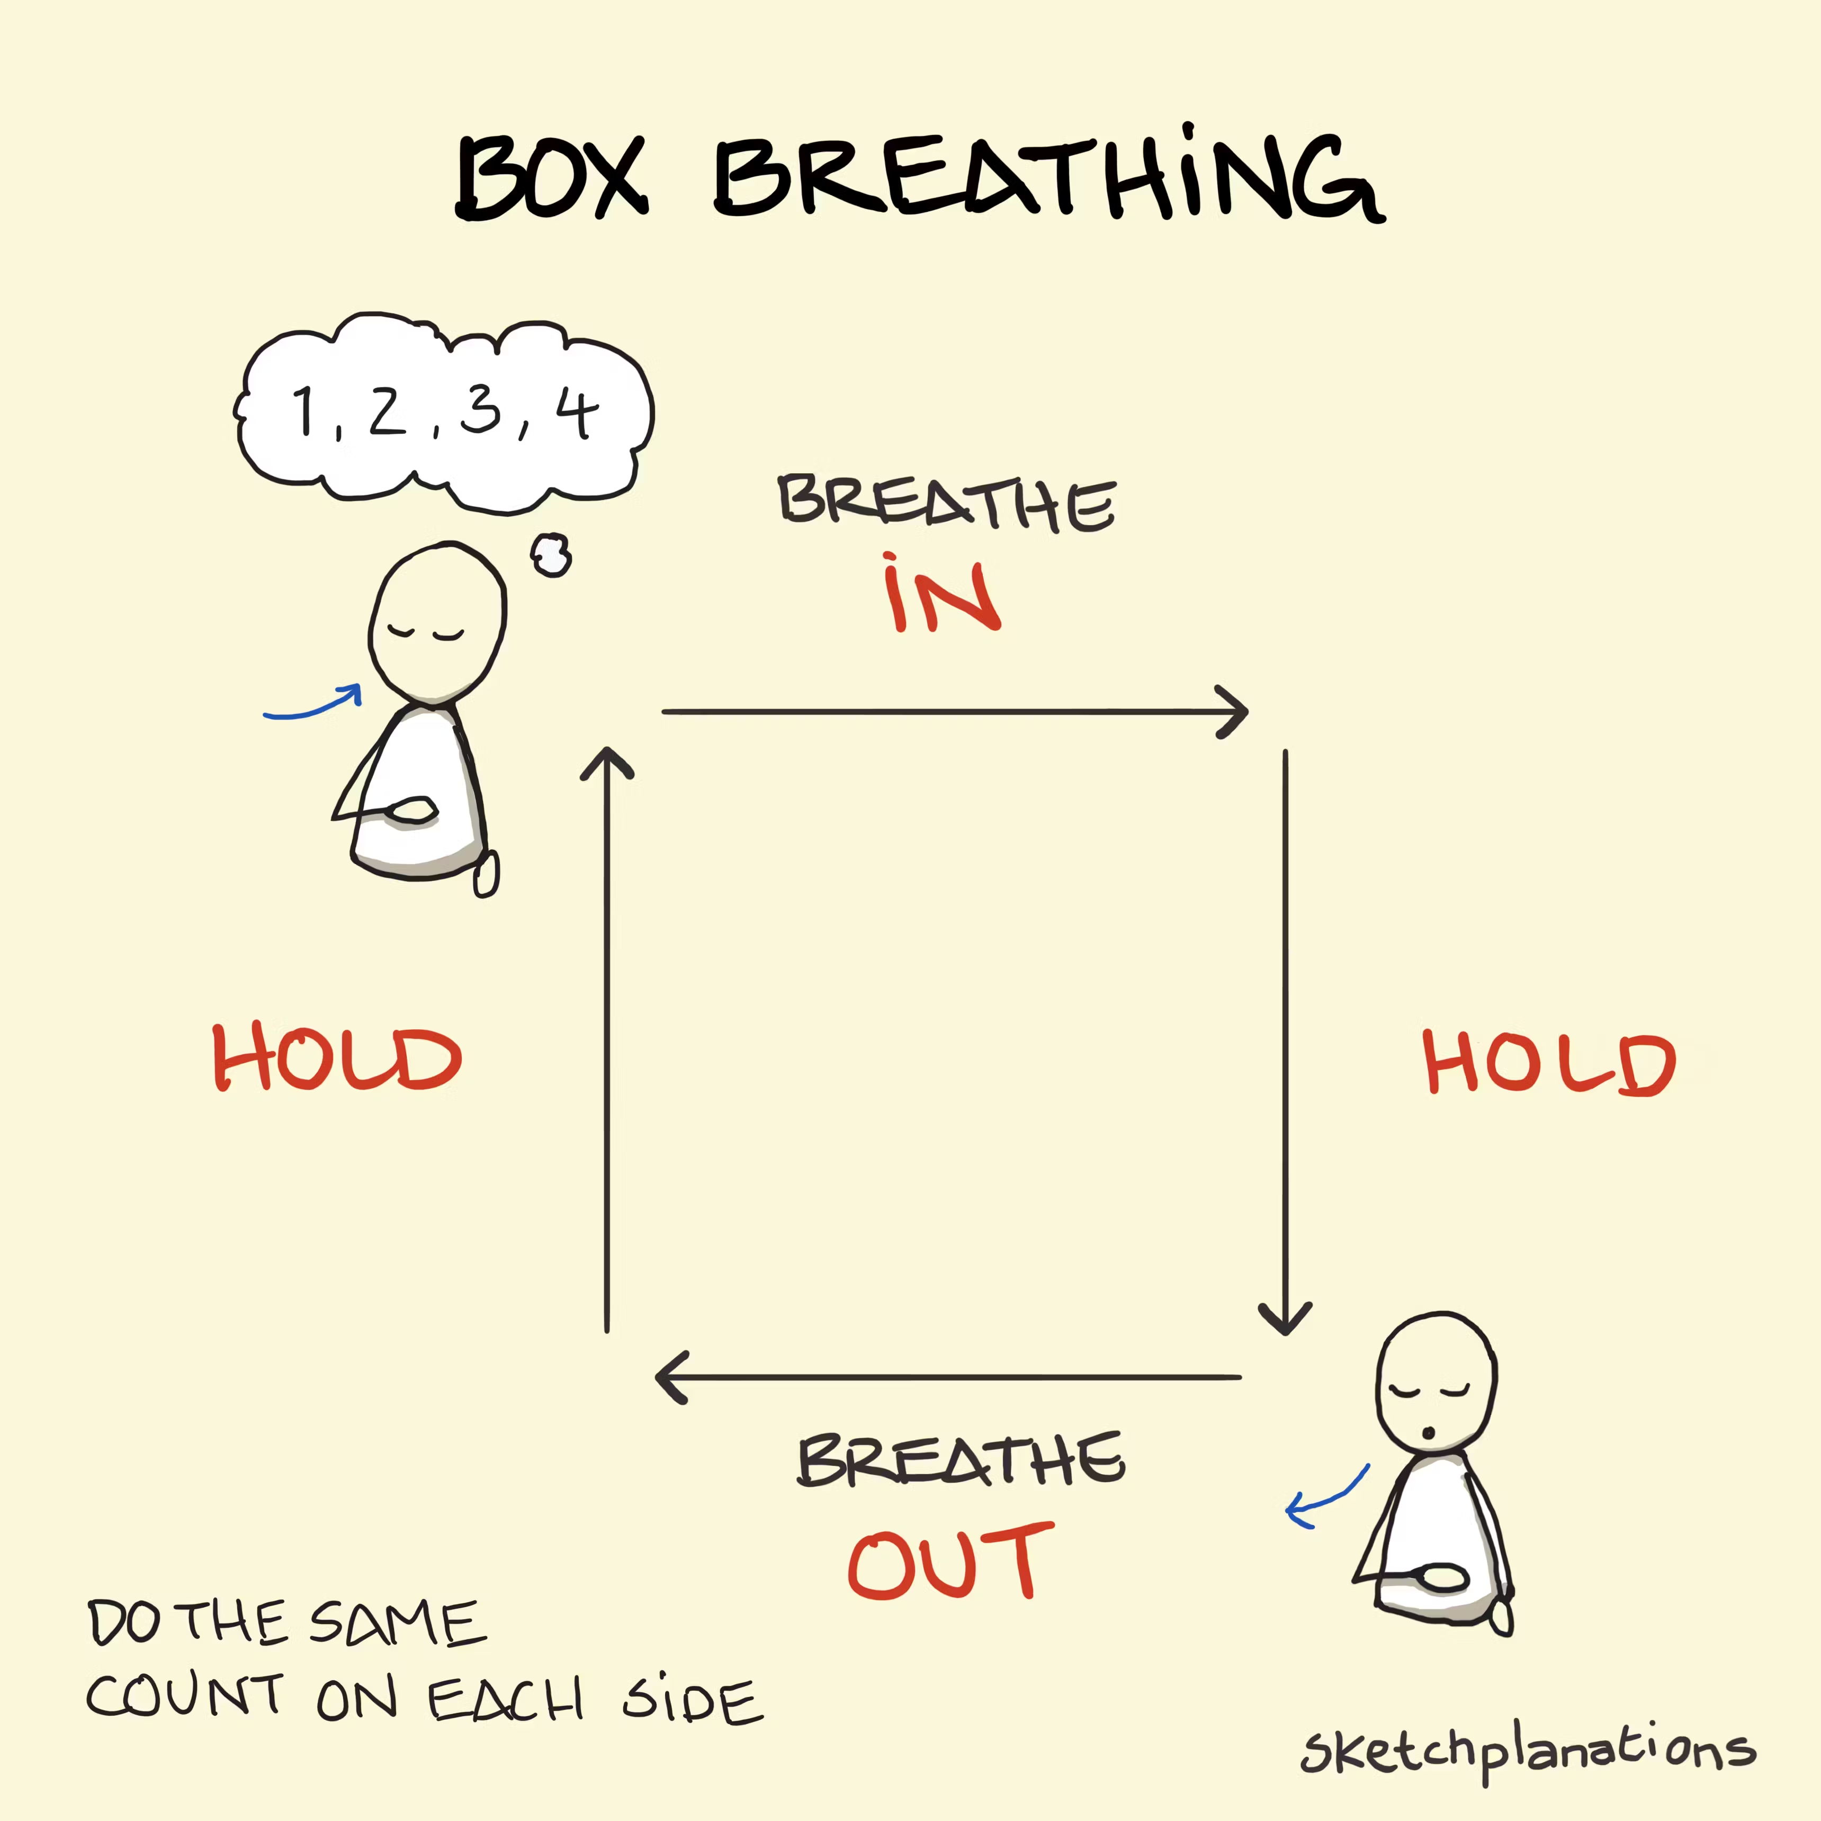

Support emotional regulation
All emotions are a valid part of the human experience, but some can lead us to make choices we are not happy with and limit our resilience. Mindfulness can support with emotion management, managing stress, promote improved sleep and provide a host of other benefits. There are many different options available – find the one you like best.

Slide 14
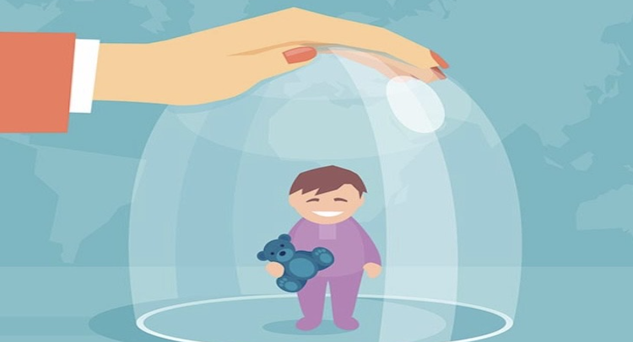
Tip 4: Don’t shield them!
Allow children to experience stressful situations and give them space to try and manage it themselves.

Slide 15
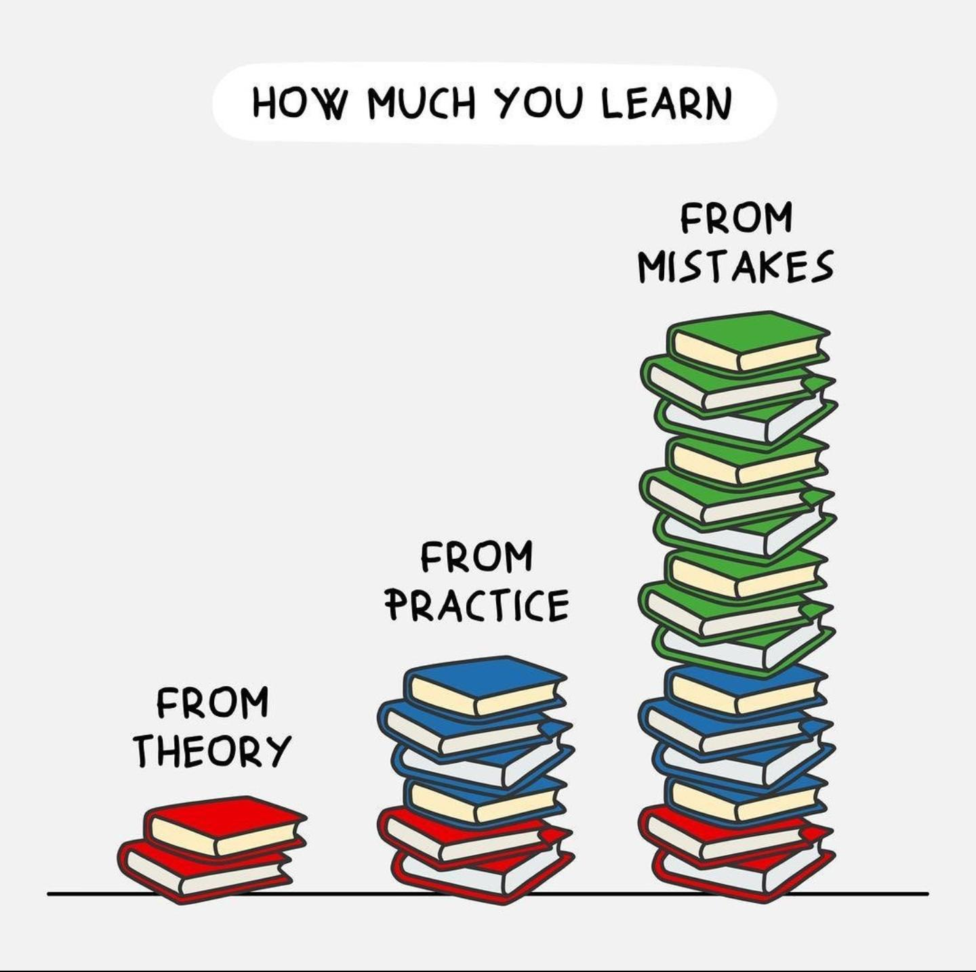
Tip 4: Don’t shield them!
Additionally, allow children to make mistakes.
Making mistakes is an important step in the learning process!

Slide 16
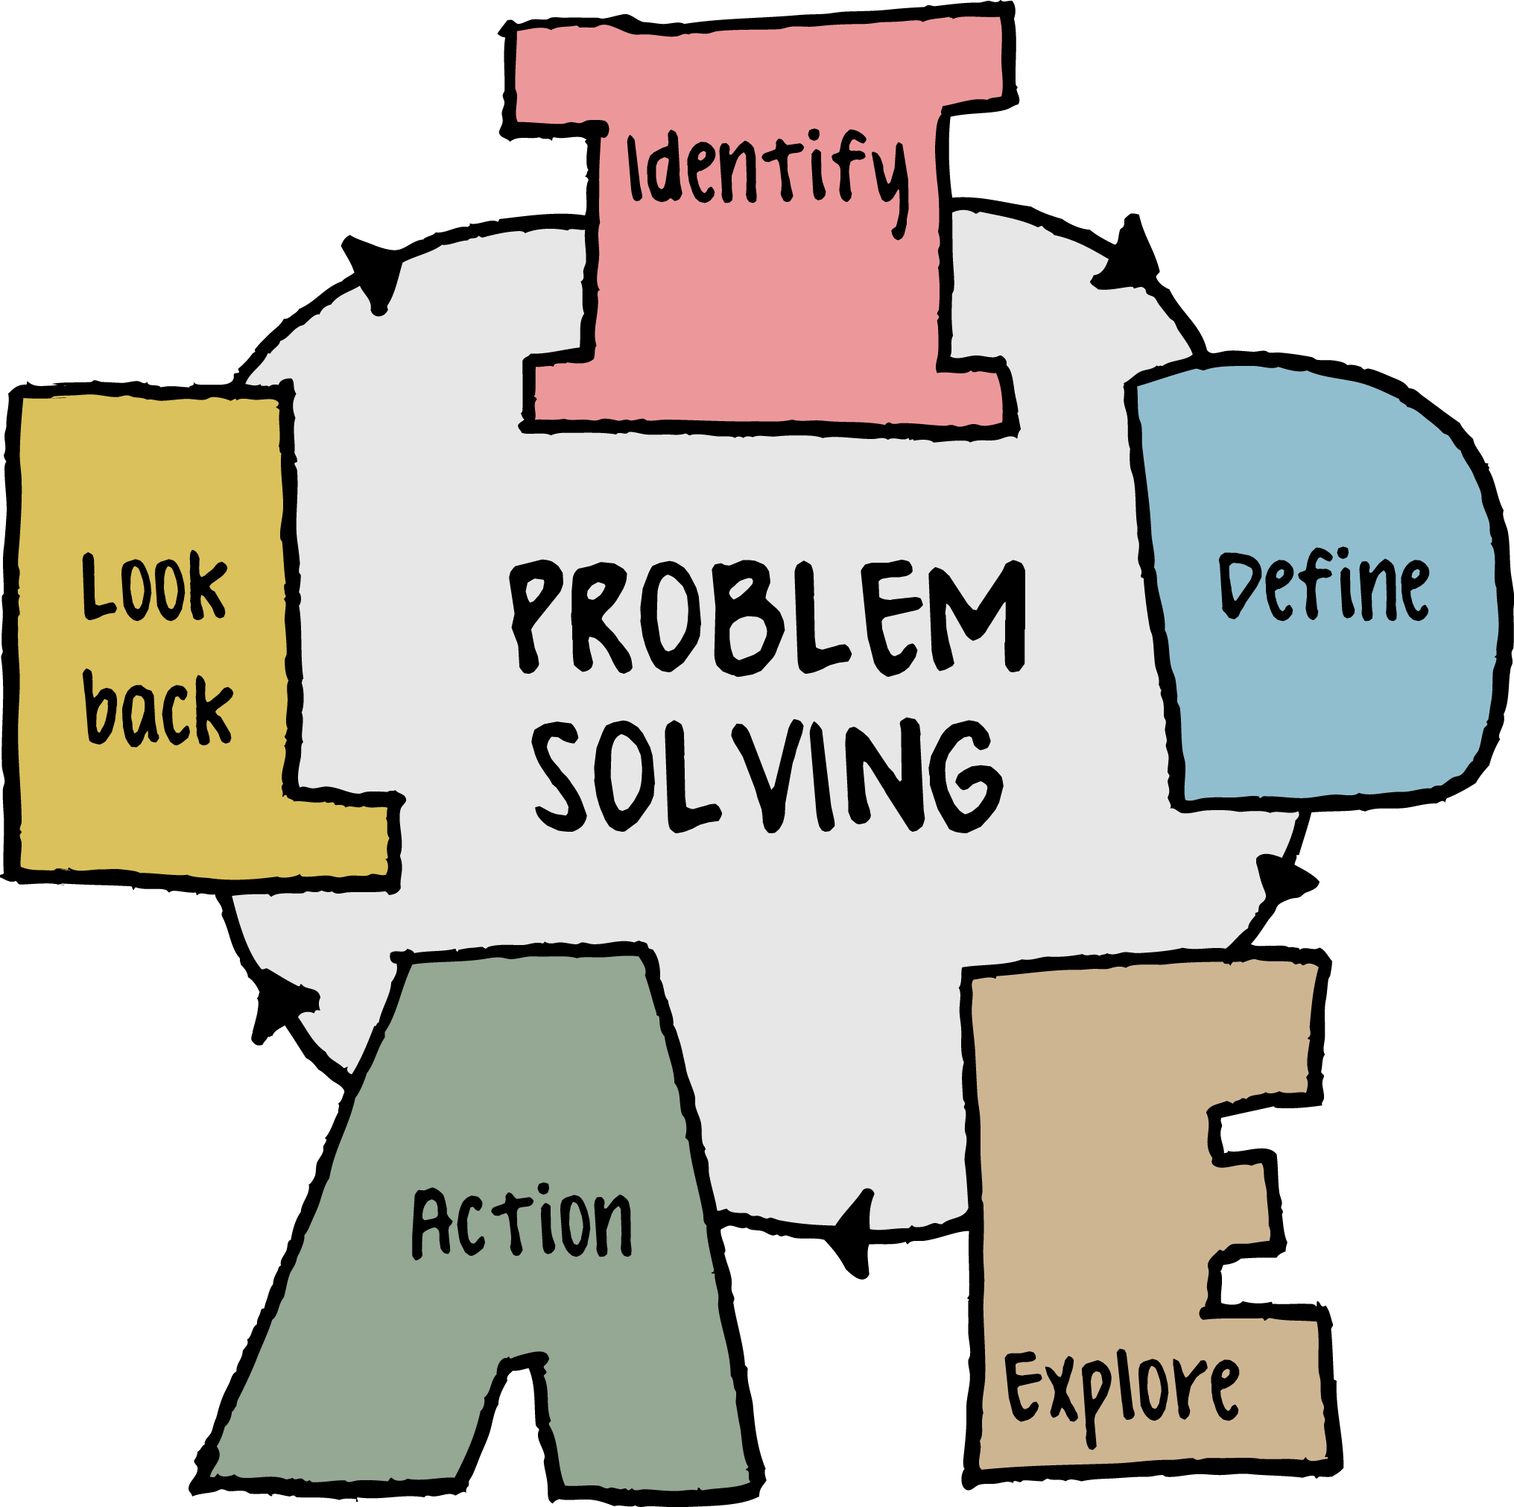
Tip 5: Problem-Solving
Name the problem
Consider all possible solutions
Pros and Cons of each solution
Pick the best option
Plan it out
Carry it out
Reflect on the outcome

Slide 17
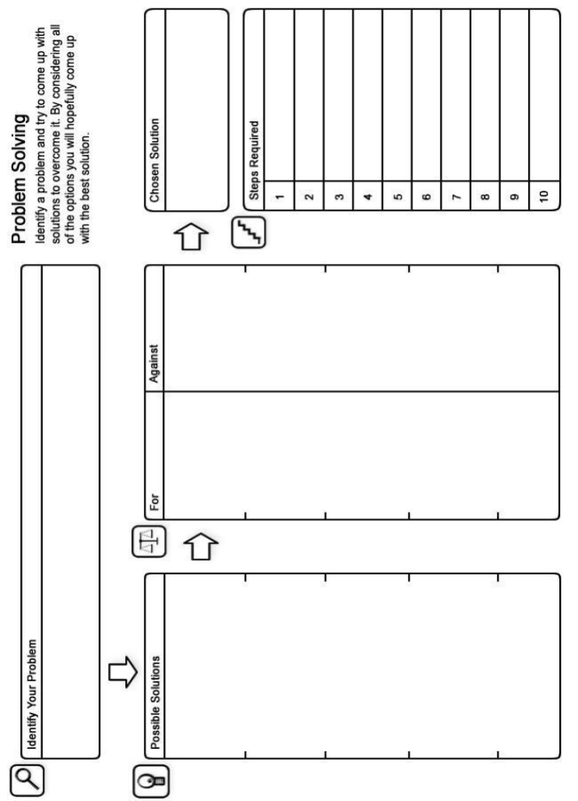
Problem-Solving
This takes time and practice.
Can develop resilience as child begins to recognise, they can cope with challenges and manage their feelings in difficult situations.

Slide 18
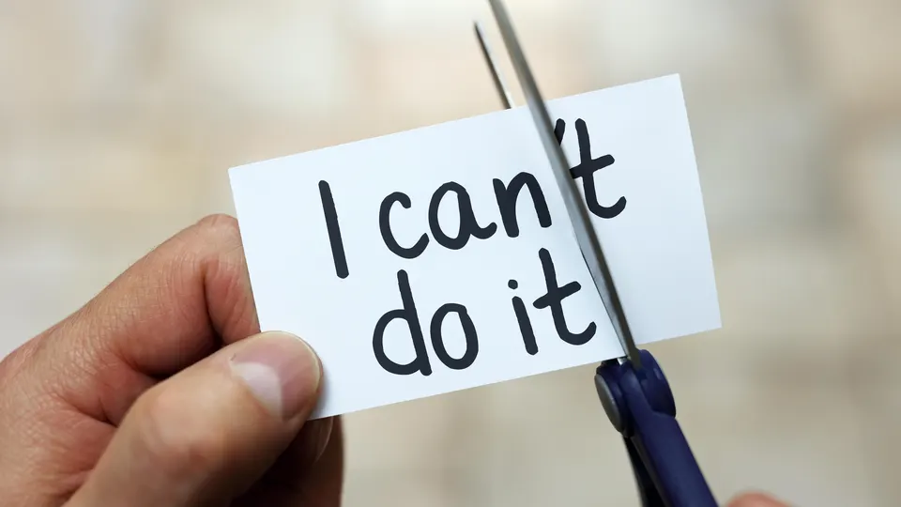
Tip 6: Constructive Self-Talk
Practising the use of positive self-talk can boost resilience when faced with a threatening or stressful situation.
Replace a worrying thought with a thought which supports resilience. Importantly, these should be realistic and focus on what can be achieved.
I’ve done this before I can do it again!
Yet!
It’s normal to feel this way!

Slide 19
Tip 7: Promote Independence
Encouraging children to complete tasks themselves shows them they can take care of themselves independently and be helpful to others. It can also be an opportunity to face fears/worries.
Consider tasks which are age appropriate.
Show your child how to do them (at a time when you are both calm and have time available)
Remember to praise the effort put into the task!
Making bed.
Getting ready for school.
Clearing the table.
Making a packed lunch.
Watering the plants.
Asking a member of staff a question.
Making their bed.
Feeding/caring for pets.

Slide 20
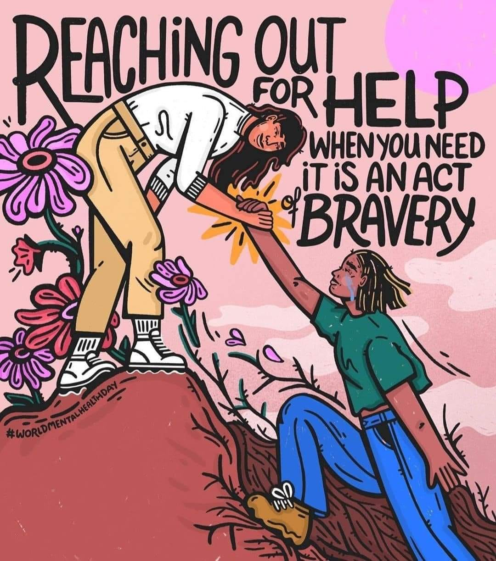
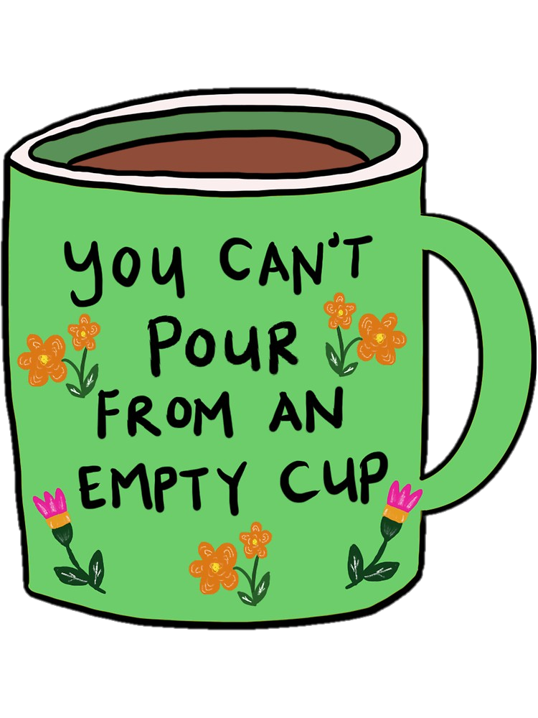
IT’S OK TO NOT BE OK. YOU ARE NOT ALONE. HELP IS OUT THERE.
Trust your instincts – if you feel your child needs further support reach out!
GP
School – Class teacher/ Mental Health Lead
Websites/helplines: ChildLine, Young Minds & Sandbox
Apps: Calm & Lumi Nova (7+)

Slide 21


Any Questions?
Feedback is very important to our service to continually improve the service we provide. Please take a few minutes to complete the questionnaire using the QR code. Thank you!

