Slide 1

Meet the Teacher Year 6
September 2023

Slide 2

We believe that we are all God's work of art.
We strive to respect and care for each other
and to use our talents to do our best
to build a better world.
By doing this,
we are
'Learning in the Light of Christ’

Slide 3
Welcome to Year 6
Working in Year 6 will be:
Ms Pemberton,
Mrs McDonald and
Ms Hilton

Slide 4
Expectations
Good attendance and punctuality
Your child follows our mission values in class and around the school.
Being good role models for the rest of the school.
Taking on leadership responsibilities.
Representing the school outside in the community as true ambassadors.
Completing home learning on time.
Ensuring reading records are up to date and in class.
Taking pride in their work and the presentation of their work.

Slide 5
Attendance
It is the parents’/carers duty to send their child to school regularly where they are of compulsory school age.
It is the school’s responsibility to record attendance and follow up absence.
Discretion of the local authorities to use legal sanctions, including penalty notices and prosecution in court.
Please email or ring the school to notify us of a child’s absence.

Slide 6
What your child will need:
They should bring in their water bottle every day.
Reading book and reading record book daily
ALL clothing to be labelled including P.E. Kits/coats etc
Coats for Autumn weather/hats/caps.
Own pencil case.

Slide 7


Contents in pencil case
Blue handwriting pen x2 (see image)
Ruler, rubber, sharpener
A Pritt Stick
Felt pens
Colouring pencils

Slide 8
Start of School Time
To continue to keep in line with government guidance, from Monday 4th September 2023, school will open from 8.40am but children will be expected to be in class by 8.45am ready for learning. This means that there will be a 5-minute soft start and learning will begin at 8.45am.
Please ensure that your child arrives in school on time and ready for their learning.
School will finish at 3.15 pm.

Slide 9
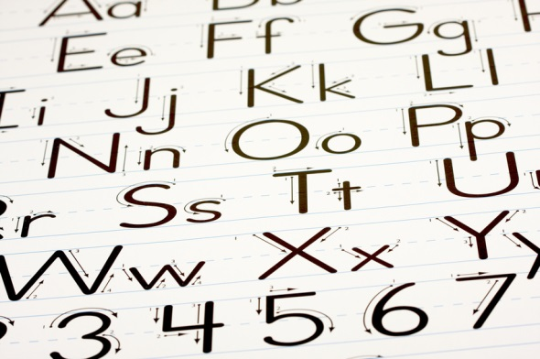

Handouts
The Year 6 Maths Learner
Usernames and passwords for our online learning sites will be in your child’s reading record:
Handwriting Letterjoin
Spelling - Spelling Shed
Mathletics
Times tables Rockstars

Slide 10

Home Learning
Home Learning is set on the Year 6 Class Blog on a Friday and is due to be completed by the following Wednesday.
Weekly Spellings – these will be handed out at the beginning of each half term for a dictation test every Friday.
Reading – 20 minutes per day, parents to sign reading diary weekly.
Maths – Mathletics
Timestables Rockstars – please encourage your child to practise their timestables at least three times a week.
English – comprehension/research etc…
Additional homework – We will be sending additional homework if we feel your child will benefit with more practice on a specific concept of our learning.

Slide 11

P.E.
The children will have P.E. on Wednesday (swimming this term) and Friday. On your child’s allocated PE Day, they will be required come to school in their PE Kit.

Slide 12


Class Blog
School website
  Children
    Year 6
      Year 6 News (right hand side)
      Parent comments very welcome!

Slide 13
Curriculum Overviews
https://popepaul.herts.sch.uk/year-6/

Slide 14

Breaktime
In Key Stage 2 the children may to bring in their own snack for break.
This snack comprises of a piece of fruit or cereal bar.
Lunchtime:
The options are a school lunch/or home packed lunch. School lunches for Reception, Year 1 and Year 2 are free. School lunches for Years 3,4,5 and 6 need to be paid for via school comms unless you
are entitled to a free school meal.
If you are not sure, please call the school office and they will be able to help you.
Cost of a school dinner is: £3.15

Slide 15


School Priorities in 2023-2024

Slide 16


Our Partnership
Home
Parish
child
The relationship between the home, school and parish is vital in the religious, spiritual and moral development of your child.
School

Slide 17
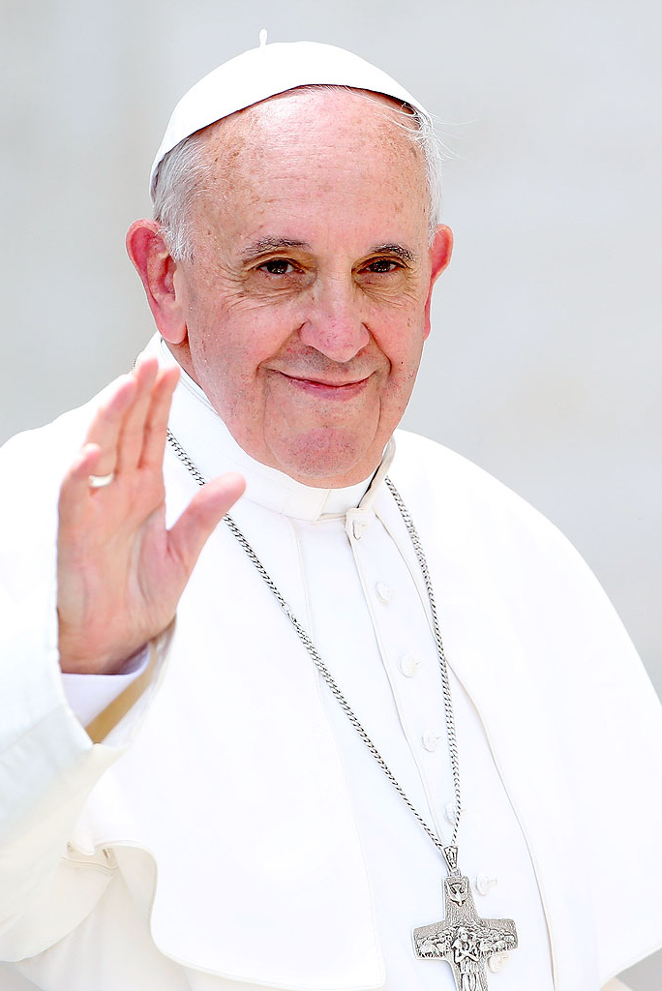
“We cannot close our eyes
To any form of racism or
exclusion, while pretending
to defend the sacredness
human life.”
Pope Francis

Slide 18


Dates for your diary
All dates can be found on the school website and each week at the end of the School’s Weekly Newsletter.

Slide 19
Dates for your diary
Tuesday 19th September 2.30pm:
Relationship and health education Information Session for all parents.
Sunday 1st October 11am:
Parish Celebration Mass of St Vincent (KS2 to lead).
Tuesday 17th and Thursday 19th October: 4pm – 6.30pm
Parent Consultations.
Friday 20th October 9.15am:
Year 6 Class Assembly

Slide 20
Secondary Transfer
Go to visit the secondary school open days
Look at schools’ websites for news
Check the admissions criteria and be realistic
Can you see your child happy in this school?
What would suit your child best? ( small, large, single sex, mixed, travel, close to home, large grounds)
Apply online by 31st October
Check the moving on booklet 2024 which is on the Year 6 class page and has been emailed today
Complete the SIF if required and provide copies of the evidence required.
( Do not tick that you are Catholic unless you have proof of baptism. If in doubt, ring the school for clarification.)

Slide 21
Year 6 SATs
The 2024 Key Stage 2 SATs will take place in the week commencing 13th May. The tests will take place over four days. An information meeting about the tests will be arranged nearer the time.

Slide 22
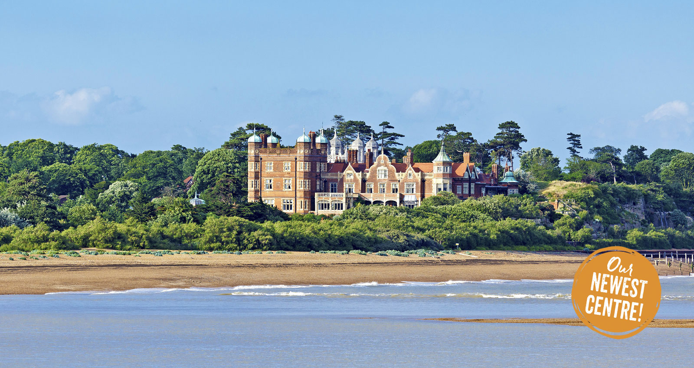
PGL Trip- Bawdsey Manor, Suffolk
June 24th- 28th
A meeting will take place next term.

Slide 23
Parent Communication
Please inform the school office via email in the morning of any changes to school pick up so that your child’s class teacher will be informed.
1
If you wish to speak to your child’s class teacher, please make an appointment through the office.
2
If you wish your child to attend the After School Club, you need to book your place online using School Comms.
3

Slide 24

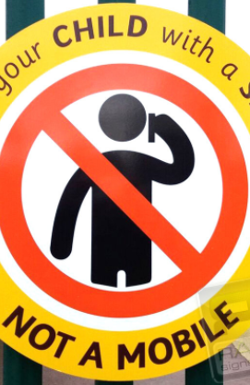
Mobile Phones
When you are bringing or collecting your
child(ren) to/from school, please ensure
that your mobile phone is turned off. It
is an important time to talk and share
with your child.
‘Greet your child with a smile not a mobile’.
For those children in Year 5 and 6:
if you wish for your child to have a
mobile phone, this will need to be kept in
his/her school bag and turned off. The
School will not be held responsible if
something happens to it or if it is lost.

Slide 25
Parking
Please note that Pope Paul Primary School takes the safety of our children very seriously.
Parents bringing children to school by car should park in a safe location but well away from the school car park, school entrance or in the area of zig zag or double yellow lines. We ask you not to park along Great Slades.
Parents should not drive into the school car park to drop children off.
Walk to School
  We want children to be energised and empowered.
  We want children and parents to make walking to school their natural choice and to stop and think before they use the car to get to school.
  We need to continue to reduce the number of cars and ease parking problems in our community. We can do this by:
  · Walking to school
  · Cycling to school
  · Driving part of the way to school and walking part of the way.

Slide 27
Any Questions?

Slide 28
Thank you!
The Year 6 team look forward to working with you.

