Slide 1


Year 5 Meet the Teacher
September 2023

Slide 2

Welcome to Year 5
Working in Year 5 will be:
Miss Donatantonio
Miss Hilton
Mrs Pandeli

Slide 3
Expectations
Good attendance and punctuality
Your child follows our mission values in class and around the school.
Being good role models for the rest of the school.
Taking on responsibilities.
Representing the school outside in the community as true ambassadors.
Completing home learning on time.
Taking pride in their learning.

Slide 4


What your child will need:
Every day they should bring in their water bottle and reading book
Own pencil case (Years 4, 5 and 6)
ALL clothing to be labelled including P.E. kits/coats etc.
Coats for autumn weather
Hats for summer weather

Slide 5

Contents in pencil case (Year 4, 5 and 6)
Blue handwriting pen x2 (Berol or Frixion)
Ruler, rubber, sharpener
A glue stick
Felt pens
Colouring pencils

Slide 6
Start of School Time
To continue to keep in line with government guidance, from Monday 4th September 2023, school will open from 8.40am but children will be expected to be in class by 8.45am ready for learning. This means that there will be a 5-minute soft start and learning will begin at 8.45am.
Please ensure that your child arrives in school on time and ready for their learning.
School will finish at 3.15pm.

Slide 7
Handouts
Curriculum Overview (whole year)
Curriculum Overview (Autumn term)
Weekly timetable
Recommended book list
The Year 5 Maths Learner
Usernames and passwords for our online learning sites:
  Spelling – Spelling Shed
  Maths – Mathletics
  Reading – ReadTheory
  Times tables - TTRockstars

Slide 8

Home Learning
Home Learning is set on the Year 5 Class Blog on a Friday and is due to be completed by the following Wednesday.
  Spellings – these will be given to the children every Friday (and written on the blog) and tested via a dictation the following Friday – Spelling Shed
  Maths – Mathletics and TTRockstars (please encourage your child to practise their times tables at least three times a week)
  Reading – 20 minutes per day (reading book OR ReadTheory)
Additional homework – We will send out additional home learning if we feel your child will benefit from more practice on specific concepts of learning.

Slide 9
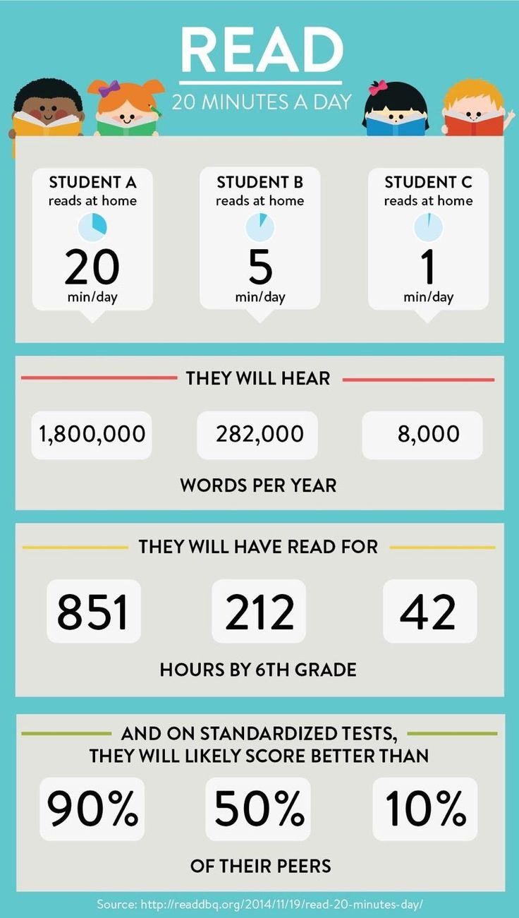

Slide 10


P.E.
This term, the children will have P.E. on Wednesday (swimming) and Thursday. On your child’s allocated PE Day, they will be required come to school in their PE Kit.
Swimming will begin tomorrow (Wednesday 13th September) and will continue until the end of the Autumn term. Children should come into school in their PE kits on this day with their swimming kit.

Slide 11

Breaktime:
In Key Stage 2, the children may bring in their own snack for break.
This snack must be a piece of fruit/veg or cereal bar.
Lunchtime:
The options are a school lunch or home packed lunch. School lunches for Years 3,4,5 and 6 need to be paid for via Schoolcomms unless you are entitled to a free school meal.
If you are not sure, please call the school office and they will be able to help you.
Cost of a school dinner is: £3.15

Slide 12


School Priorities in 2023-2024

Slide 13


Our Partnership
Home
Parish
child
The relationship between the home, school and parish is vital in the religious, spiritual and moral development of your child.
School

Slide 14

“We cannot close our eyes
To any form of racism or
exclusion, while pretending
to defend the sacredness
human life.”
Pope Francis

Slide 15


Dates for your diary
All dates can be found on the school website and each week at the end of the School’s Weekly Newsletter.

Slide 16
Dates for your diary
Date | Time | Event
12/09/23 | 14:45 | Y5 Meet the Teacher Meeting
19/09/23 | 14:30 | Relationship and Health Education Information Session for all parents
01/10/23 | 11:00 | Parish Celebration Mass of St Vincent (KS2 to lead)
04/10/23 | 09:15 | Y5 Class Mass (classroom)
13/10/23 | 09:15 | Y5 Class Assembly (hall)
17/10/23 & 19/10/23 | 16:00-18:30 | Parent Consultations
04/12/23 | All day | Year 5 Class Trip – British Library
06/12/23 | 19:00 | KS2 Advent Service (OLASV Church)

Slide 17
Parent Communication
Please inform the school office via email in the morning of any changes to school pick up so that your child’s class teacher will be informed.
1
If you wish to speak to your child’s class teacher, please make an appointment through the office.
2
If you wish your child to attend the After School Club, you need to book your place online using School Comms.
3

Slide 18

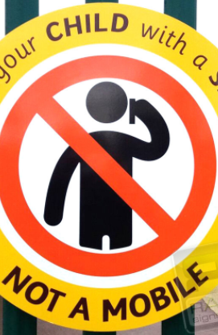
Mobile Phones
When you are bringing or collecting your
child(ren) to/from school, please ensure
that your mobile phone is turned off. It
is an important time to talk and share
with your child.
‘Greet your child with a smile not a mobile’.
For those children in Year 5 and 6:
if you wish for your child to have a
mobile phone, this will need to be kept in
his/her school bag and turned off. The
school will not be held responsible if
something happens to it or if it is lost.

Slide 19
Parking
Please note that Pope Paul Primary School takes the safety of our children very seriously.
Parents bringing children to school by car should park in a safe location but well away from the school car park, school entrance or in the area of zig zag or double yellow lines. We ask you not to park along Great Slades.
Parents should not drive into the school car park to drop children off.
Walk to School
  We want children to be energised.
  We want children and parents to make walking to school their natural choice and to stop and think before they use the car to get to school.
  We need to continue to reduce the number of cars and ease parking problems in our community. We can do this by:
    Walking to school
    Cycling to school
    Driving part of the way to school and walking the rest.

Slide 20

Any Questions?

