Slide 1
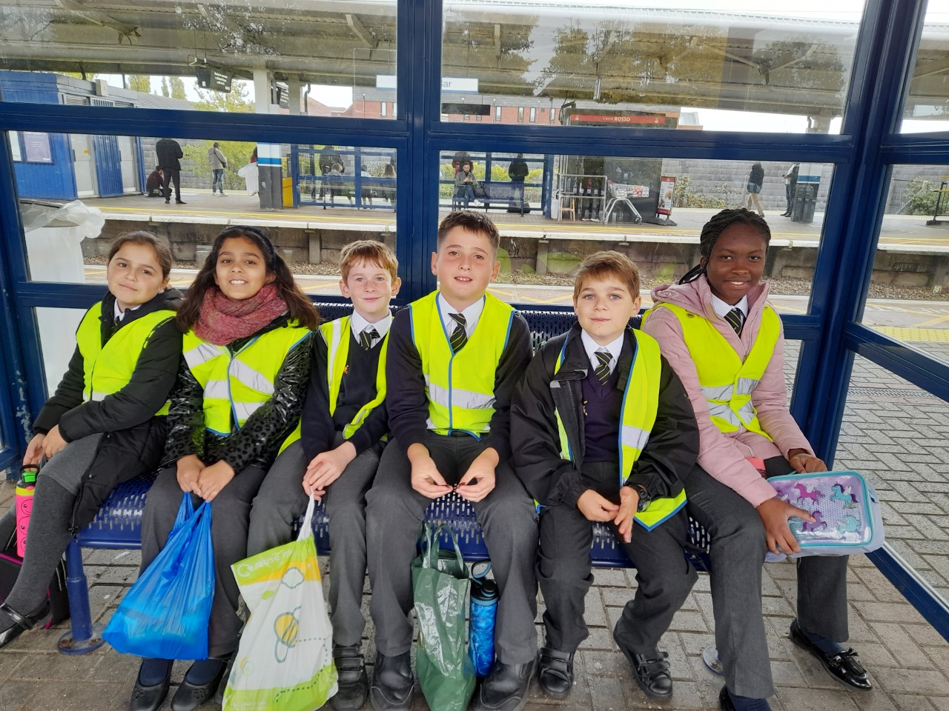
Pilgrimage to see the relics of St Bernadette at St Joseph’s Church Stevenage

Slide 2
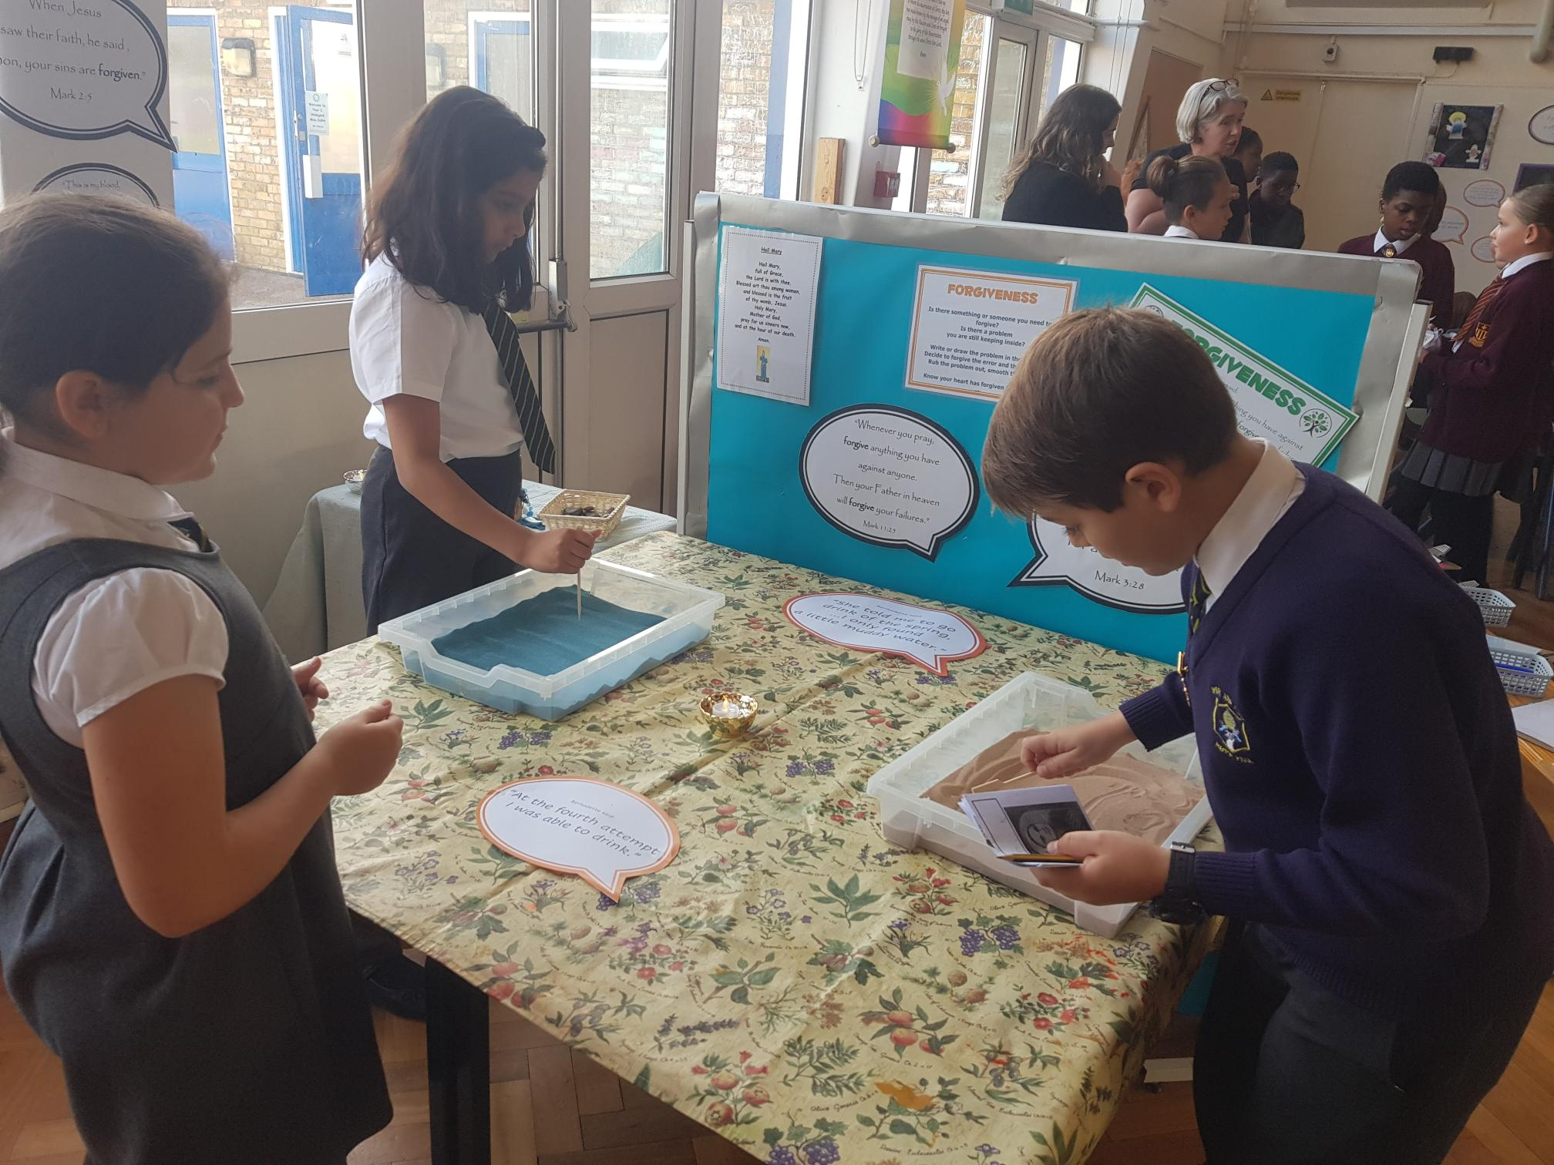
Joining with other local primary schools to reflect on The Rosary at St Vincent’s School.

Slide 3
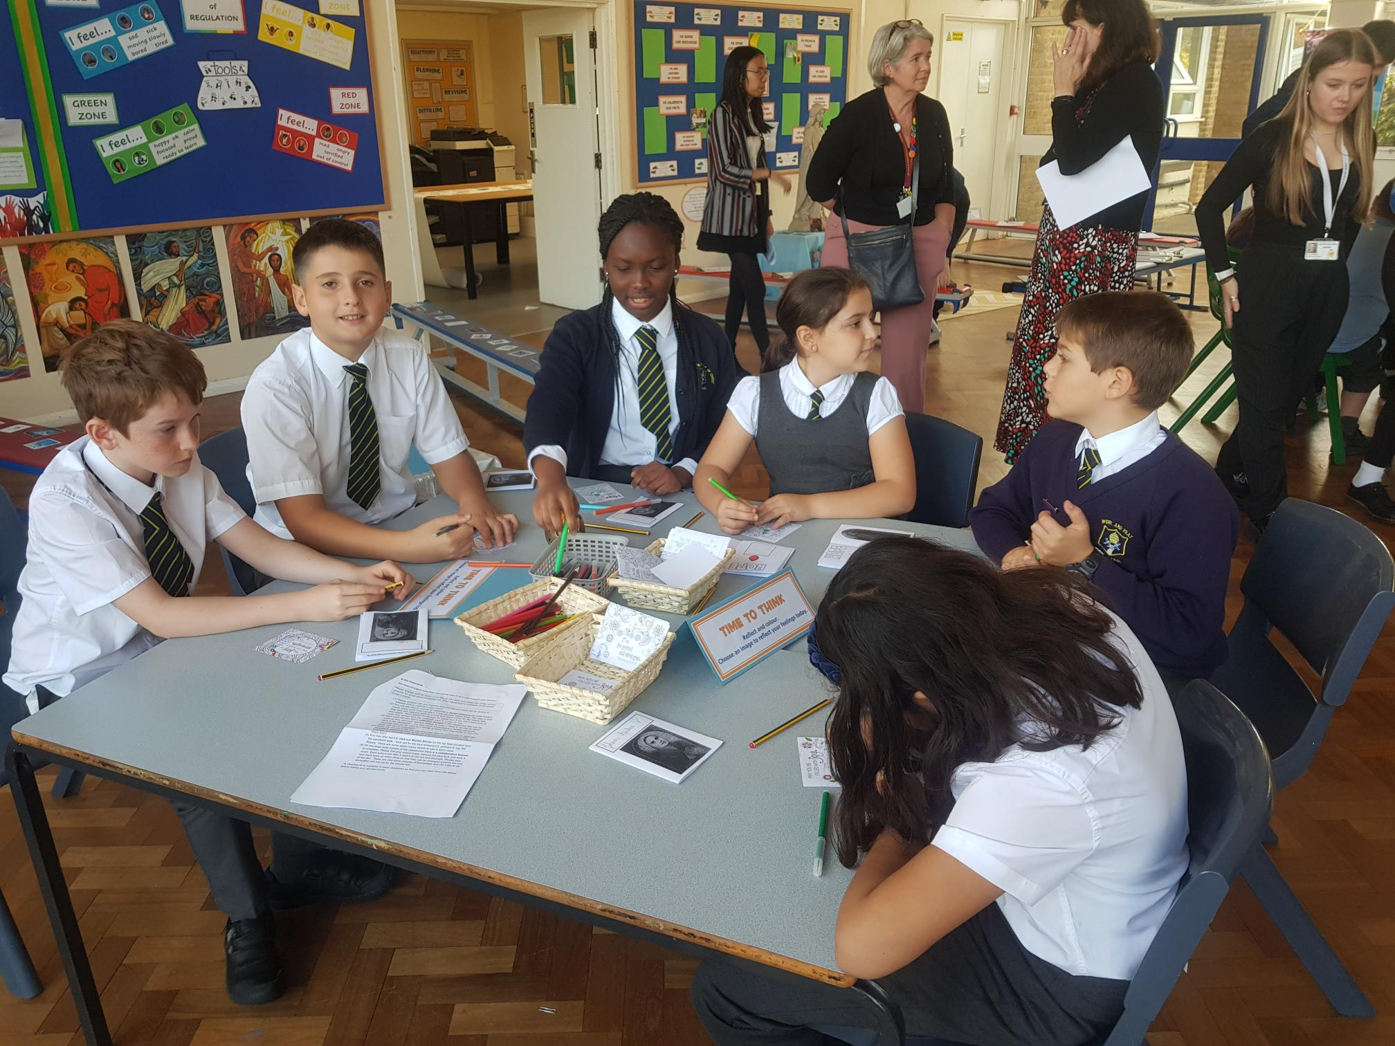

Slide 4
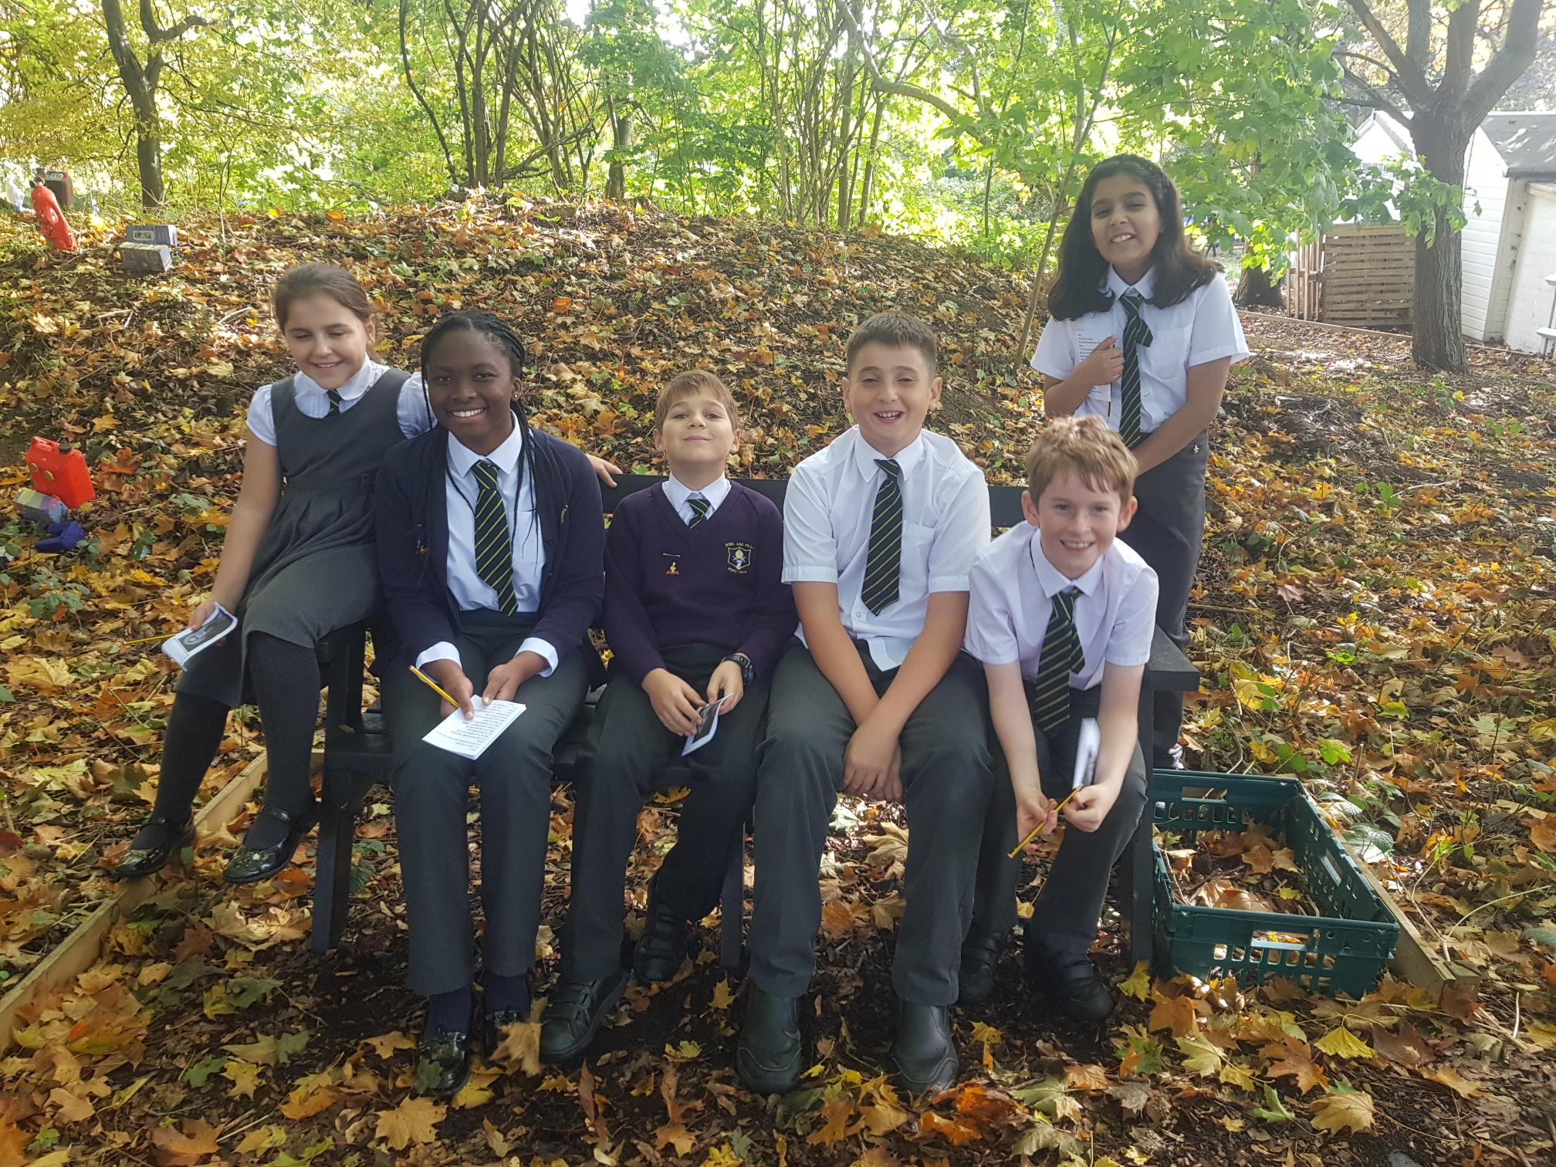
Enjoying a woodland walk!

Slide 5
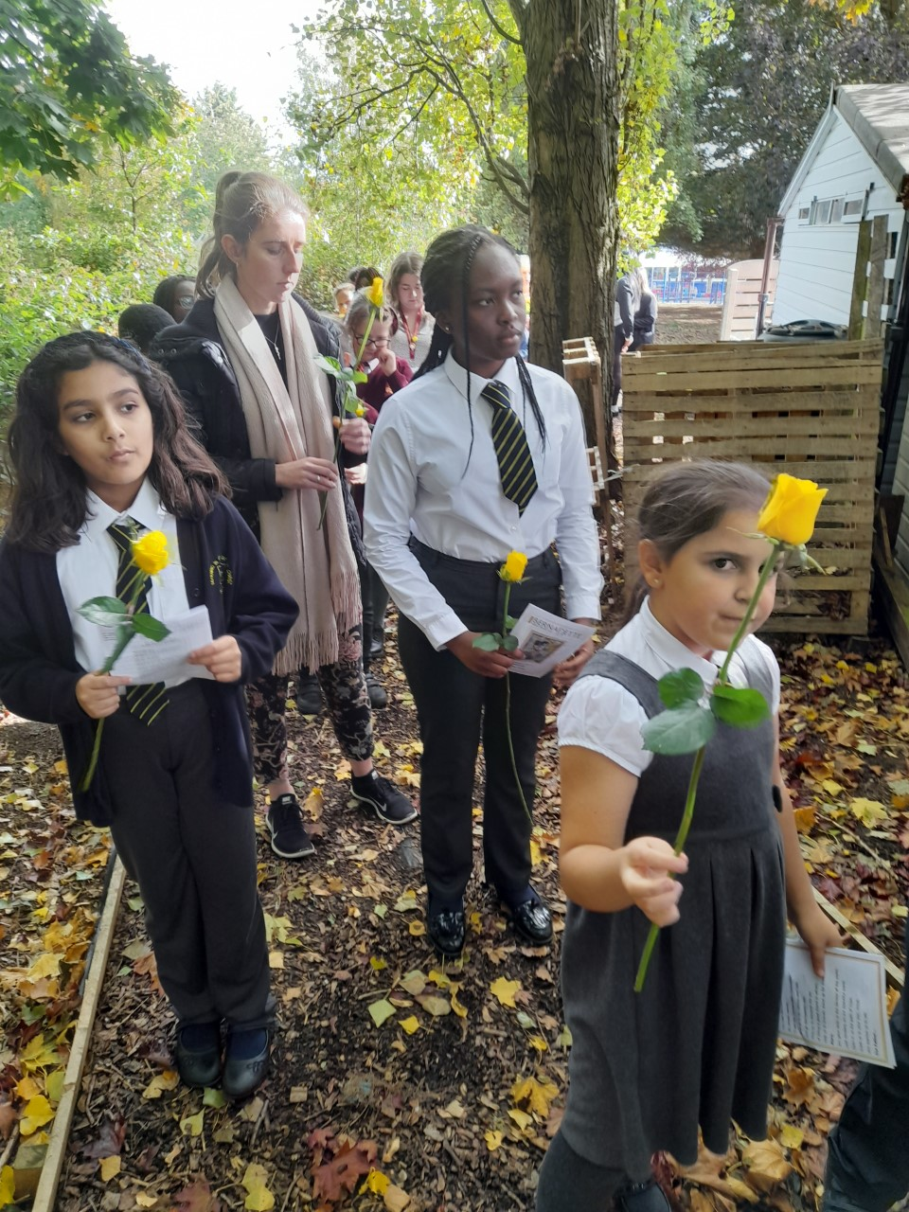
Processing to the church carrying a yellow rose to place at Mary’s Statue.

Slide 6
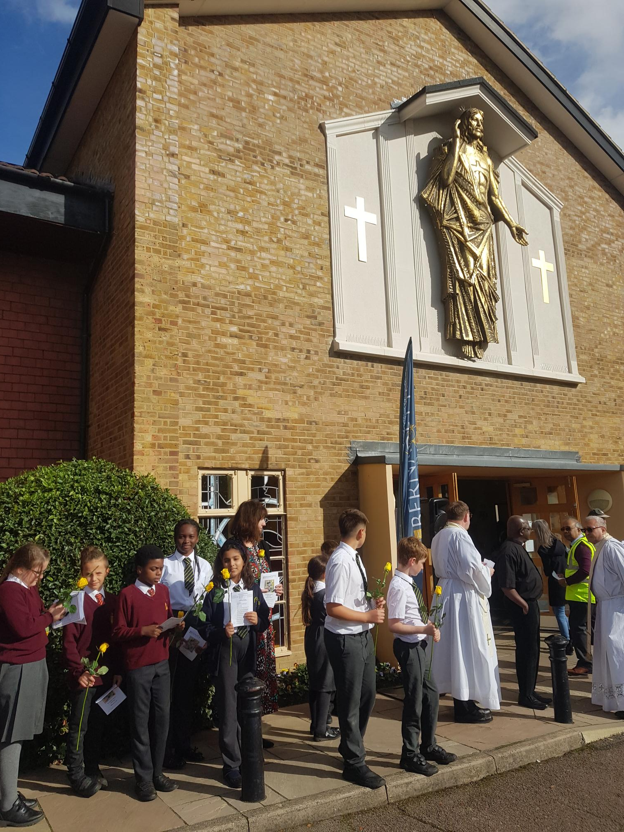
Waiting for the relics to arrive.

Slide 7
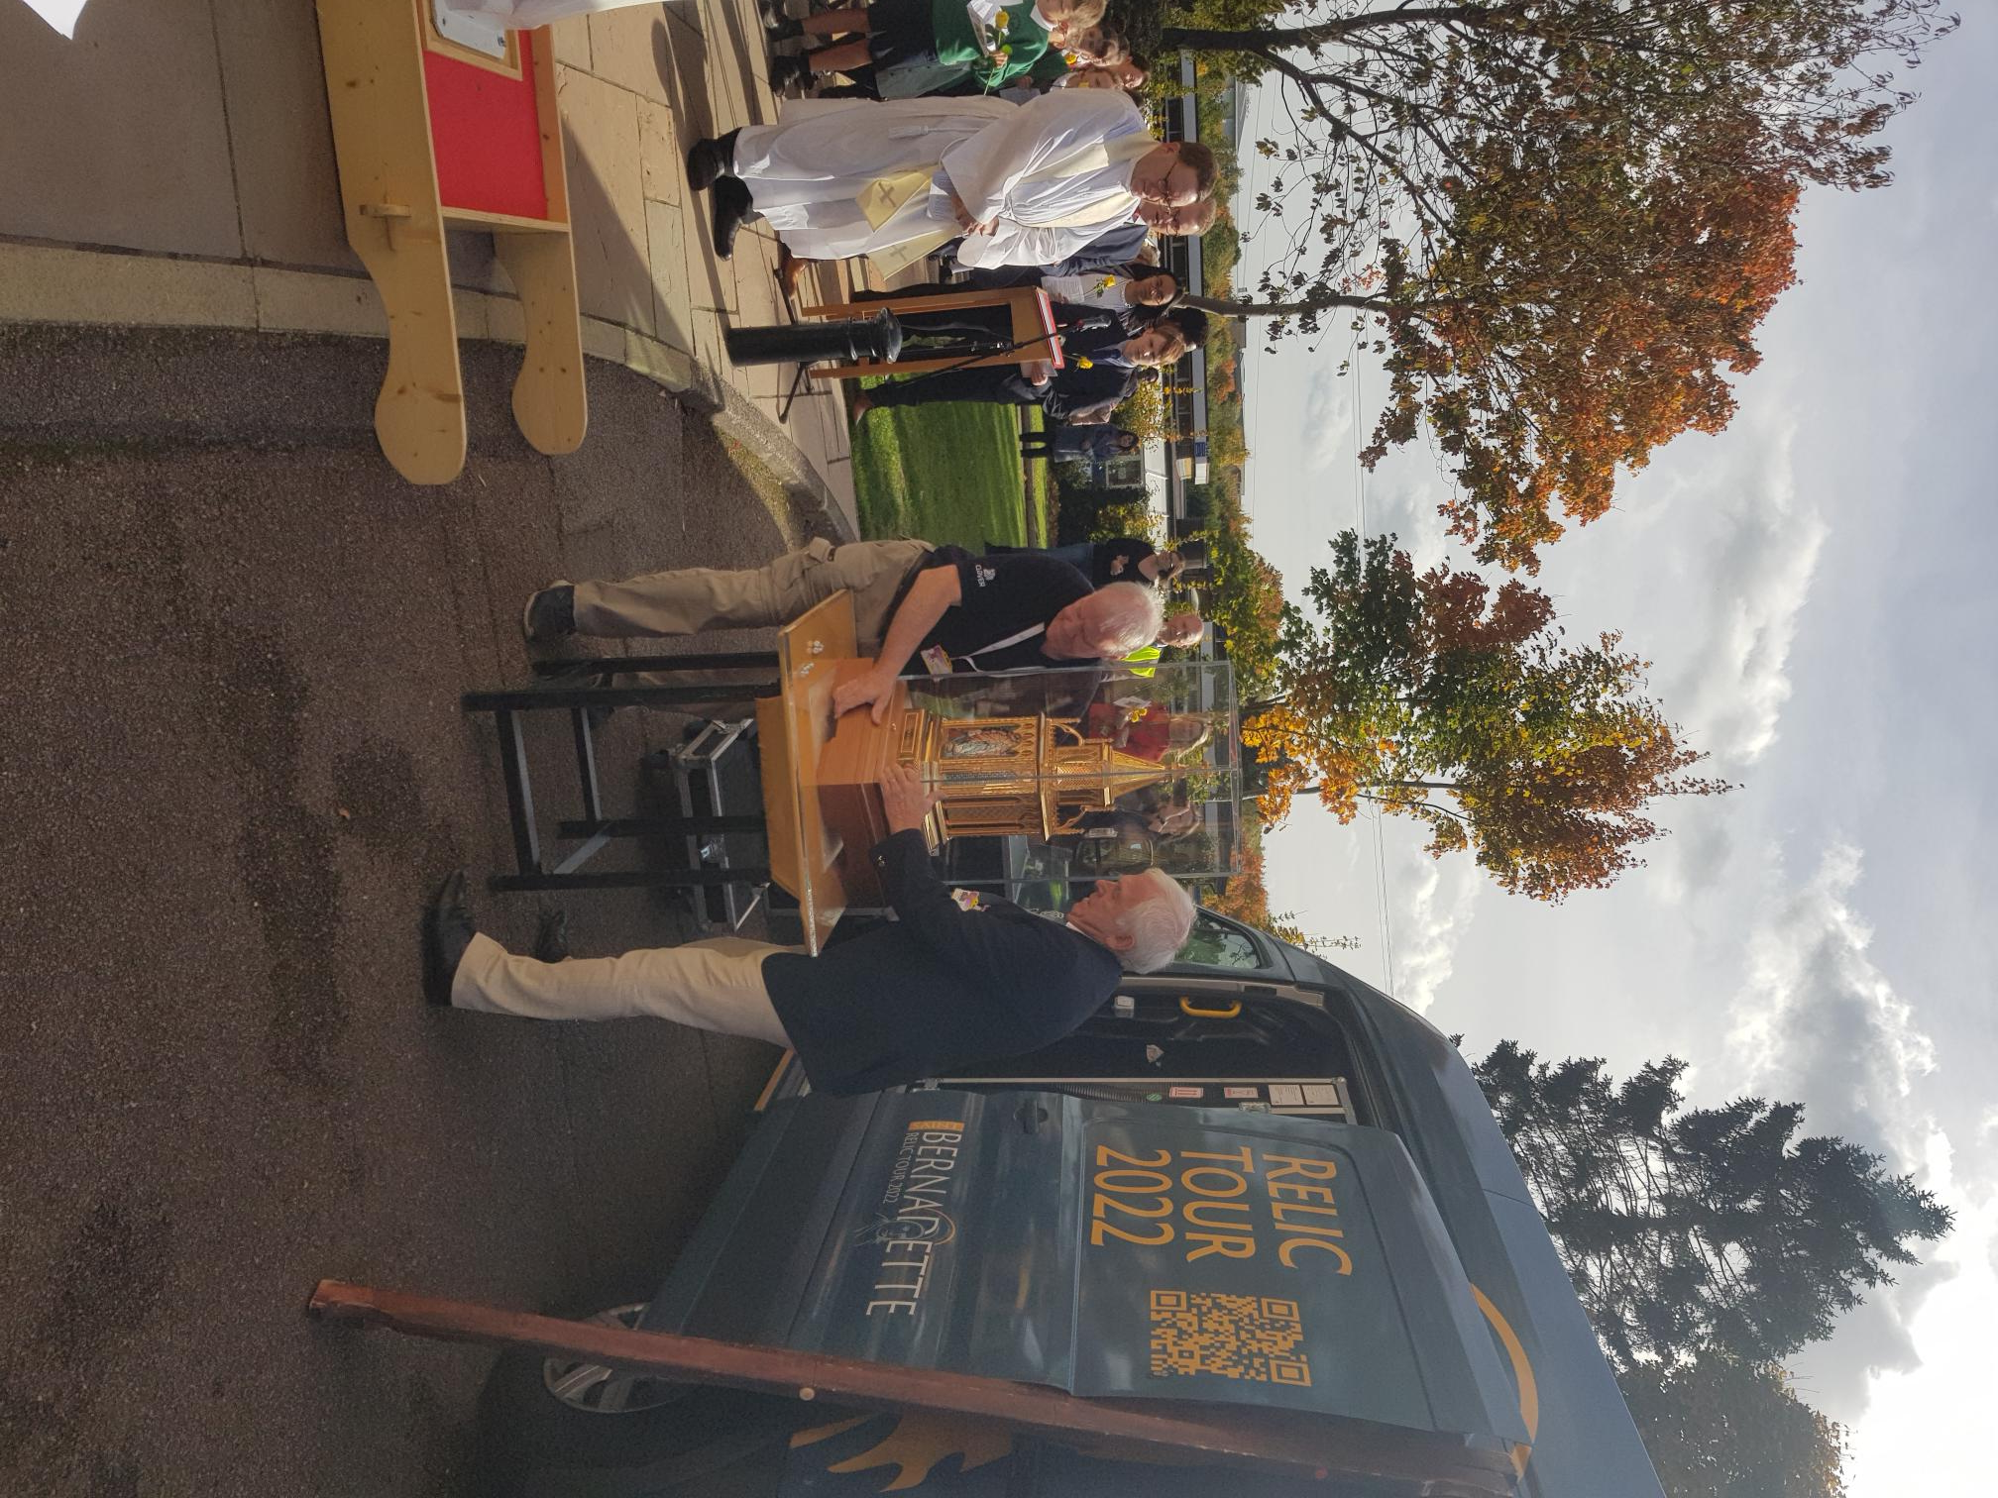

Slide 8
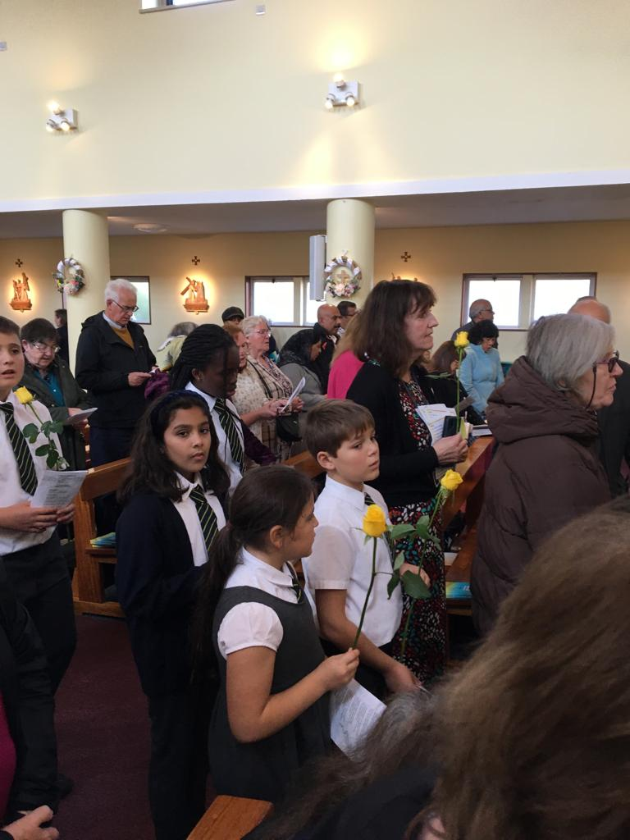

Slide 9
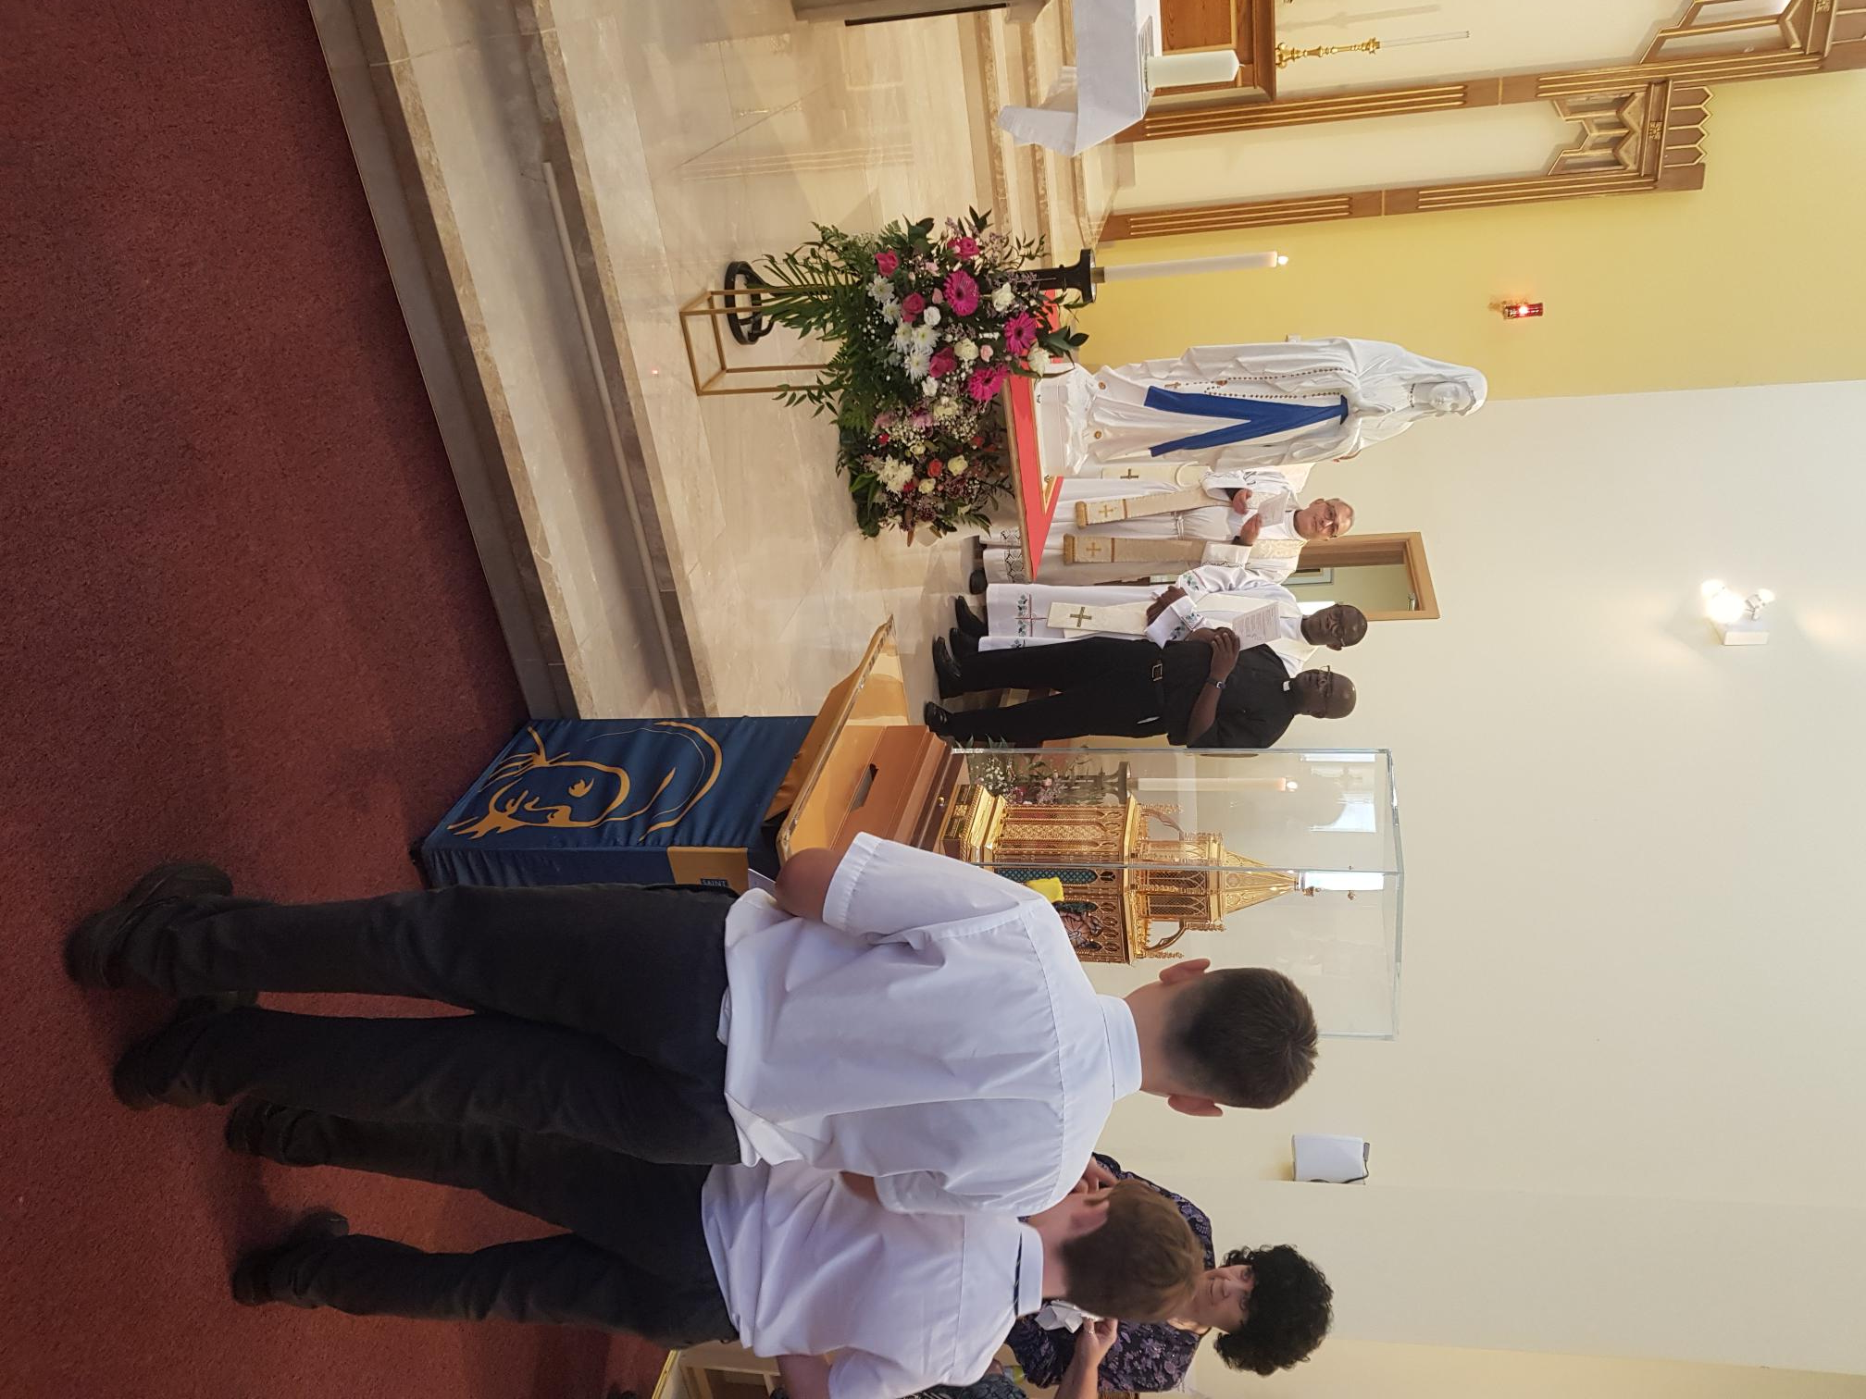
Venerating the relics of St Bernadette.

