Slide 1
Meet the Teacher Year …..
September 2022

Slide 2
We believe that we are all God's work of art.
We strive to respect and care for each other
and to use our talents to do our best
to build a better world.
By doing this,
we are
'Learning in the Light of Christ’

Slide 3
Welcome to Year 4
Class Teacher:
Ms Rita Varga
Working in Year 4 will be:
Mrs Vieyra
Mrs Poyiadzis
Mrs McDonald

Slide 4
Expectations
Good attendance and punctuality
Your child follows our mission values in class and around the school.
Being good role models for the rest of the school.
Taking on responsibilities.
Representing the school outside in the community as true ambassadors.
Completing home learning on time.
Ensuring reading records are up to date and in class.
Taking pride in their work and the presentation of their work.

Slide 5
Attendance
From September 2022, the usual rules on school attendance apply, including:
Parents’ duty to send their child to school regularly where they are of compulsory school age;
It is the school’s responsibility to record attendance and follow up absence;
Discretion of the local authorities to use legal sanctions, including penalty notices and prosecution in court.

Slide 6
What your child will need:
Everyday they should bring in their water bottle, reading book and reading record book.
Correspondence from parents to be emailed to the school office: admin@popepaul.herts.sch.uk
ALL clothing to be labelled including P.E. Kits/coats etc
Coats for Autumn weather/hats/caps
Own pencil case with a Berol/ ink pen (blue) and pencils (colouring equipment) is allowed.

Slide 7
Start of School Time Change
In line with government guidance, as from Monday 4th September, school will open from 8.40am but children will be expected to be in class by 8.45am ready for learning. This means that there will be a 5 minute soft start and learning will begin at 8.45am. For most families this will not mean any change in routine as the majority of children arrive in school by 8.45am.
Please ensure that your child arrives in school on time and ready for their learning.
School will finish as before at 3.15 pm.

Slide 8

Handouts
Year 4 Booklist
https://www.booksfortopics.com
The Year 4 Maths Learner
User names and passwords for our online learning sites are already in Reading record logs:
Letterjoin
Spelling - Spelling Shed
Mathletics
Times tables Rockstars
Study Ladder

Slide 9
Home Learning
Home Learning is set on the Year 4 Class Blog on a Friday and is due to be completed by the following Tuesday.
Weekly Spellings – Spelling dictation on Fridays and consolidation via the Home Learning
Reading – 5 - 10 minutes per day, Chn to independently update their logs and present them on Wednesdays.
Maths/ English – Mathletics and Times tables Rockstars+ Study Ladder

Slide 10
P.E.
The children will have P.E. on Monday and Wednesday. On your child’s allocated PE Day, they will be required to come to school in their PE Kit.
Swimming will begin in the Spring term.

Slide 11

Class Blog (including curriculum overviews)
School website
  Children
    Year 4
      Year 4 News (right hand side)
      Parent comments very welcome!

Slide 12
Multiplication Table Check
Specific to Year 4
12X12
Online test
Practice test available
TT Rockstars style
6sec/question
No league table

Slide 13
Lunchtime
In Key stage Two (Years 3, 4, 5 and 6) the lunches are paid for via school comms unless you are entitled to a free school meal. If you are not sure, please call the school office and they will be able to help you.

Slide 14

School Priorities in 2022-2023

Slide 15
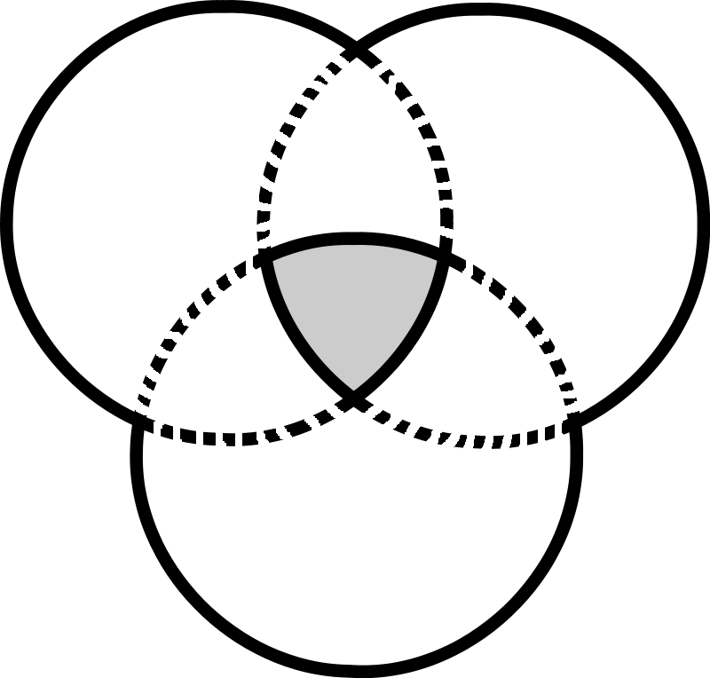
Our Partnership
The relationship between the home, school and parish is vital in the religious, spiritual and moral development of your child.
Home
Parish
child
School

Slide 16
Our Year of Pilgrimage
This year at Pope Paul we are focusing on our Year of Pilgrimage with the children
alongside the support of their family and parish.

Slide 17


Slide 18

Year of Pilgrimage
at
Pope Paul
This year we invite our school community; children, staff, governors and parents to become pilgrims and to go on our own special journey, a virtual and real pilgrimage which will help us to deepen our faith in God and live life to the full, building a better world.

Slide 19
What do we have to do on our pilgrimage?

Slide 20

Prayer – On our journey we will spend lots of time in prayer, talking and listening to God and what He is teaching us.
Penance – This word describes how we will turn to Jesus, which involves turning away from doing things our own way.
Solidarity – This word describes friendship. On our pilgrimage we are not alone – we can find joy in being with our fellow pilgrims!
Charity – The word ‘charity’ is from the Latin term ‘caritas’, which means love. On our journey of faith towards God, we will look for opportunities to love others the way God loves us and to build a better world.

Slide 21

Dates for your diary
All dates can be found on the school website and each week at the end of the School’s Weekly Newsletter.

Slide 22
Parent Communication
Please inform the school office via email in the morning of any changes to school pick up so that your child’s class teacher will be informed.
1
If you wish to speak to your child’s class teacher, please make an appointment through the office.
2
If you wish your child to attend the After School Club, you need to book your place online using School Comms.
3

Slide 23

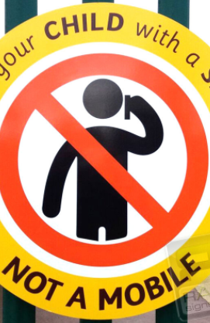
Mobile Phones
When you are bringing or collecting your
child(ren) to/from school, please ensure
that your mobile phone is turned off. It
is an important time to talk and share
with your child.
‘Greet your child with a smile not a mobile’.
For those children in Year 5 and 6:
if you wish for your child to have a
mobile phone, this will need to be kept in
his/her school bag and turned off. The
School will not be held responsible if
something happens to it or if it is lost.

Slide 24

Parking
Please note that Pope Paul Primary School takes the safety of our children very seriously.
Parents bringing children to school by car should park in a safe location but well away from the school car park, school entrance or in the area of zig zag or double yellow lines. We ask you not to park along Great Slades.
Parents should not drive into the school car park to drop children off.
Walk to School
  We want children to be energised and empowered.
  We want children and parents to make walking to school their natural choice and to stop and think before they use the car to get to school.
  We support the Living Streets ethos and need to continue to reduce the number of cars and ease parking problems in our community. We can do this by:
  · Walking to school
  · Cycling to school
  · Driving part of the way to school and walking part of the way.

Slide 25
Remember that if you have any concerns, please contact the school office by email or phone.

Slide 26
Any Questions?

Slide 27
Thank you.
The Year 4 team and I look forward to working with you.

