Slide 1
Meet the Teacher September 2021
We believe that we are all God's work of art.
We strive to respect and care for each other
and to use our talents to do our best.
By doing this, we are
'Learning in the Light of Christ’

Slide 2
Welcome to Year 1
Class Teacher
Miss Lambie
Working in Year 1 will be:
Mrs Shea
Morning support
Ms Hilton, Mrs Lopez and Mrs Steff
Wednesday PPA cover

Slide 3
Expectations
Good attendance and punctuality
Following our mission values in class and around the school.
Being good role models for the rest of the school.
Taking on responsibilities.
Representing the school outside in the community.
Completing home learning on time.
Ensuring reading records are up to date and in class.
Using our learning power characters.
Taking pride in their work and the presentation of their work.

Slide 4
Attendance
From September 2021, the usual rules on school attendance apply, including:
Parents’ duty to send their child to school regularly where they are of compulsory school age;
It is the school’s responsibility to record attendance and follow up absence;
The availability of local authorities to use legal sanctions, including penalty notices and prosecution in court.

Slide 5
What your child will need:
Everyday they should bring in their water bottle, reading books and reading record book
Correspondence from parents to be emailed to the school office: admin@popepaul.herts.sch.uk
ALL clothing to be labelled including P.E. Kits
Coats for Autumn weather.
Blue school book bags for Year 1. Rucksacks are not needed and are too large for their pegs.

Slide 6
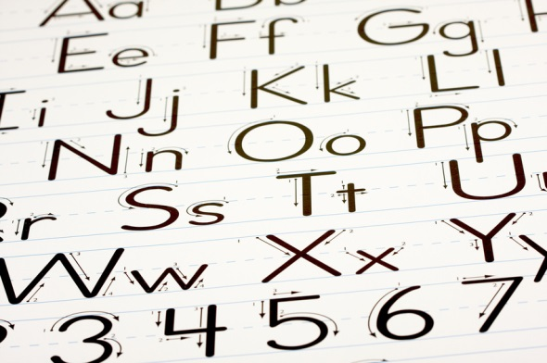
Handouts
Curriculum jigsaw year 1
The Year 1 Maths Learner
User names and passwords for our online learning sites:
Handwriting Letter Join
Mathletics (to follow)
Read Theory (same as last year)
Google classroom ( same as last year)

Slide 7
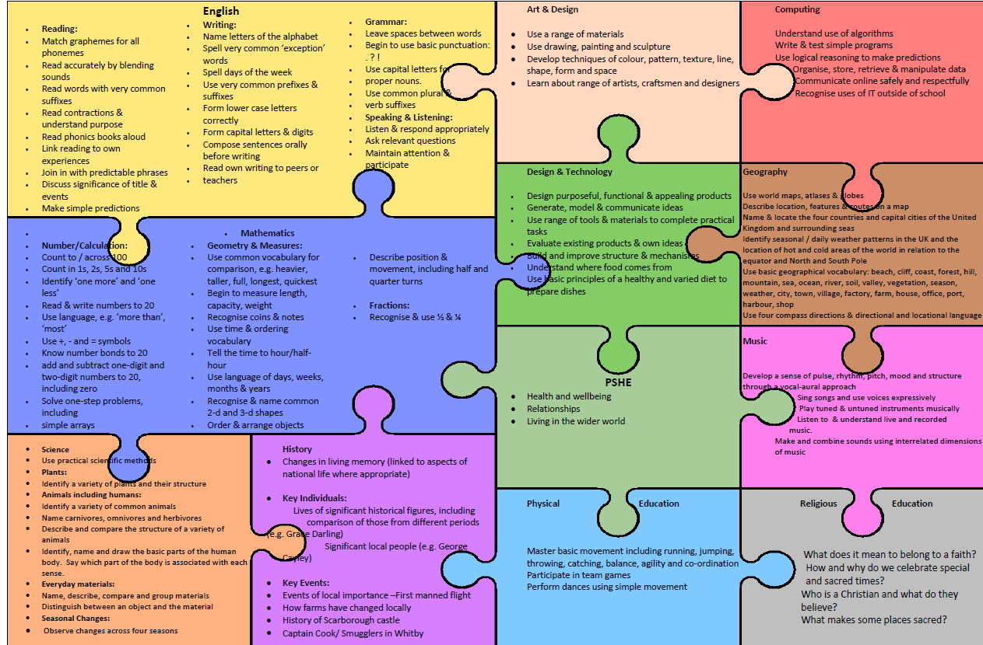

Slide 8
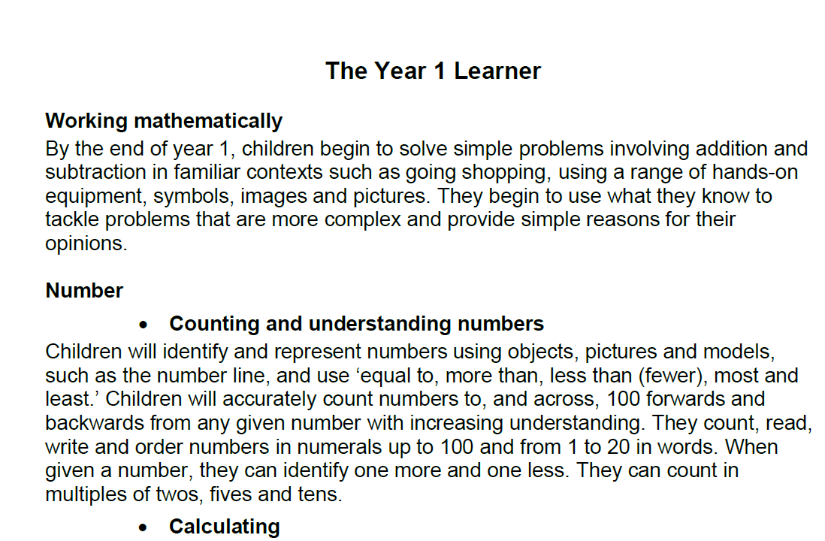

Slide 9
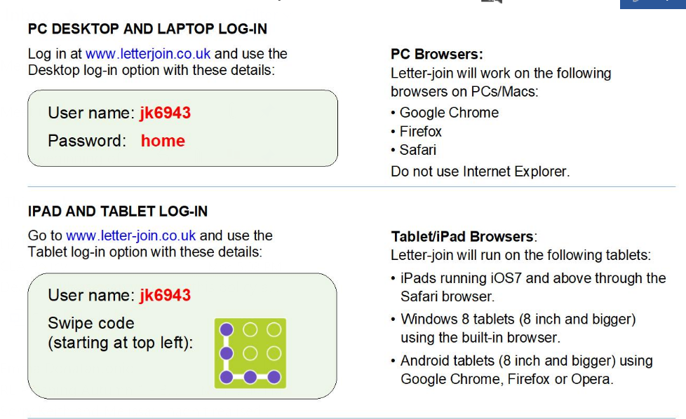
Letter-join

Slide 10
Home Learning
Home Learning is set via the class blog but after half term it will be set on Google Classroom on a Friday and due to be completed by the following Wednesday.
Spellings – year 1 word list
Reading – 5 - 10 minutes per day, parents to sign diary weekly.

Slide 11
P.E.
The children will have P.E. on Wednesdays and Thursdays.
On your child’s allocated PE Day, they will come to school in their PE Kit included Pope Paul joggers and sweatshirts.

Slide 12

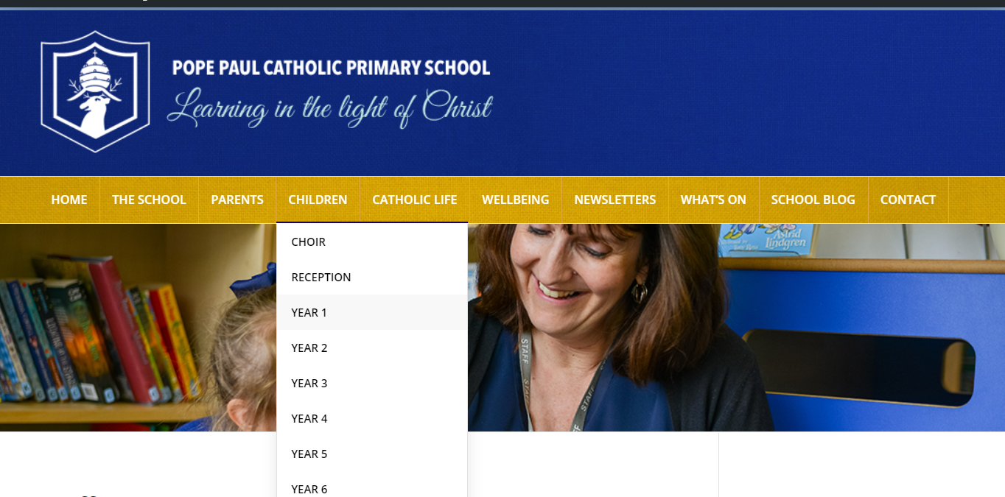
Class Blog

Slide 13
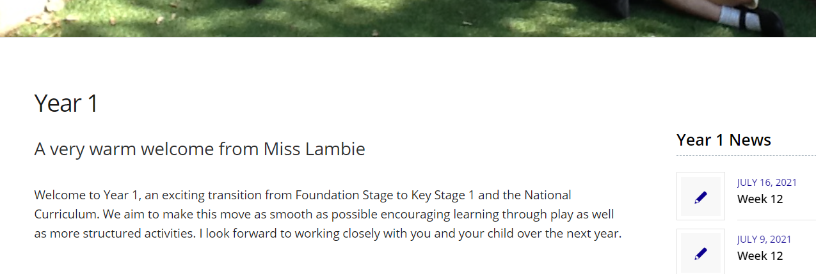
Class Blog

Slide 14
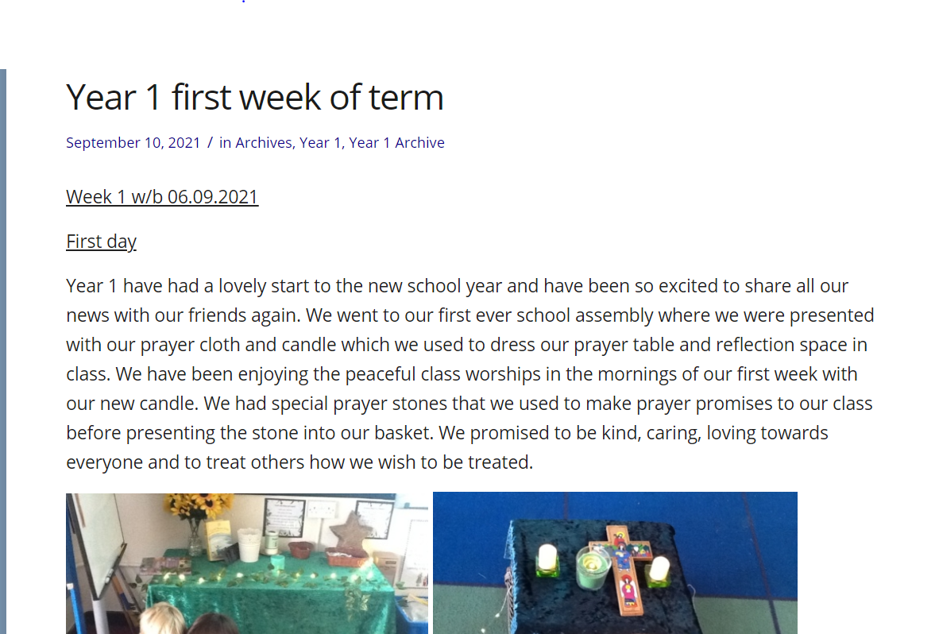

Slide 15
Lunchtime
Your child can have a hot lunch if they would like it. Hot lunches are free for all children from Reception to Year Two (Rec, Year1, Year 2).

Slide 16

School Priorities in 2021-2022

Slide 17
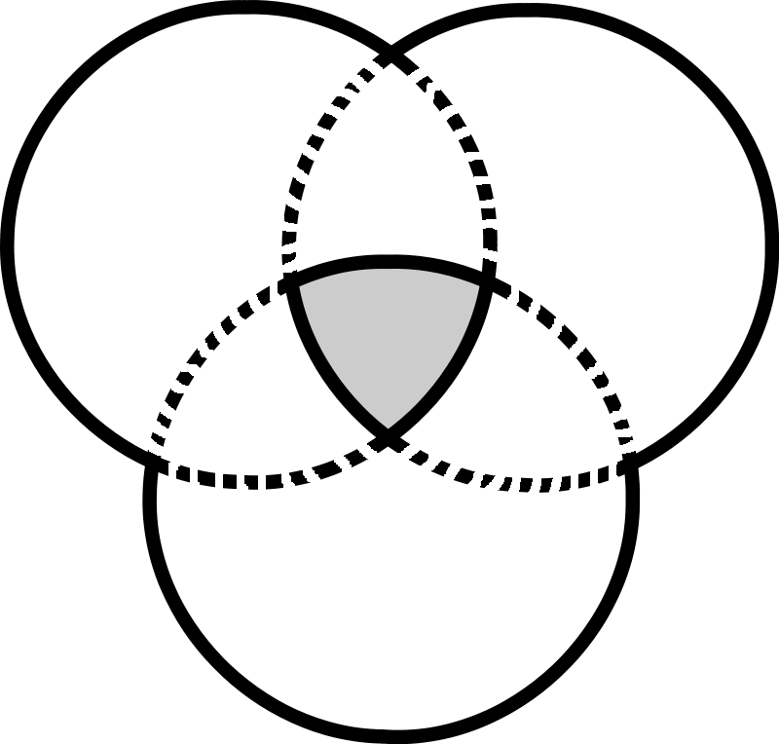
Our Partnership
The relationship between the home, school and parish is vital in the religious, spiritual and moral development of your child.
Home
Parish
child
School

Slide 18

Our Year Of Growth
This year at Pope Paul we are focussing on our Year of Growth with the children alongside the support of their family and parish.

Slide 19

Year Of Growth
2021-2022
Growing in Wellness
Growing in Faith
Growing in Knowledge and skills

Slide 20
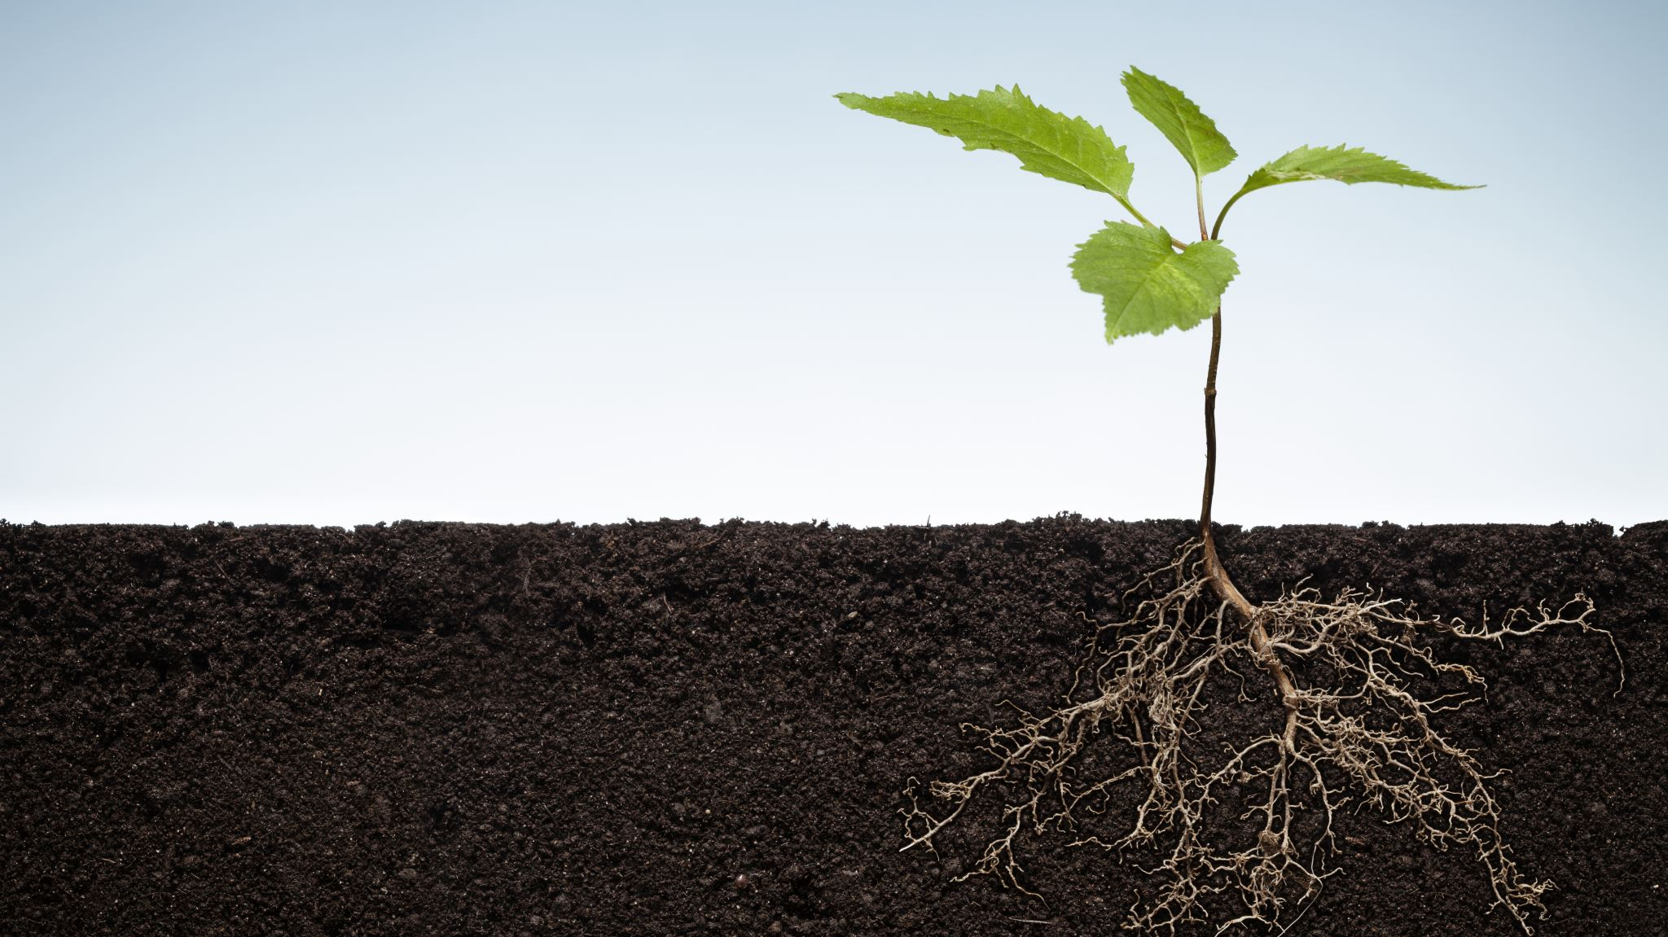
Growing In Faith
We pray during our Year of Growth that we will grow and become strong in spirit, filled with wisdom, and that the grace of God will be upon us.
Amen

Slide 21

Dates for your diary
All dates can be found on the school website and each week at the end of the School’s Weekly Newsletter.
KS1 Nativity-
Monday 13th Dress rehearsal and Tuesday 14th December recorded
Year 1 Assembly on Candlemas-
Friday 4th February

Slide 22
Parent Communication
Please inform the school office via email in the morning of any changes to school pick up so that your child’s class teacher will be informed.
1
If you wish to speak to your child’s class teacher, please make an appointment through the office.
2
If you wish your child to attend the After School Club, you need to book your place online using School Comms.
3

Slide 23

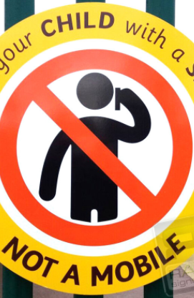
Mobile Phones
When you are bringing or collecting your
child(ren) to/from school, please ensure
That your mobile phone is turned off. It is
an important time to talk and share with
your child.
‘Greet your child with a smile not a mobile’.

Slide 24

Parking
Please note that Pope Paul Primary School takes the safety of our children very seriously.
Parents bringing children to school by car should park in a safe location but well away from the school car park, school entrance or in the area of zig zag or double yellow lines. We ask you not to park along Great Slades.
Parents should not drive into the school car park to drop children off.
Walk to School
  We want children to be energised and empowered.
  We want children and parents to make walking to school their natural choice and to stop and think before they use the car to get to school.
  We support the Living Streets ethos and need to continue to reduce the number of cars and ease parking problems in our community. We can do this by:
  · Walking to school
  · Cycling to school
  · Driving part of the way to school and walking part of the way.

Slide 25
Remember that if you have any concerns, please contact the school office by email or phone.

Slide 26
Any Questions?

Slide 27
Thank you.
The Year 1 team and I look forward to working with you.

