Slide 1
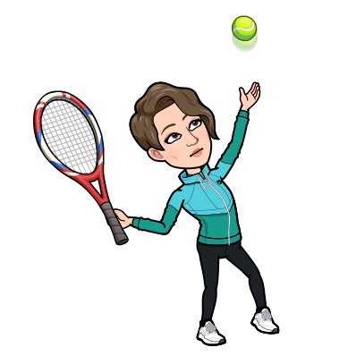
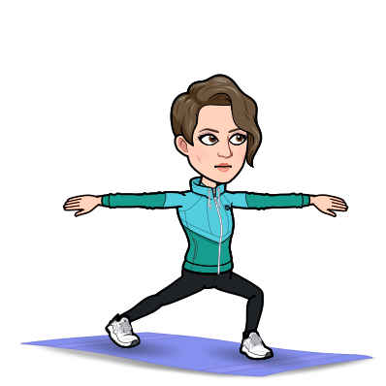
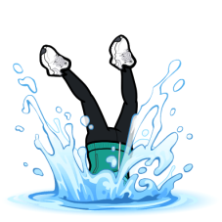
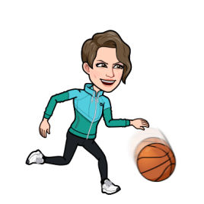
I
Our PE Journey in Y5 & Y6
“In Y6, I am now ready to move to secondary school after mastering the skills and knowledge of how to live an active and healthy lifestyle, with a love for sport.”
Athletics
Key Vocabulary
Explosive
Reaction
Athlete
Fitness
Power
Diet
Compete
Values
Performance
We will identify good athletic performances and explain why.
End of Year 5&6
We will participate in organised competition.
“In Y5, I can identify, modify and refine my technique to improve and reach my peak performance.”
Strike and field
“In Y6, we plan to outwit the opposition individually, as a pair or as a team, when they are batting, bowling or fielding.”
Key Vocabulary
Interception
Positioning
Bowling
Batting
Control
Variation
Rules
Teams
We will use the skills we prefer with competency and consistency.
Key Vocabulary
North
South
East
West
Route
Map
Reading
Compass
Navigation
Safety
“In Y5, I can bowl with control and accuracy, field affectively as part of a team and strike a bowled ball consistently .”
Outdoor
Adventure
We will develop our range and quality of S&F games.
We will except responsibility for personal and group decisions and safety.
Summer Term
“In Y6, I can explain how a sequence is formed, using appropriate terminology.”
We will take part in problem solving and ‘survival’ activities.
We watch performances and use criteria to make judgements and suggest improvements .
“In Y6, I can navigate a variety of orienteering challenges; using mapping skills and given clues.”
“In Y5, I can respond to challenges and use simple mapping skills.”
Gymnastics and Dance
We will make up long sequences & perform them with fluency & clarity of movement.
“In Y5, I can devise appropriate responses to challenges and adapt to changing circumstances
Swimming
We will swim 25m with confidence and develop survival skills.
Key Vocabulary
Muscle
Tension
Posture
Patterns
Unison
Tension
Fluency
Perform
Sequence
Choreograph
Body management
Spring Term
“In Y6, I can games in different positions and
formations”
“In Y5, I can vary direction, levels and pathways, to improve the look of a sequence both on the floor and on apparatus.”
Key Vocabulary
Formation
Possession
Position
Ball control
Zone
“In Y5, I can use my developed skills to play in 4v4 & 5v5 games with a good understanding of the sport.”
Key Vocabulary
Awareness performance
Suggestion
Support
Over arm
Underarm
Accuracy
Attack
Defend
combination
We will identify aspects of our own & other performances, offering advice on how to improve. .
“In Y5, I can perform a variety of sending ,
Striking and receiving techniques, with great control and fluency.”
We will perform simple jumping actions with control.
Invasion Games
We will our ability to use tactics and strategies.
“In Y6, I can modify and refine my skills and techniques to improve my performance and adapt to different situations.”
Autumn Term
Multi-Skills
We will combine & perform skills with control, adapting them to meet the needs of different situations.

