Slide 1
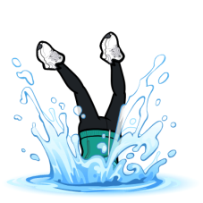
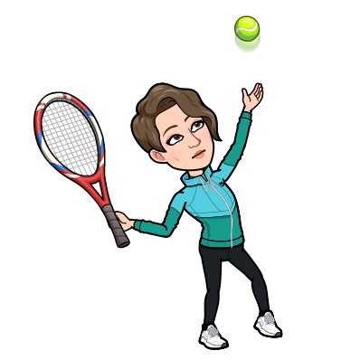
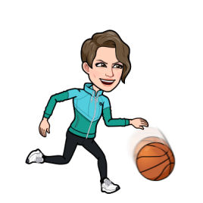
I
Our PE Journey in Y1 & Y2
“In Year 2, I can challenge myself in different games and races.”
Sports Day Activities
We will develop the fundamental skills of running, throwing and jumping.
Key Vocabulary
Run
Speed
Race
Jump
Throw
Effort
Challenge
End of Year 1&2
We will participate in organised competition.
“In Year 1, I can show consistency and control in running, throwing and jumping. .”
We will develop water confidence and basic stroke technique.
Team Games (Invasion)
We will develop, learn and follow rules to new games.
Key Vocabulary
Attack
Defend
Teamwork
Target
Scoring
Roles
Goal
“In Year 2, I can use these skills for attacking and defending games.”
Swimming
We will have to work sensibly and effectively in pairs and small groups
Outdoor
Adventure
Key Vocabulary
Problem
Solve
Help
Listen
Talk
Captain
Ideas
Team Trust
We will participate in team games.
Summer Term
“In Year 1, I can travel with, send and receive different size balls and objects.”
We will use our new skills to create and perform an individual sequence.
“In Year 2 I can overcome tricky challenges and think of solutions with my team .”
“In Year 1, I can respond to and overcome simple challenges.”
Gymnastics and Dance
We will continue to develop flexibility, strength, technique, control and balance.
“In Year 1, I can show a variety of gymnastic skills with increasing control.”
We will take part in problem solving and ‘survival’ activities.
We will play basic modified games, with a focus on sport based skills..
Key Vocabulary
Left
Right
Jump
Hop
Skip
Stretch
High
Low
Forwards
Backward
Spring Term
“In Year2, I can use my sending and receiving skills in a game against other players. ”
Key Vocabulary
Throw
Roll
Catch
Kick
Control
Pass
“In Year 2, I can perform my new skills and different levels and speeds.”
“In Year 1, I can send and receive simple objects in games.”
Key Vocabulary
Space
Safety
Travel
Dodge
Direction
Control
Balance
“In Year 2, I can travel confidently and creatively, show control and agility.”
We will perform simple jumping actions with control.
Ball Games
We will begin to apply all of these in a range of activities.
We will develop throwing, kicking and catching skills..
“In Year 1, I can safely find a space in indoor and outdoor areas.”
Autumn Term
Multi-Skills
We will master basic movements; including running, jumping, throwing and catching.

