Slide 1
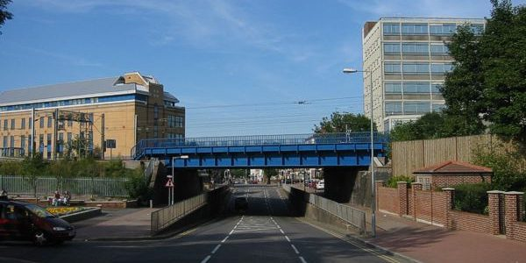
The God who speaks through Creation...
here in Potters Bar

Slide 2
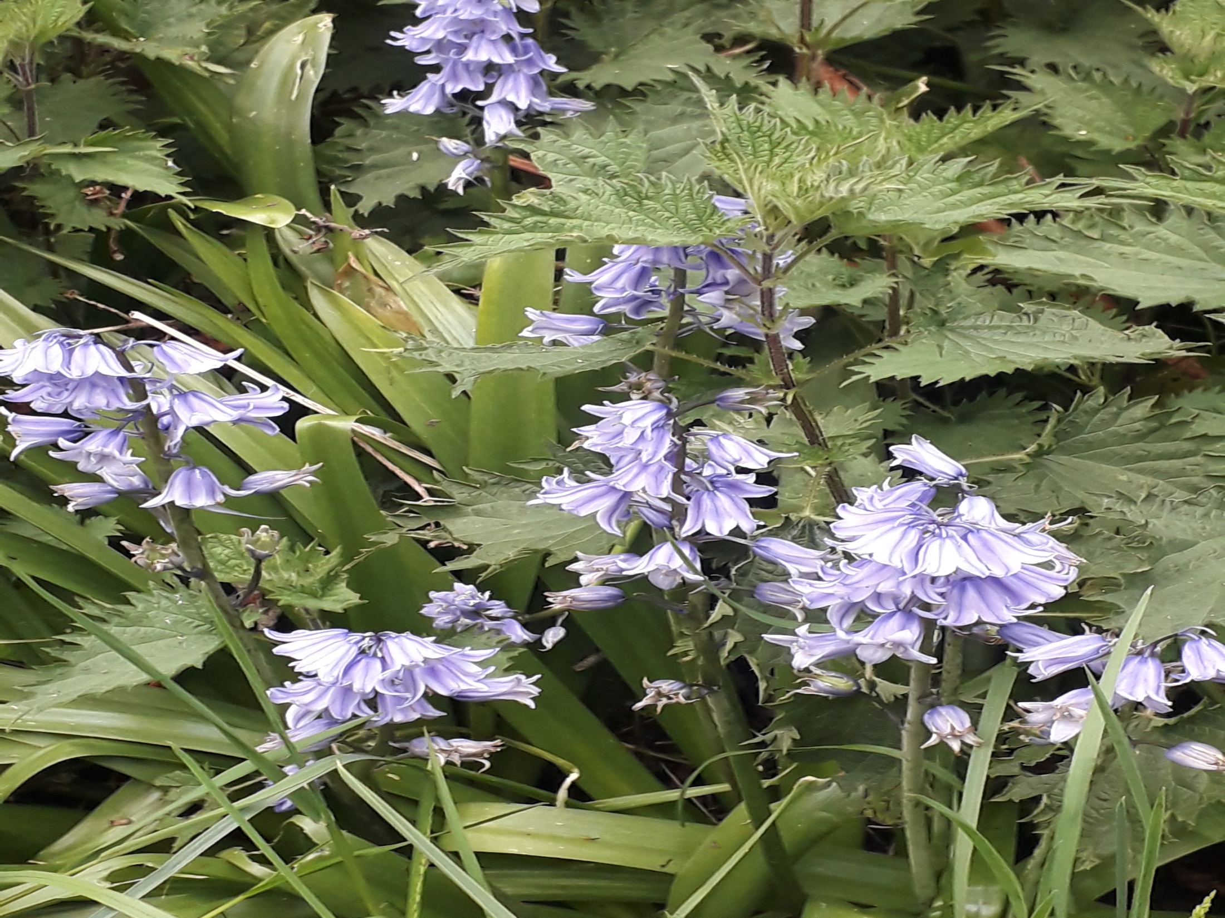

Slide 10
