Slide 1
Other Faith Week
11th February – 15th February, 2019

Slide 2
Years 3 – 6 visit the Hindu Temple in Neasden

Slide 7
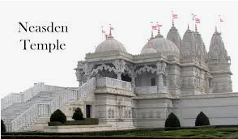

Slide 8
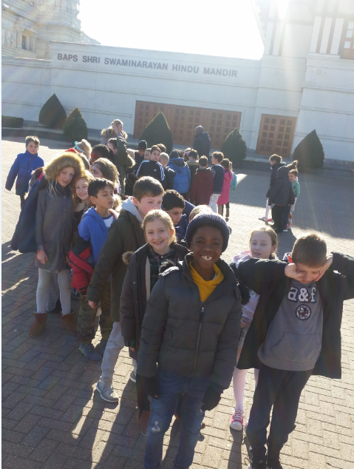

Slide 9
A Jewish Workshop
Reception
and
Year 1

Slide 10
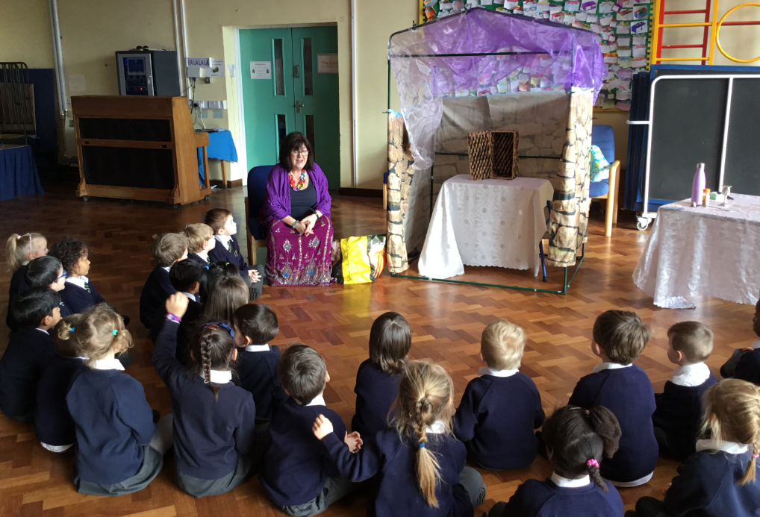

Slide 11
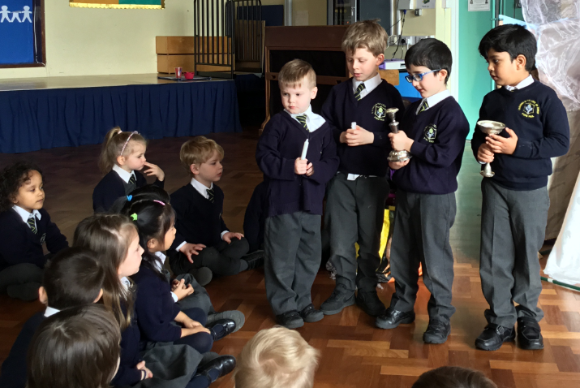

Slide 13
Showing the Jewish festival of Shabbat

Slide 14
Year 2
Visit to the Oshwal Centre Jain Temple

Slide 15
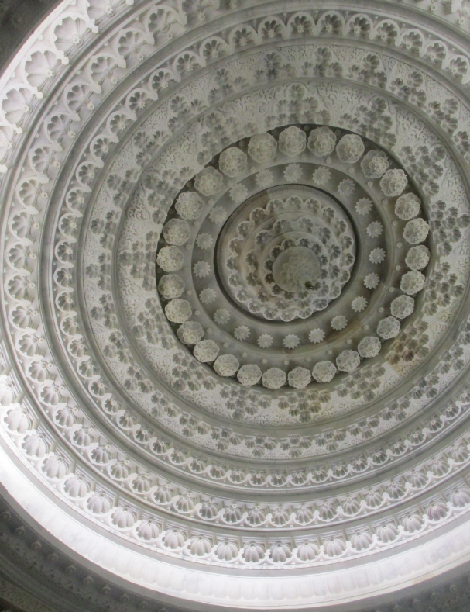

Slide 16
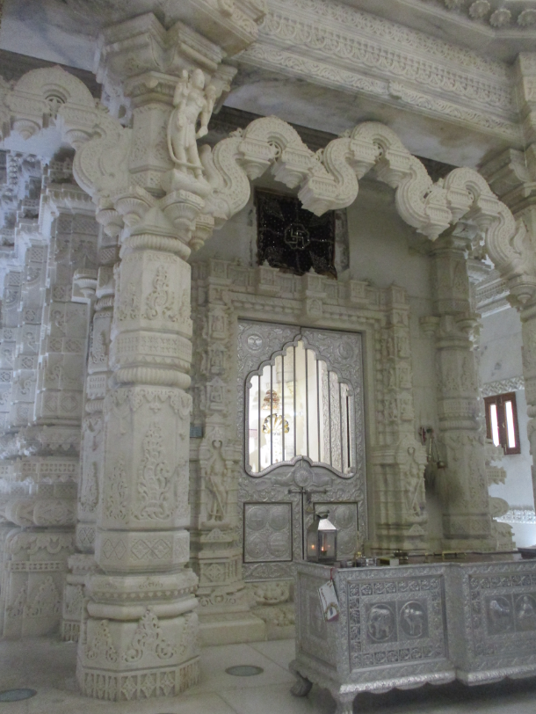

Slide 17
