Slide 1


The White Rose
Maths
Curriculum
at
Pope Paul

Slide 2


We believe that we are all God’s work of art.
We strive to respect and care for each other and to use our talents to do our best,
to build a better world.
By doing this we are learning in the light of Christ.
Amen.

Slide 3
Welcome!

Slide 4
Aims of this workshop:
Find out about our Maths Scheme (White Rose)
Learn about the resources available to parents/carers that can assist you with your child’s learning.
How the new scheme will look in your child/children’s exercise book.

Slide 5
Since September 2025, we have been following the White Rose maths scheme.

Slide 6
Reasons for moving to White Rose Whole School Maths Scheme

Slide 7
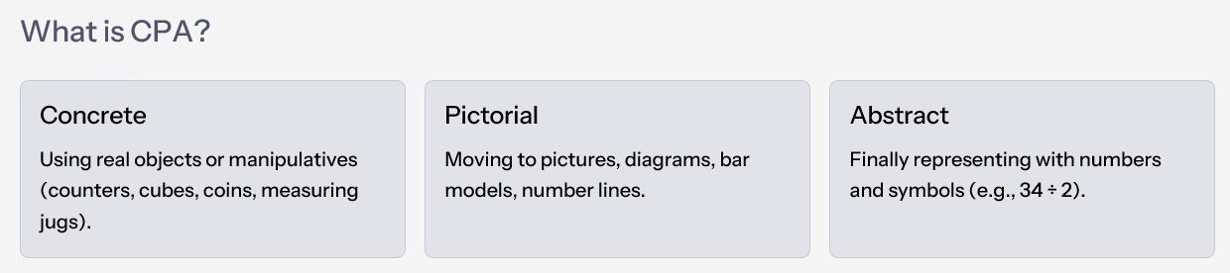



1.: Challenge through: Depth, Not Bigger Numbers
White Rose challenges pupils by:
Asking them to explain why something works, not just "get the answer."
Using small numbers at first to expose the structure (e.g., 12 ÷ 4 with counters → then extending to 120 ÷ 4).
Using reasoning questions (true/false, "spot the mistake", odd one out) to deepen understanding.
So the challenge is thinking harder, not just handling larger numbers.
2.: Use of CPA approach
Year 1 – Addition
Year 2 – Fractions
Year 3 – Multiplication
Concrete: Children use cubes or counters to add 8 + 5.
Concrete: Folding paper to show halves/quarters.
Concrete: Repeated addition with counters in equal groups.
Pictorial: They then draw circles or a ten frame to show the same addition.
Pictorial: Colouring parts of a shape or bar model.
Pictorial: Arrays and bar models.
Abstract: 4 × 6 = 24.
Abstract: Finally, they write 8 + 5 = 13.
Abstract: Writing ½ = 2/4.

Slide 8


Year 5 – Fractions and Decimals
Year 6 – Problem Solving
Concrete: Base 10 and fraction strips to show tenths/hundredths.
Children are taught to draw first (bar model, diagram, or sketch of a shape).
Pictorial: Bar models showing equivalence (e.g., 0.4 = ⅖).
Example: A ribbon is 2.4m. ⅔ is cut off. How much remains?
Abstract: 2/5 + 0.4 = 0.8.
Draw a bar → split into 3 parts → shade 2 parts → reason before calculating.
By this point, mark making is automatic — children know how to represent a problem visually before tackling the abstract arithmetic.
Why we value this approach:
Gives structure and consistency in every year and topic.
Children build confidence from hands-on experience, moving gradually to abstract maths.
They are trained to think and represent problems, not just perform calculations.
By Year 6, they are independent problem solvers, able to choose and draw representations that help them tackle SATs questions and prepare for secondary maths.

Slide 9
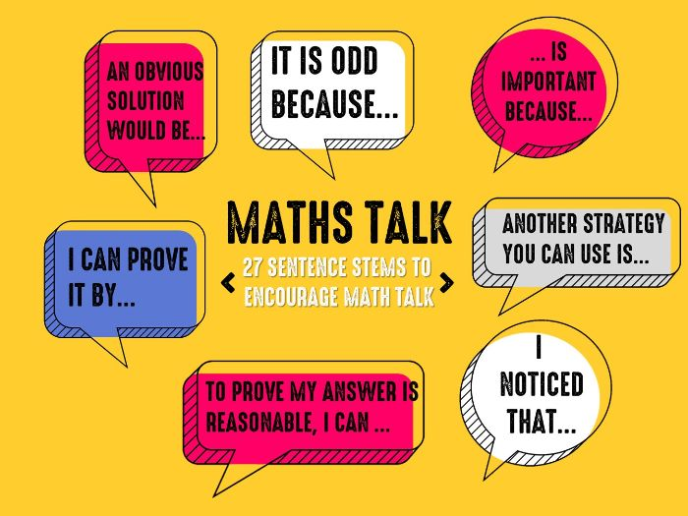
3.: Mathematical talk
Speaking Frames and Vocabulary :
In every step, children are given specific mathematical vocabulary (e.g. denominator, greater than, partition, equivalent).
The schemes provide possible sentence stems such as:
"There are _______equal parts."
"I know the shape has been split into equal parts because …“
￼ _________is greater than ___________ because …" ￼
• These act as speaking frames that support children to use accurate language, even when the ideas are new.

Slide 10
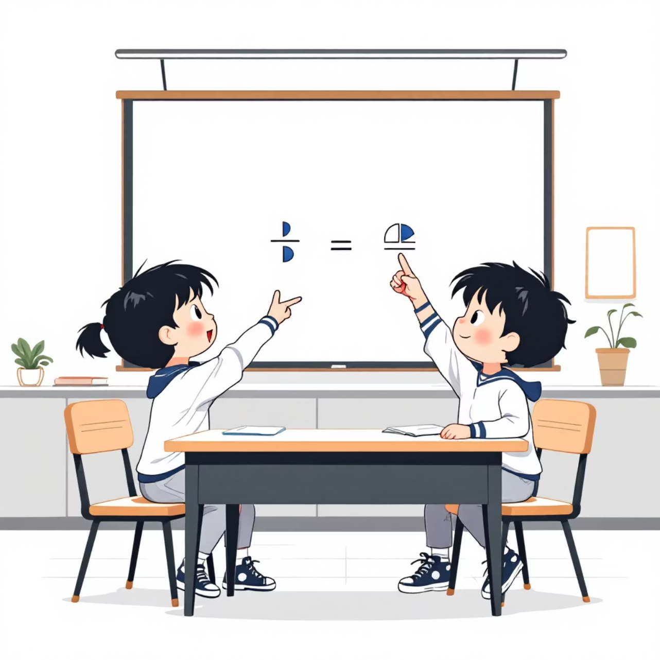
Built-in Talk and Discussion
• Every small step in White Rose includes a task where children must discuss their reasoning with a partner.
• Example (Year 2 Fractions) ￼: "Which shape shows one half? Explain your answer to your partner."
• Example (Year 2 Place Value) ￼: "What mistake has Tiny made? Talk about it with a partner."
• These are not optional extras — the expectation is that verbal reasoning comes before recording.

Slide 11
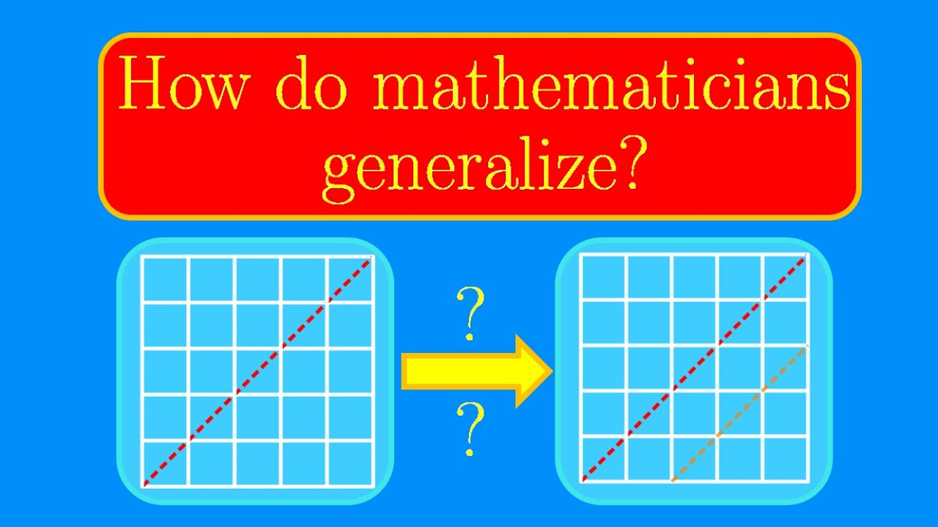
From Talk to Proof and Generalisation
Discussion First
Critical Thinking
Pattern Recognition
After discussion, children are asked to prove, explain, or generalise:
"This is always true, sometimes true, or never true. Explain why." ￼
"What do you notice? Can you prove it will always happen?" ￼
This routine means children learn that maths is not just about getting an answer, but about convincing others and spotting patterns.

Slide 12
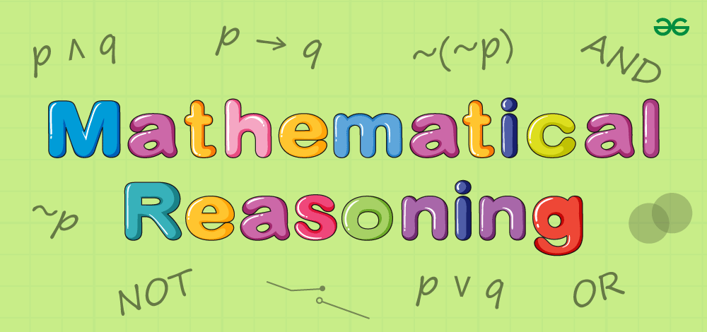
Consistency Across KS1 and KS2
Upper KS2
Lower KS2
Speaking frames support proof and generalisation (e.g., "If___________ is true, then must also be true.").
Talk moves towards formal justification, mirroring secondary school expectations.
KS1
Stems become more comparative (e.g., ___________ is greater than _______________because…").
Talk emphasises reasoning and linking representations.
Sentence stems are simple (e.g., "There are _______tens and________ ones.").
Talk focuses on describing and noticing.

Slide 13
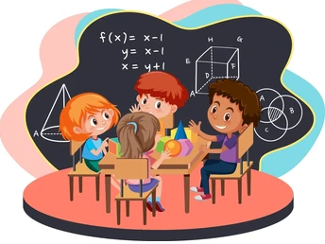

Why This Matters for Children
Children gain confidence with mathematical vocabulary.
They practise thinking out loud, which strengthens memory and understanding.
They learn to listen, challenge, and justify, not just calculate.
By Year 6, children can explain their reasoning clearly — a key skill for SATs and secondary maths.

Slide 14
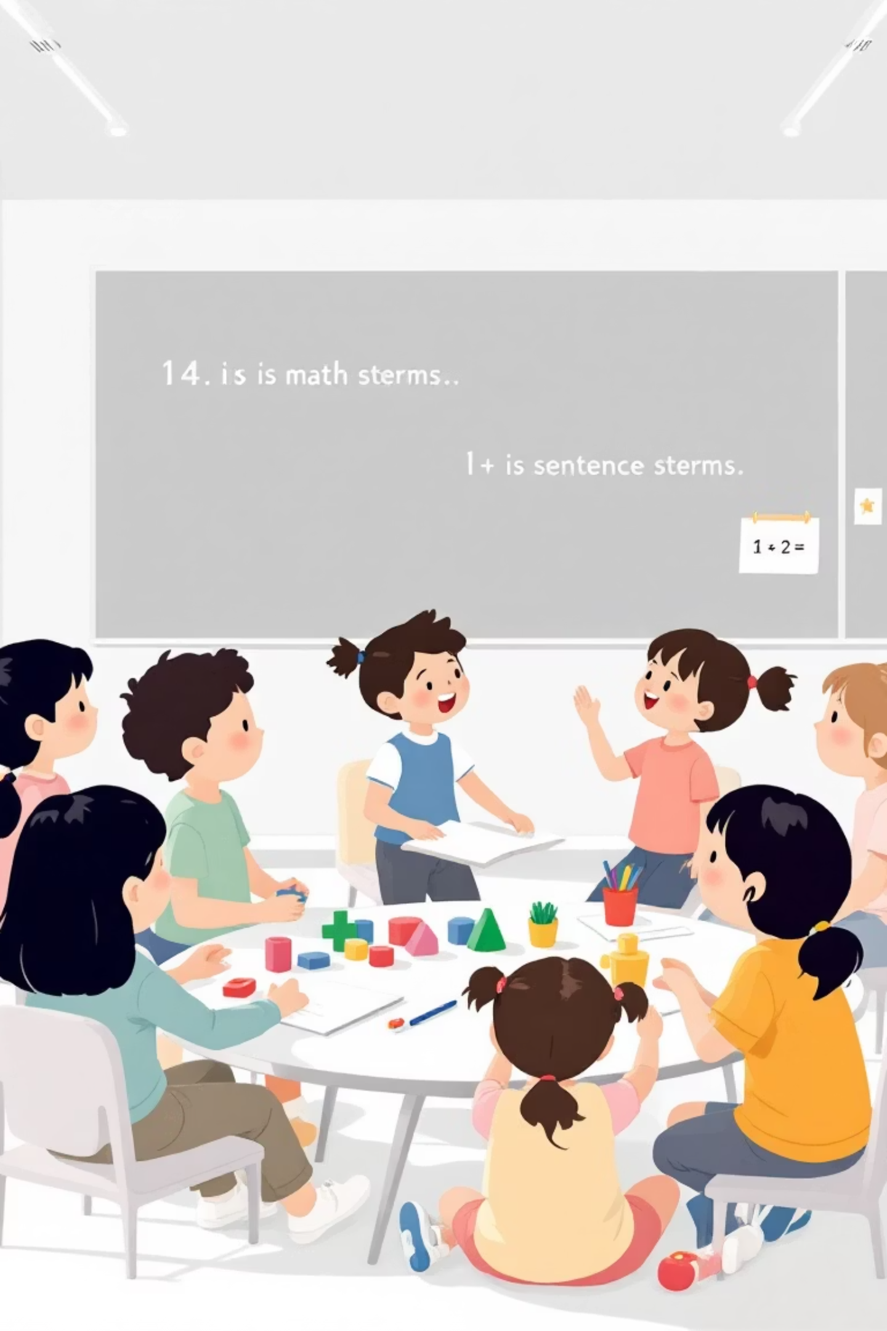
4.: Link to Our School's Oracy Target
White Rose directly supports our school development plan priority on oracy:
Children are expected to talk, reason, and justify at every stage of learning.
Sentence stems scaffold high-quality responses, so all pupils have a "way in" to discussion.
Regular peer talk develops listening, turn-taking, and confidence in speaking — core oracy skills valued across the curriculum.
By Year 6, children can explain, draw, and justify their solutions clearly, preparing them for both SATs and secondary school discussions.

Slide 15
5.: Opportunities for consolidation, connection making and challenge:
Progression Step by Step
Example from Year 2 Fractions:
Each step revisits prior knowledge (retrieval), introduces a new idea in manageable chunks, and then extends it.
Every block is broken down into small, carefully sequenced steps.
First children learn to recognise halves → then find halves → then extend to quarters, thirds, and three-quarters → finally compare and count in fractions.
This shows clear progression within the block, making sure all children can build on what they already know.

Slide 16
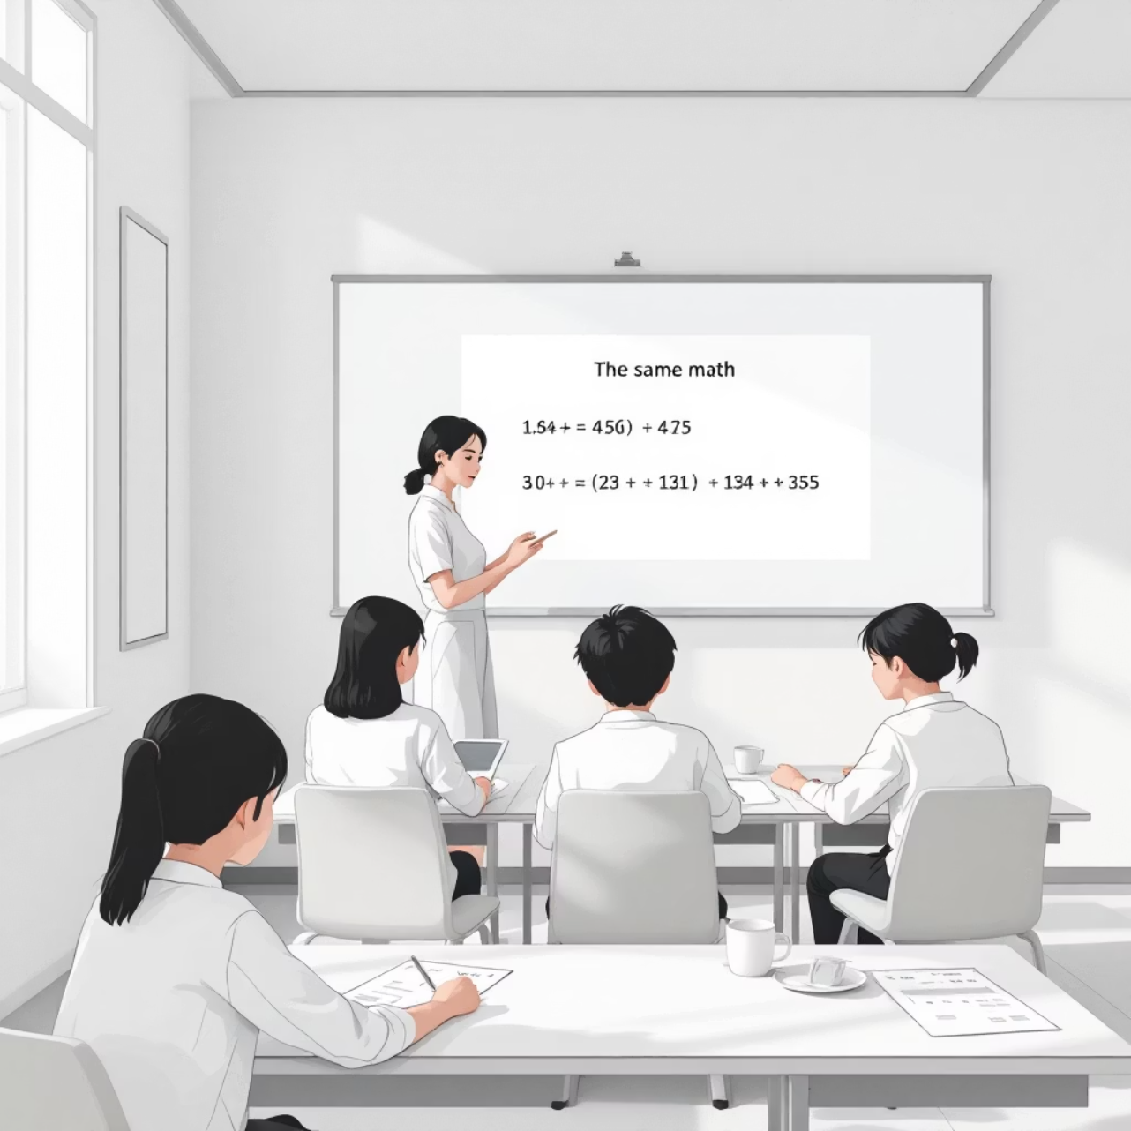
Challenge for Every Ability
All children work on the same concept together, but at different levels of depth.
Tasks are designed so that:
Children who need practice have structured questions that reinforce core skills.
Children working at greater depth are stretched through reasoning and problem-solving challenges.
Examples include:
"Is this always true, sometimes true, or never true? Explain your reasoning."
"Tiny has made a mistake. Can you prove what went wrong?"

Slide 17




Why Parents Should Value This Approach
No Child Left Behind
Stretch for Every Learner
Ensures no child is left behind – small steps mean concepts are secure before moving on.
Provides stretch for every learner – higher-order reasoning challenges keep more able pupils engaged.
Support and Independence
Clear Progression
Balances support and independence – Infinity resources help children who need consolidation to catch up and thrive.
Progression is clear, consistent, and built into every step, from Year 1 through to Year 6.

Slide 18
What will my child’s maths book look like at Parent Consultations?

Slide 19
Consistency Across the School
All children from Year 1 to Year 6 use yellow squared maths exercise books.
Each lesson is headed with the date and the learning objective so you can see what the focus has been.
Daily Maths Routine
Lessons begin with a Fluency activity called Flash 4:
Four short questions that revisit key facts.
Strengthens fast recall.
Helps children retrieve earlier learning and keep skills fresh.
These are completed daily as a class and answers are recorded in the maths books.

Slide 20
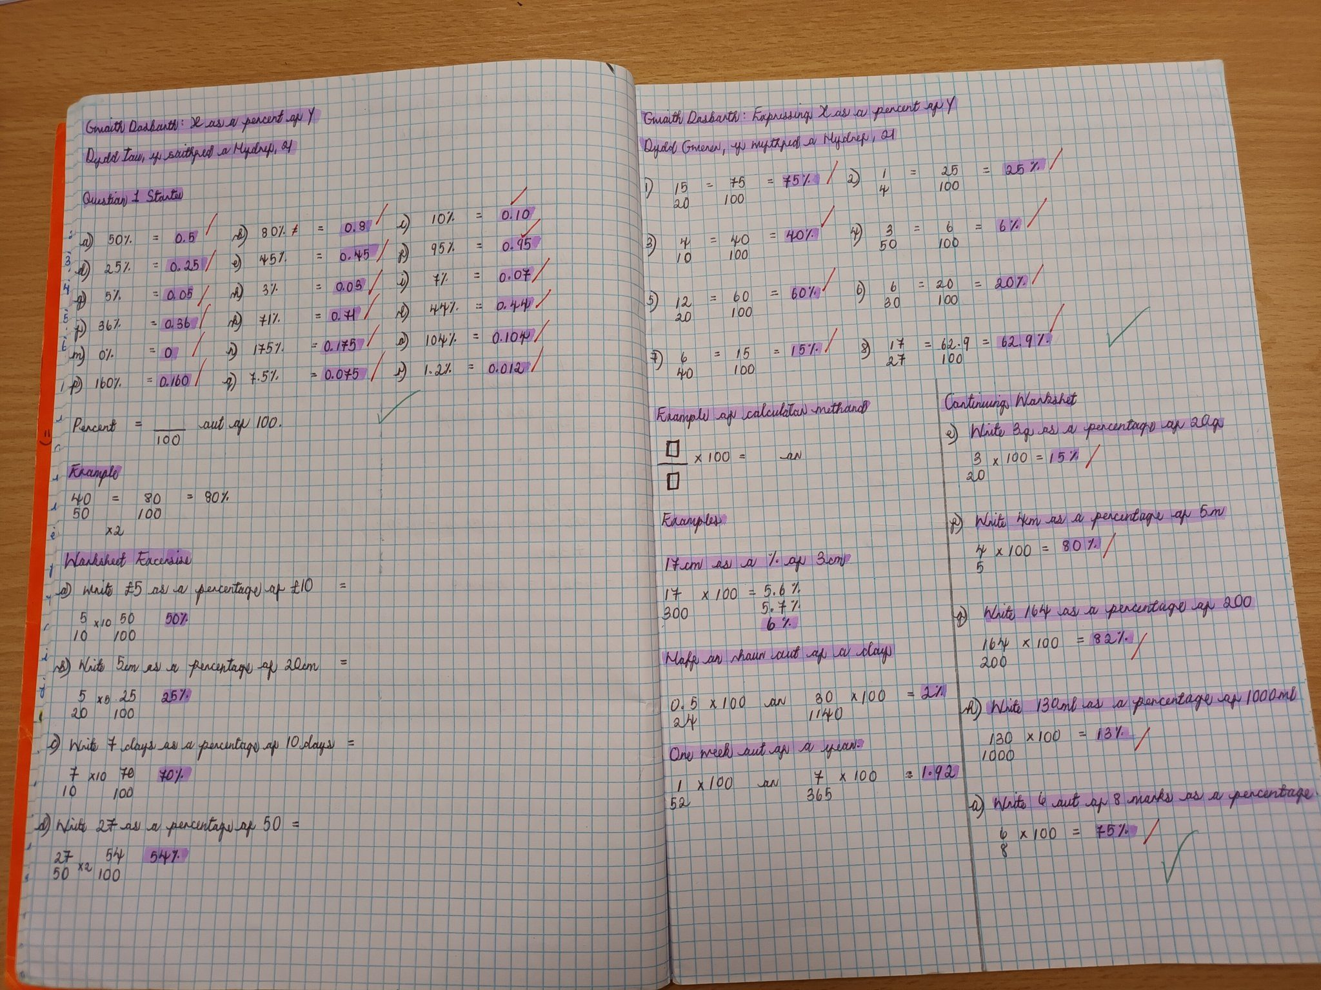
Mathematics Recording and Workbook System
Years 2, 3 and 4
• Children record most independent work in the White Rose printed workbooks, purchased for all children.
• Workbooks contain structured practice and reasoning tasks.
• Some children complete all questions and then move onto challenge tasks.
• Others may complete a selection and then consolidate using White Rose Infinity resources for extra practice.
• After workbook tasks, children return to their yellow squared books to complete further challenge or consolidation activities.

Slide 21
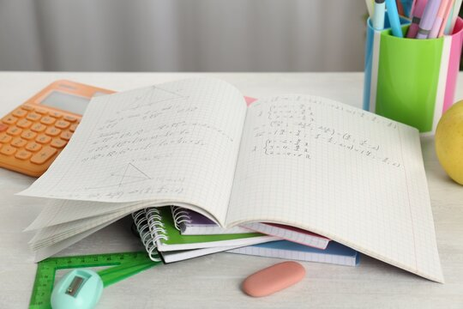
Years 5 and 6
• Children work directly in their yellow squared maths books for all lessons.
• The content still follows White Rose, but instead of using workbooks, the questions and tasks are transferred straight into the exercise book.
• This helps children prepare for the expectations of secondary school recording.

Slide 22
Feedback and Marking
Regular Review
Feedback Methods
Progress Awareness
• Teachers regularly review both exercise books and workbooks.
• Feedback may be given in different ways:
• This means children are constantly aware of how they are progressing.
Verbal feedback noted in books.
Self-marking or peer marking built into lessons.
Teacher guidance to highlight next steps.

Slide 23
You can support your children by using the Home Learning videos and also the free workbooks which will mirror the learning in school.

Slide 24
Any Questions?

