Slide 1
Coffee Morning
Growth Mindset
Beth Cullen
Education Mental Health Practitioner
Hertsmere Mental Health Support Team

Slide 2
What is the Mental Health Support Team?
Mental Health Support Teams serve as a bridge between the NHS and education services in response to increasing numbers of children & young people with anxiety or low mood.
We offer:
1:1/group interventions to support individuals with anxiety, low mood or behavioural difficulties (in Primary schools we work with parents, in Secondary schools we work with students).
Whole School Approach – working to support the school community in building a shared understanding of mental health and emotional wellbeing and to reduce stigma around accessing support for mental health.
Signposting – working to ensure each child access support appropriate to their needs.

Slide 3

Growth Mindset
What does this mean to you?

Slide 4

Background
Carol Dweck (Psychologist)
Researched how children managed failure – either as a necessary step in learning or as the result of not being smart enough.
Some participants saw talent, ability and intellect as fixed while others saw it as something which could grow with hard work.
Through research developed the idea of ‘mindset’ as a way individuals think about talent and ability.

Slide 5
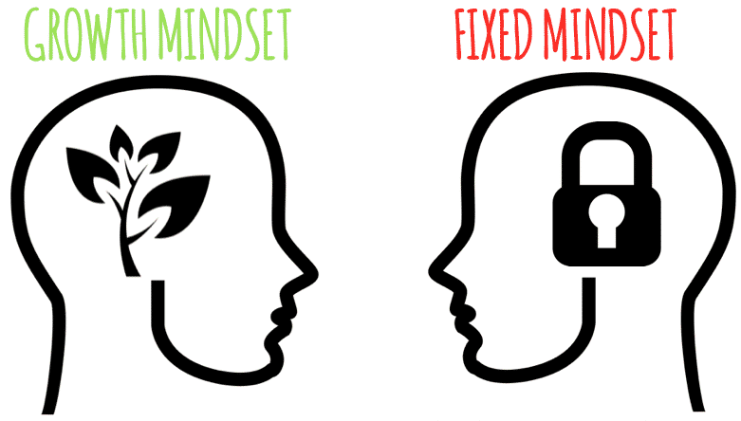
Ability and intellect is set in stone.
Failure is permanent.
Critical feedback = an attack.
Need to prove oneself.
Threatened by the successes of others.

Slide 6

Why is a fixed mindset problematic?
More likely to choose an easy task and put in less effort.
More likely to give up when challenges arise.
Focus is on measurable accomplishments.
Less likely to take creative risks.
Avoidance of new things which appear scary.
Why bother?
Why try?

Slide 7
Ability can improve through practice.
Failure is a chance to learn and develop.
Critical feedback = opportunity to improve.
Embrace challenges.
Journey of continual improvement.
Successes of others can teach us something!

Slide 8
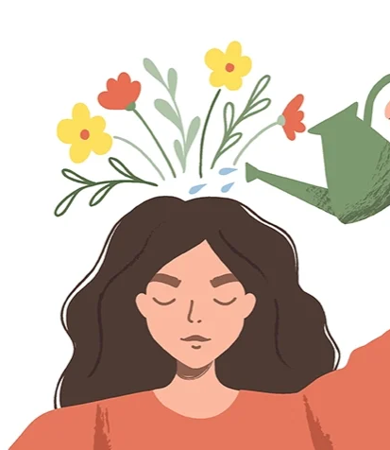
How does having a growth mindset benefit us?
it supports growing and developing abilities
we are more likely to put more effort in to improve
when challenges arise, we are more likely to try to problem-solve
it makes us more likely to take creative risks which provide an opportunity to learn new things

Slide 9
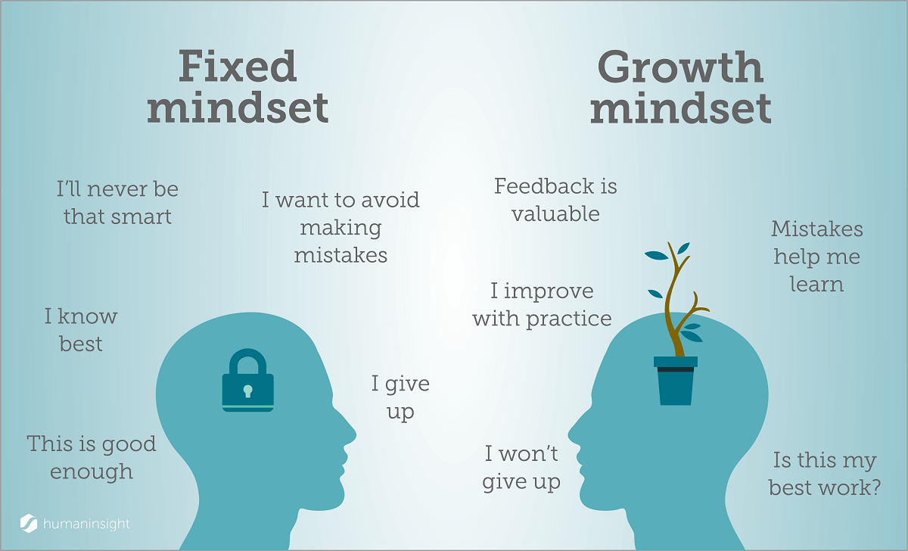
How can we support development of growth mindset in children?
Talk about the brain.
Mistakes are OK!
Communicate differently.
Understand and support children with their emotions when they are learning.

Slide 10

Talk about the Brain
Let them know what they do can help them to grow their brain!
That feeling of working hard = neurons firing in the brain, literally building a stronger brain.
They can help their brain by practicing, asking questions and engaging with the learning.

Slide 11
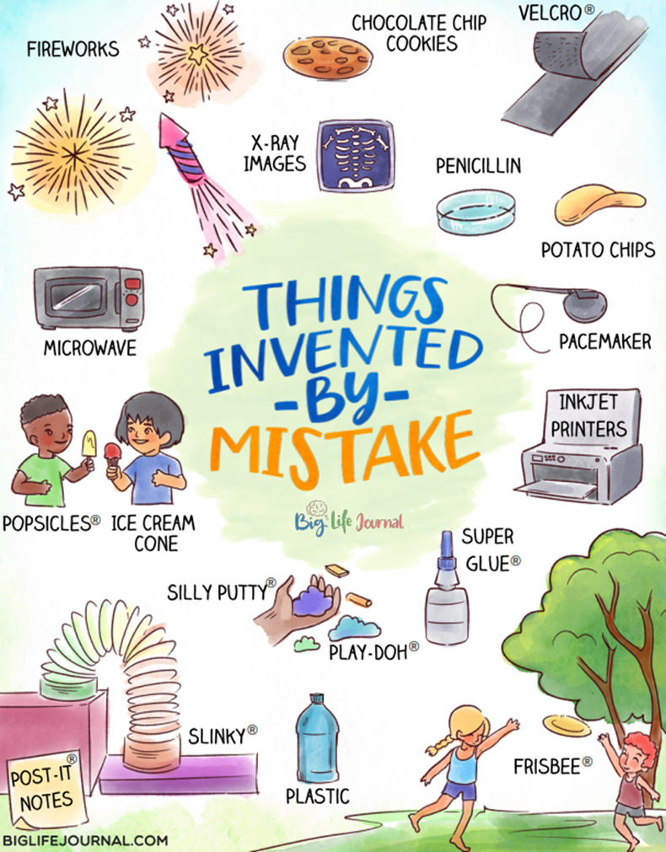
Mistakes are OK!
Mistakes are a part of life – we can learn from them.

Slide 12


Mistakes are OK!
Model making mistakes and learning from them.
Speak positively about making mistakes and how they supported you in learning and developing.
When reading/watching TV speak about mistakes characters make and consider what they could do next.

Slide 13
Communicate differently…
If they later make a mistake, they may assume they aren’t as talented as first thought.
This shows the focus isn’t on the outcome but on the enjoyment of the activity.
You’re a natural at that!
I like watching you do that.
vs.
Shows the CYP they control the outcome with their choices.
Limits self-belief in the capacity to improve.
It’s time to try a new strategy!
It’s OK. Maybe you’re not cut out for this.
vs.
Top tip: turn negative thoughts around by adding ‘yet’ to the end.

Slide 14
Praise wisely:
I can see you tried lots of strategies to solve that maths question! You stuck at it to find one which works!
Telling people, they are smart can have a negative impact on them!
Instead, praise:
hard work
perseverance
effort
the journey – not the result!
You have been working hard with those drills – your ball control has really improved.

Slide 15

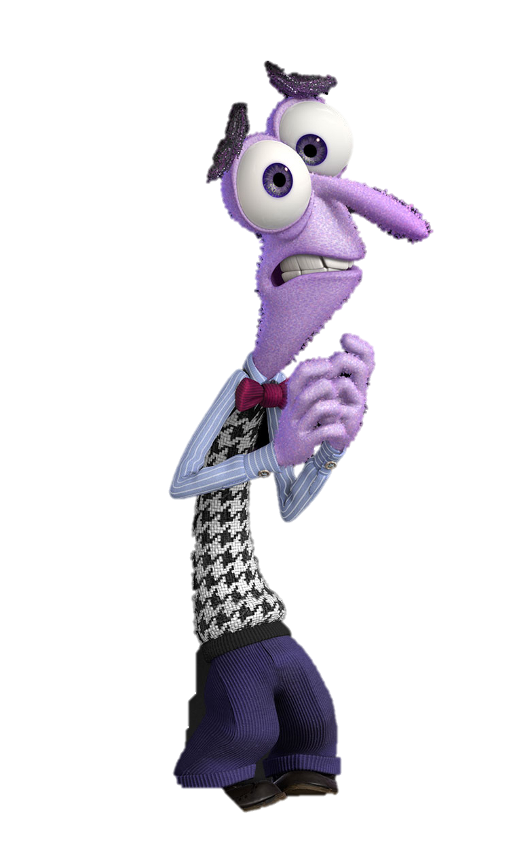
Support CYP with emotions when learning.
Learning new skills and persevering through challenges can be tough. When feelings like anger or fear arise, our stress response (flight, fight, freeze) can be triggered. This is our brain working to keep us safe and can leave us with uncomfortable symptoms like sweating, brain fog, butterflies and others. This can make it difficult to concentrate and keep trying.

Slide 16
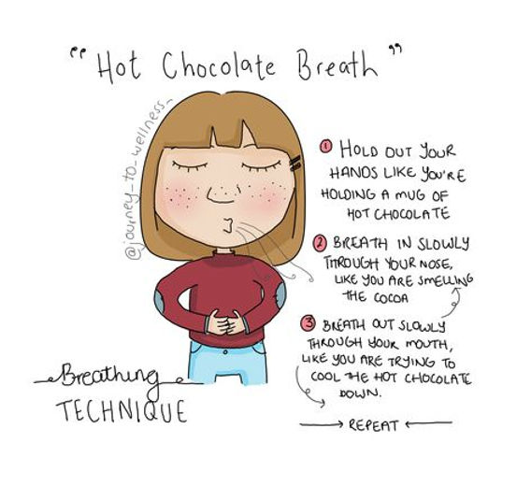
Counteracting strong emotions:
Work with your child to find strategies which support them in managing strong feelings. Here are some examples:
Box breathing
Hot chocolate breath
Jumping jacks
Palm push
Progressive muscle relaxation
Positive self-talk e.g., “I can do hard things, I will try again”

Slide 17
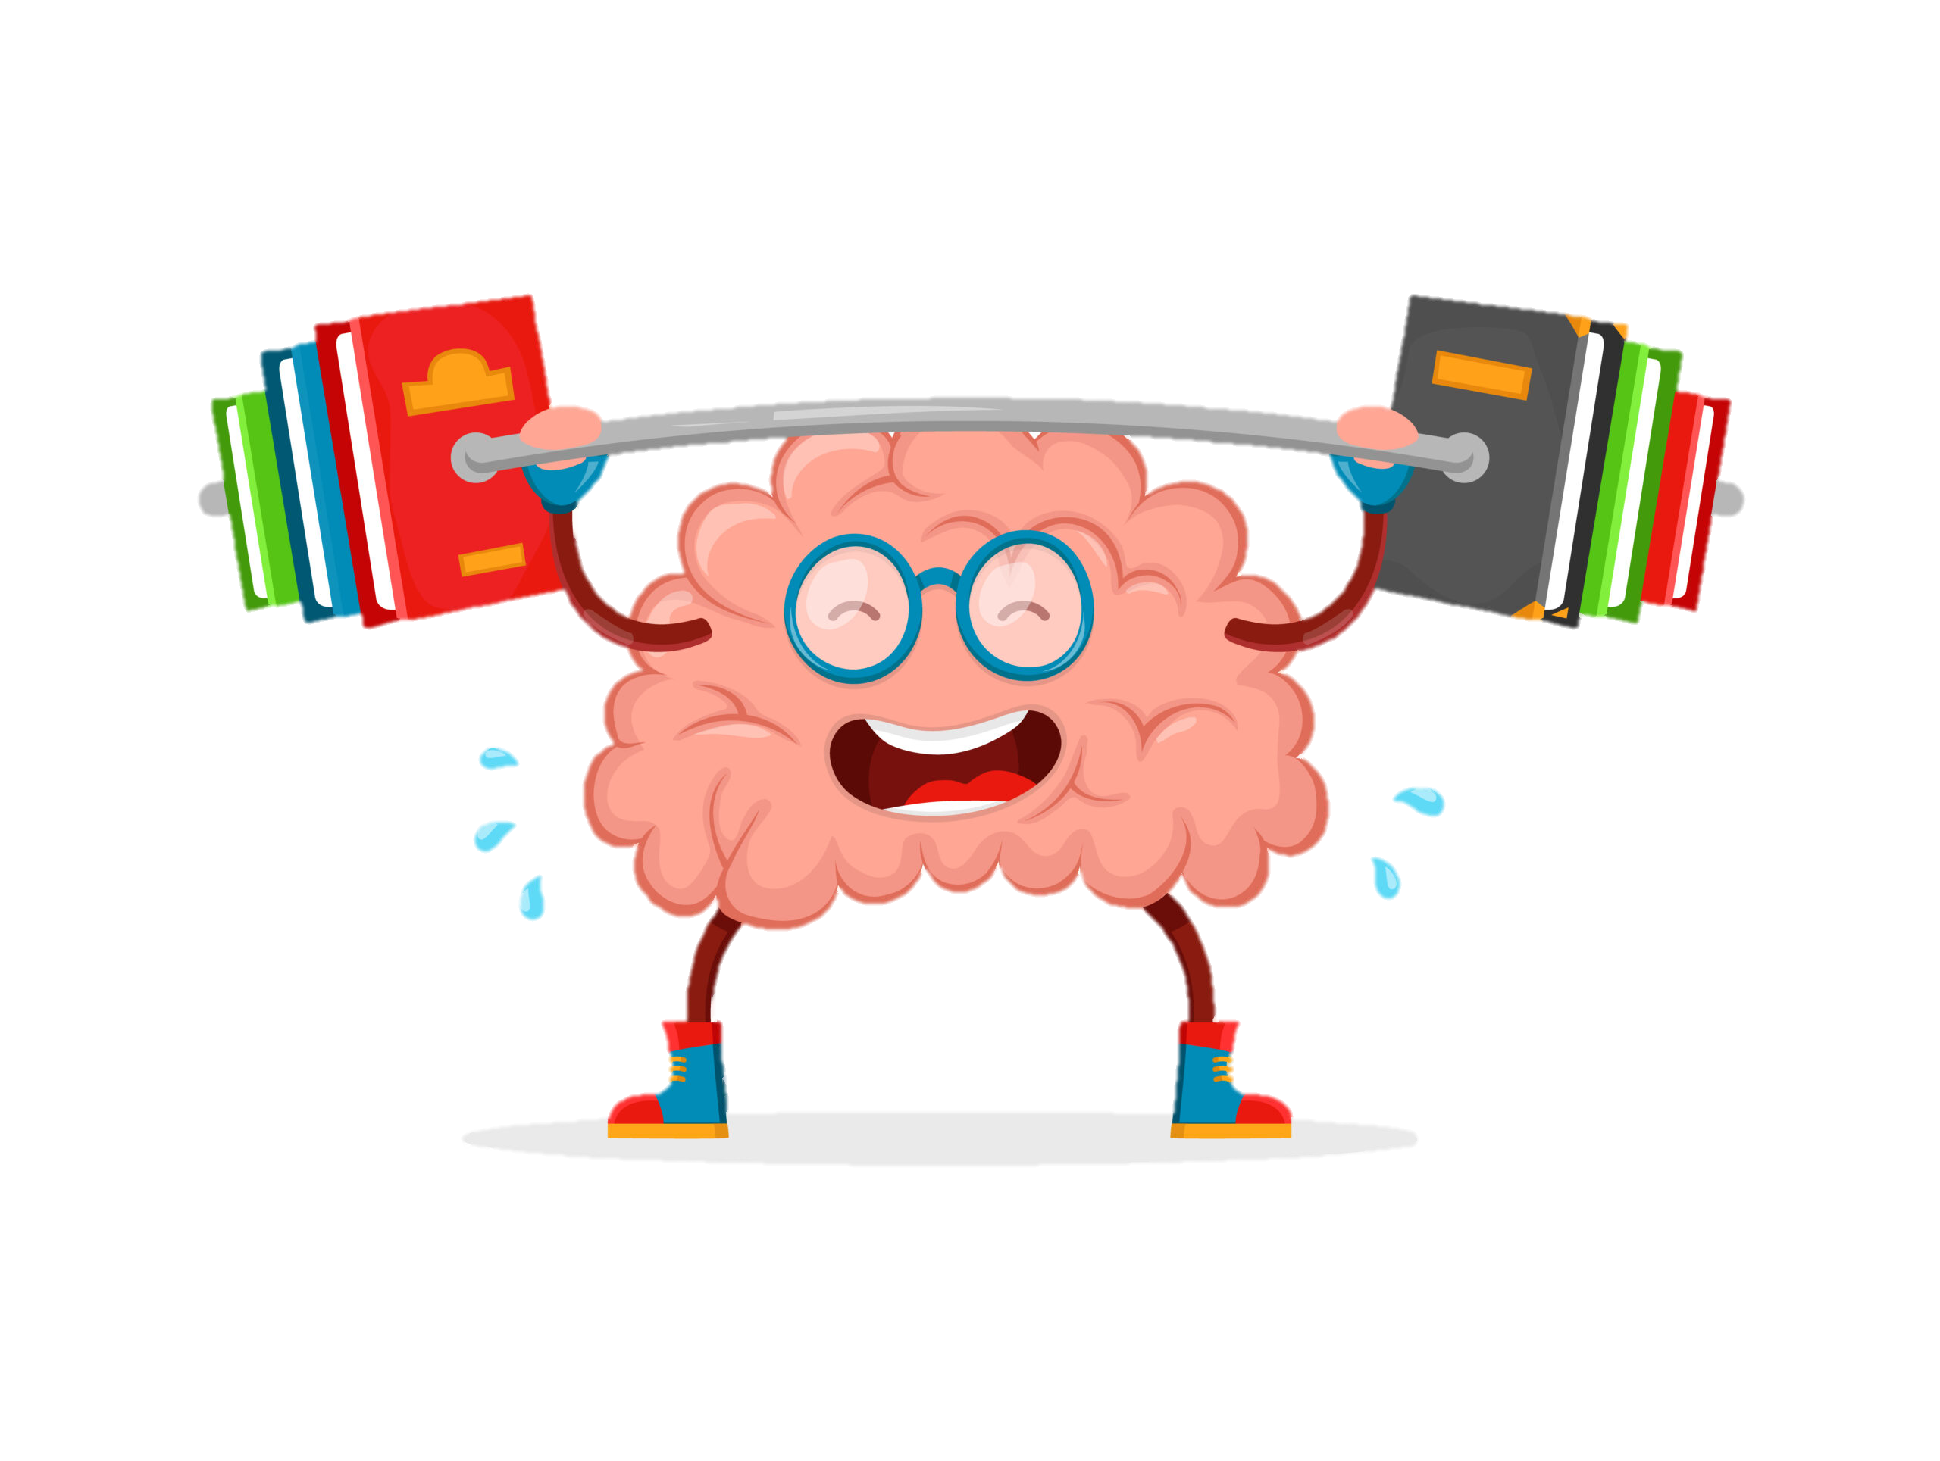
Remember…
mindset isn’t fixed – it is a choice. With motivation, practice, and encouragement we can all develop a growth mindset.

Slide 18
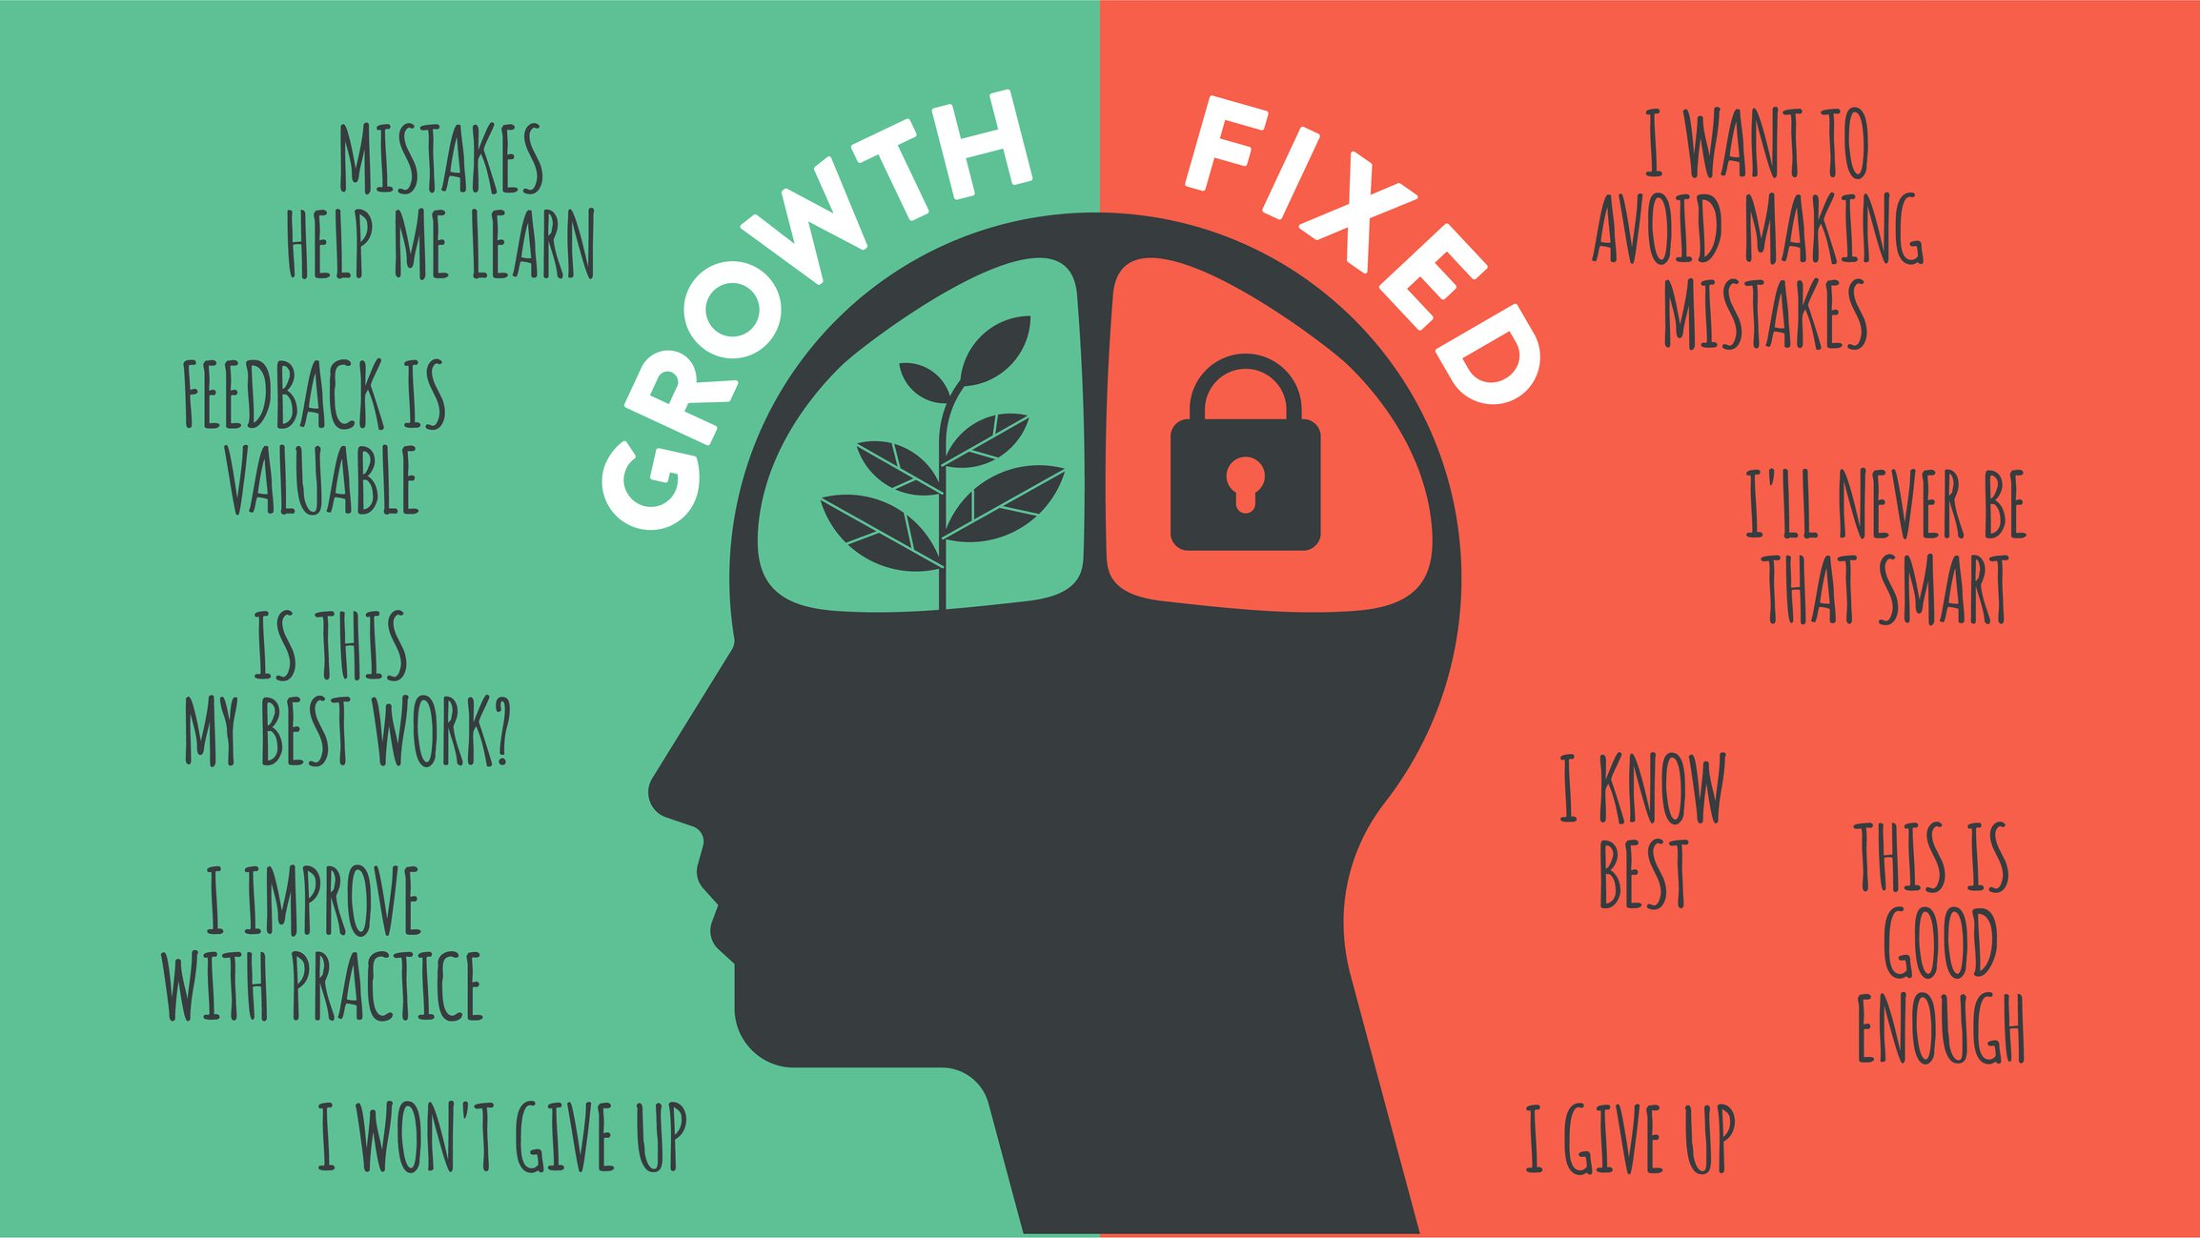
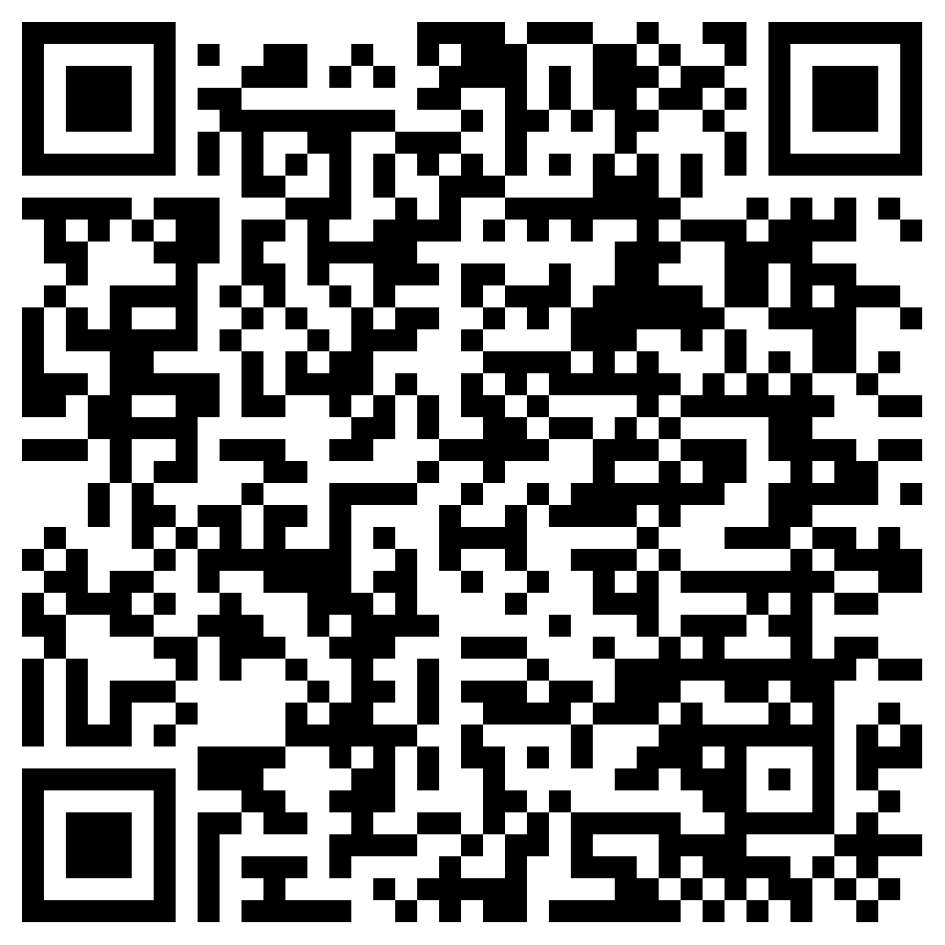
Feedback
Thank you for coming today.
If you would like to provide feedback regarding today’s event – please use the QR code.

