Slide 1
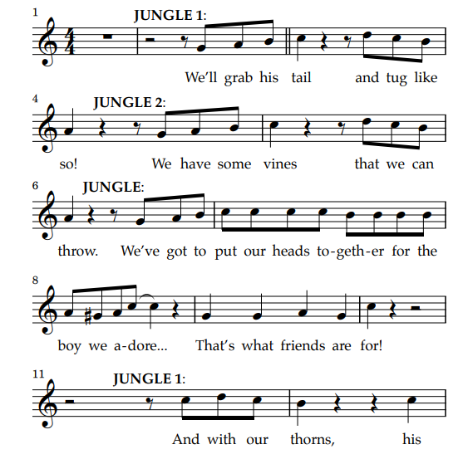
That’s what friends are for Scene 8

Slide 2
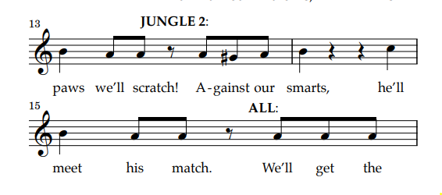

Slide 3
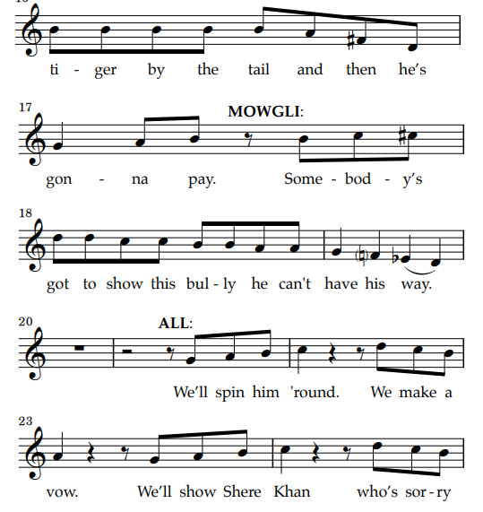

Slide 4
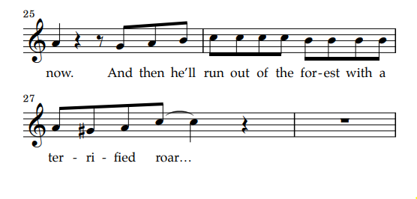
https://www.google.com/search?q=+jungle+book+kids+curtisville&client=avast-a-3&biw=1366&bih=625&tbm=vid&sxsrf=APwXEddL_fjo7Q-EeDRk1m5WXkfYKbBpWg%3A1687997103376&ei=r8qcZJbEFoudhbIPkJ-hiAY&ved=0ahUKEwjW1-mdl-f_AhWLTkEAHZBPCGEQ4dUDCA0&uact=5&oq=+jungle+book+kids+curtisville&gs_lcp=Cg1nd3Mtd2l6LXZpZGVvEANQAFgAYIQPaABwAHgAgAFdiAFdkgEBMZgBAKABAcABAQ&sclient=gws-wiz-video#fpstate=ive&vld=cid:3e1178b1,vid:C3IfliYnxuo

Slide 5
https://www.lrcstageproductions.com/jungle-book-kids-music.html

Slide 6
Scene 1 Mowgli and Bagheera
https://www.fourcornersdrama.com/practice.html#/
Evening Falls

Slide 7
Scene 2 Kaa 1 – 5 Mowgli and Bagheera
Kaa the snake
Trust in Me

Slide 8
By the ranks or single file Over every jungle mile Oh, we stamp and crush Through the underbrush In the military style! In the military style! Hup, two, three, four Keep it up, two, three, four
Colonel Hathi’s March
Hup, two, three, four Keep it up, two, three, four Hup, two, three, four Keep it up, two, three, four
Oh, the aim of our patrol Is a question rather droll For to march and drill Over field and hill Is a military goal! Is a military goal!
Hup, two, three, four Dress it up, two, three, four

Slide 9
Scene 3
Night into Day
Colonel Hathi’s March
Hathi Forgets

Slide 10
Scene 4
Baloo the Bear
The Bare Necessities

Slide 11
Scene 5
Monkey Business
King Loui Fanfare
I wanna be like you

Slide 12
Scene 6
Shere Khan

Slide 13
Scene 7
Bedtime
Mowgli Runs

Slide 14
Scene 8
Mowgli Runs
That’s what friends are for
That’s what friends are for Reprise
Baloo: Sshhhh!
Mowgli: What should I do?
Baloo: Come on everybody. Let’s put our heads together. We can stad up to Shere Khan and keep Mowgli here with us in the jungle.

Slide 15
Scene 9
The Bare Necessities (Finale)
I Wan'na Be Like You (Bows)

