Slide 1
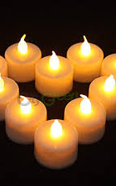
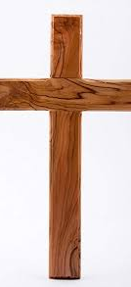
Come to us
Cross
Come to us, living Lord, teach us how to love you.
Bible
Come to us, word of God, teach us how to love you.
Candle
Come to us, light of Christ, teach us how to love you.

Slide 3
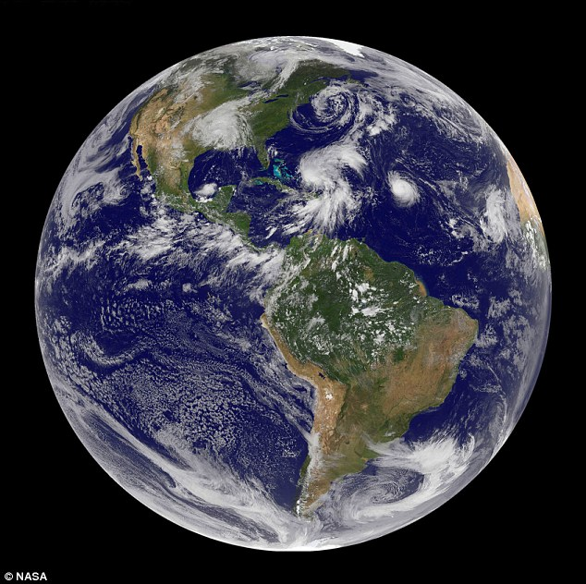
‘Our diverse planet’

Slide 4
What do Scientists do?
Asking questions
Observing
Looking for patterns
Setting up enquiries
Using equipment
Fair testing
Recording data, taking repeat measurements

Slide 5
Finding out about scientists
Reception, Year 1, Year 5 and Year 6 learnt about Donald Palmer
Year 2 learnt about Charlotte Armah
Year 3 and Year 4 learnt about Francis Crick

Slide 6
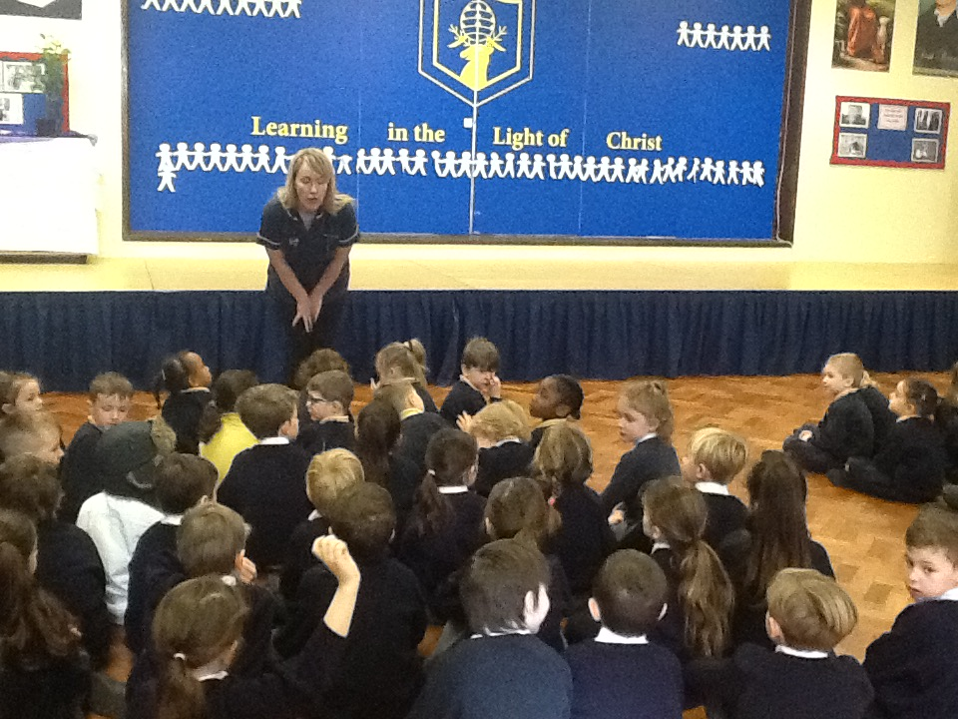
Meeting a scientist
Reception, Year 1 and Year 2 met Mrs Worrell who is a nurse.

Slide 7
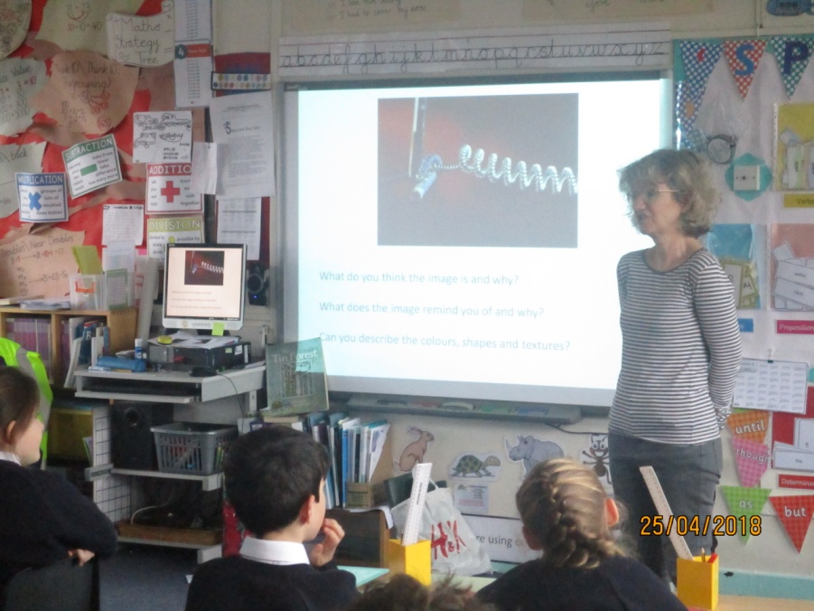
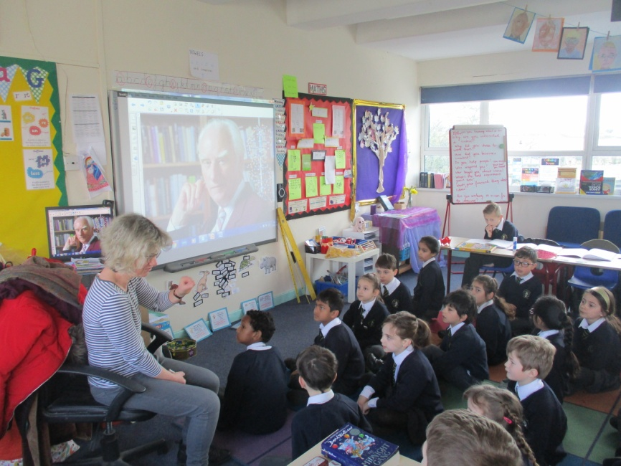
Meeting a scientist Year 3 and 4 met Vicky Dearing
Year 3 and Year 4 met

Slide 8
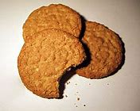
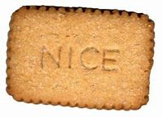
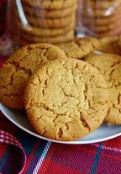
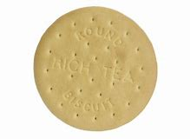
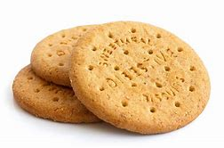
Can you recommend the best biscuit to dunk?
I’m tired of my biscuits dropping in my tea!
Can you recommend the best biscuit to dunk?

Slide 9
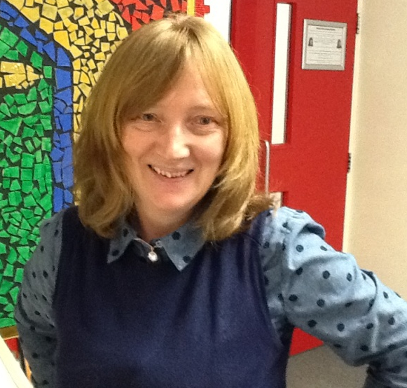
Hobnobs are the best!
I like dunking hobnobs!
Nice are the best!!
Ginger nuts are the best!!

Slide 10
Rich tea are the best!
Digestives
are the best!

Slide 11
Can you recommend the best biscuit to dunk?
I’m confused Pope Paul School please help !
Can you investigate and find out which biscuit is the best and why?

Slide 12
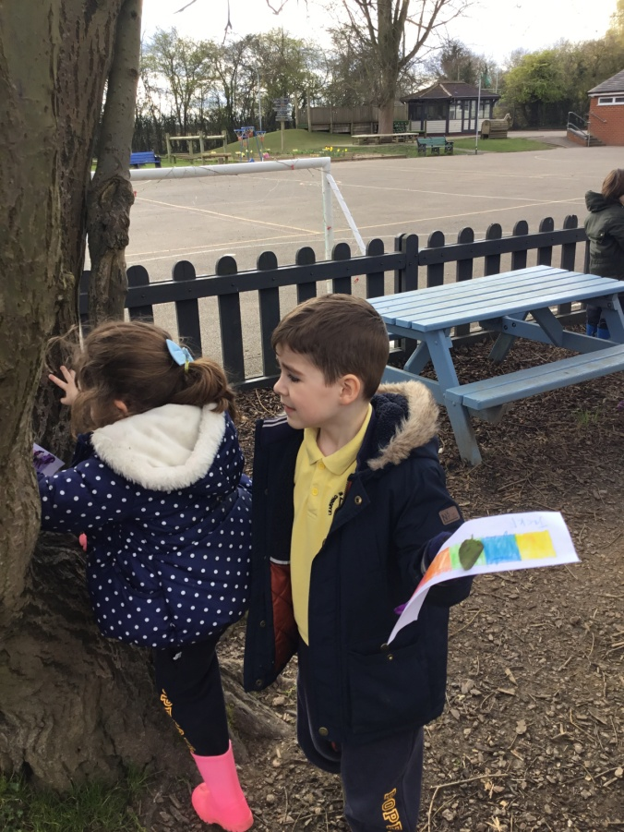
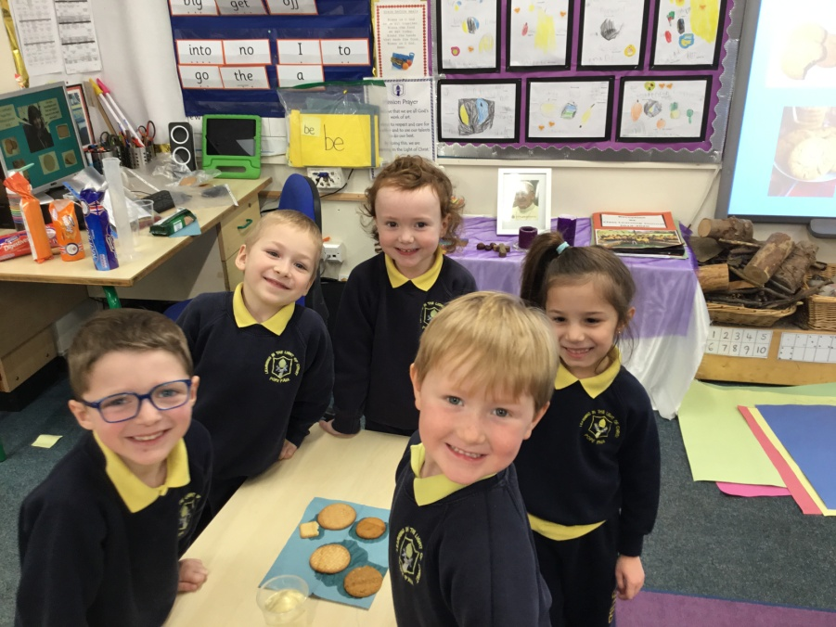
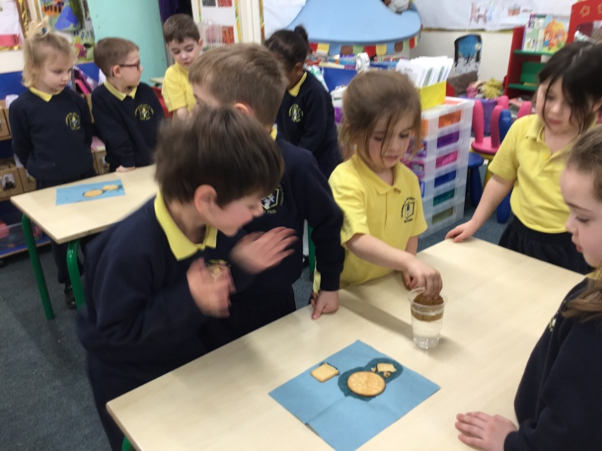
Reception Being scientists

Slide 13
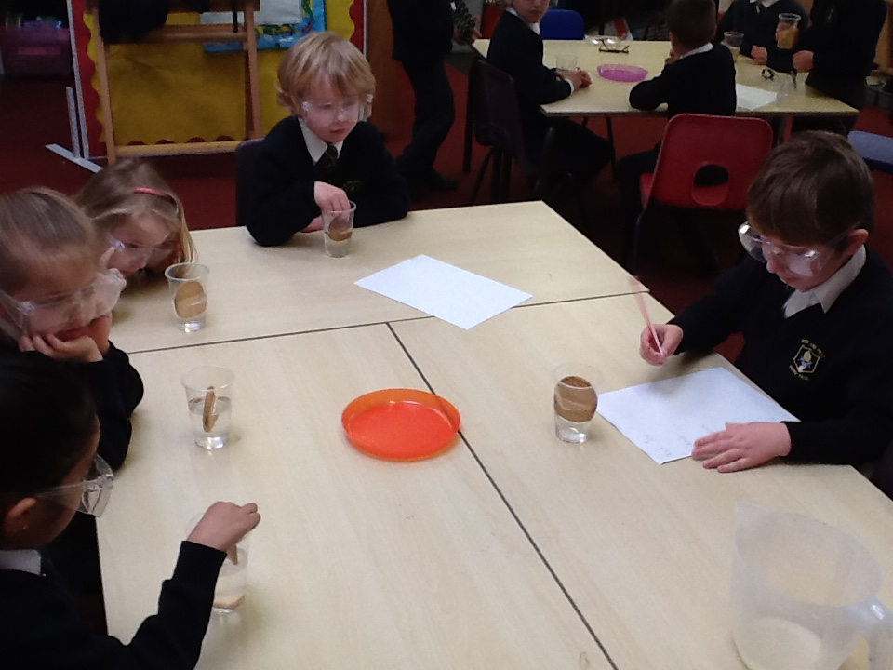
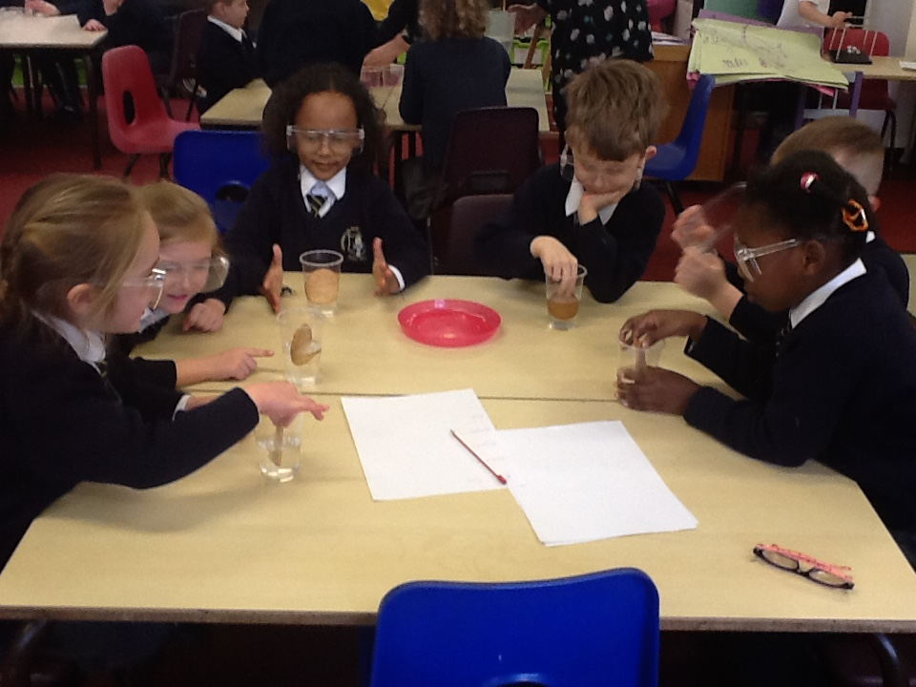
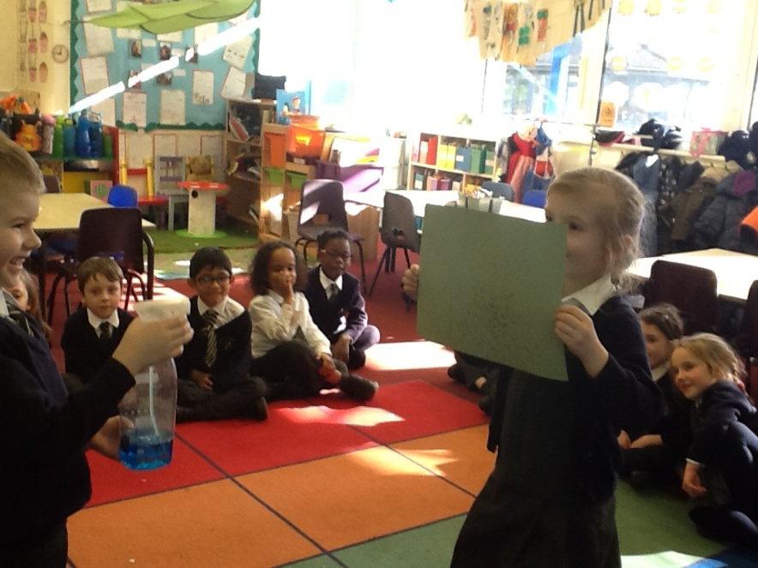
Year 1 Being scientists

Slide 14
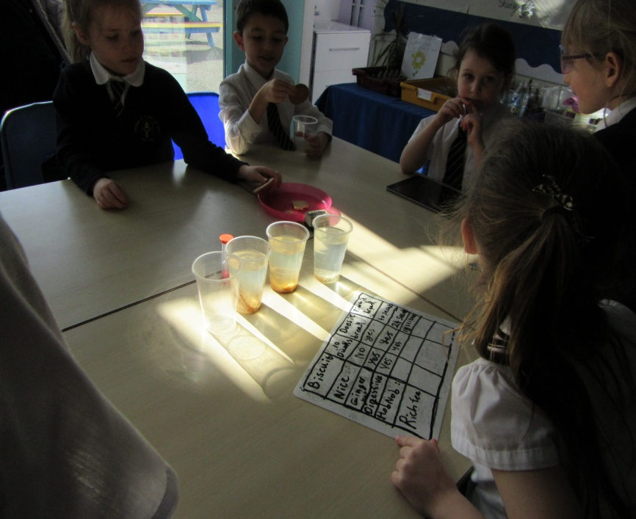
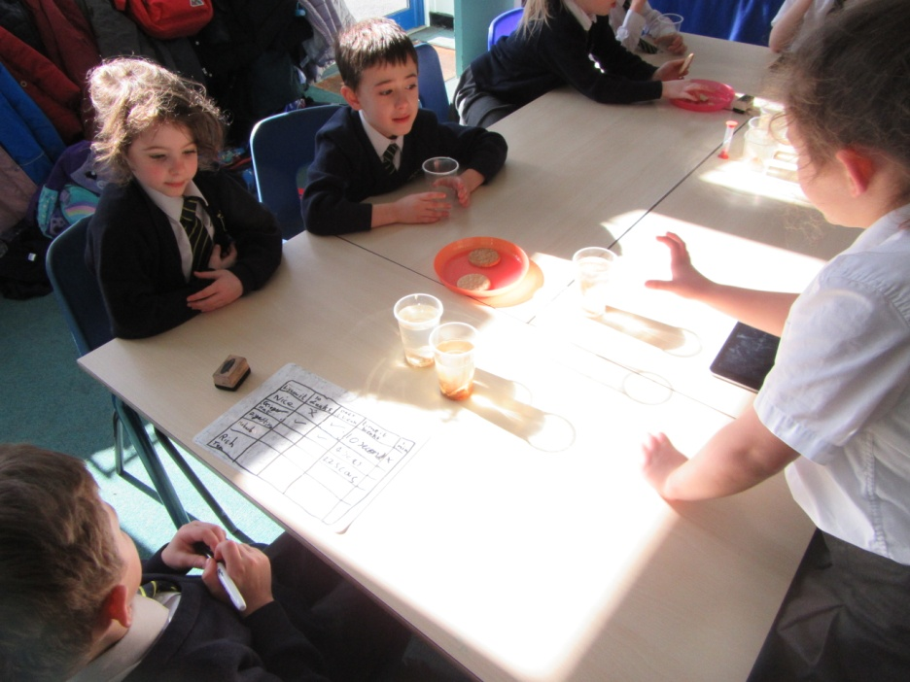
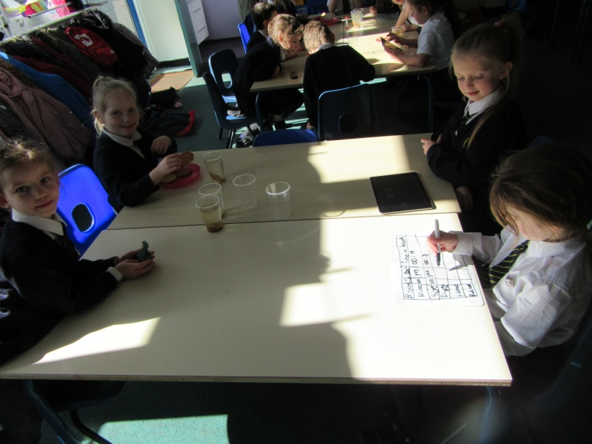
Year 2 Being scientists

Slide 15
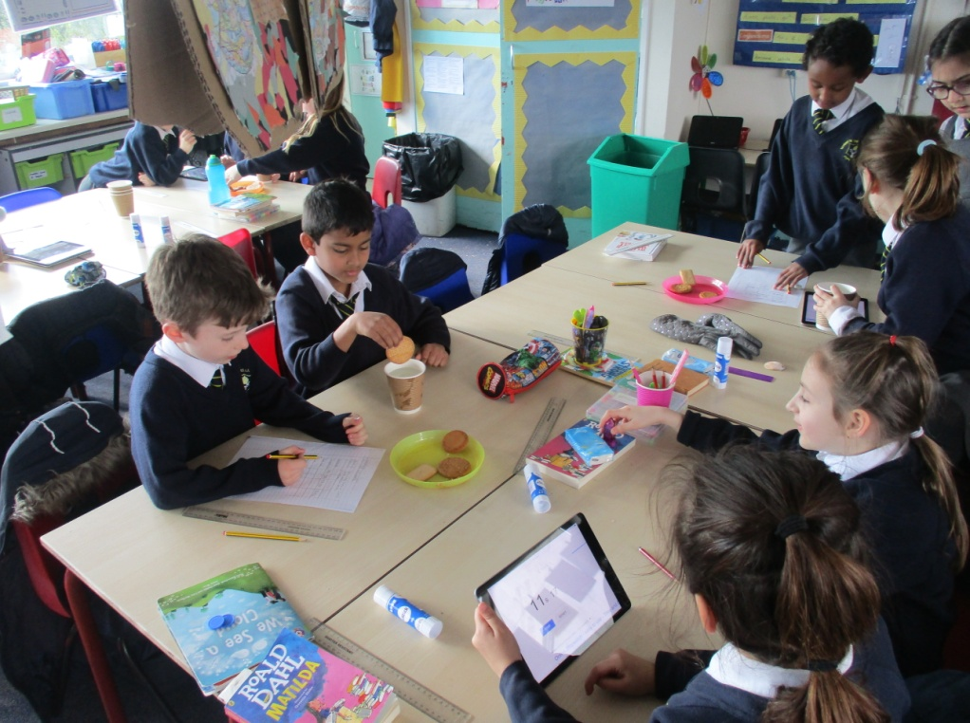
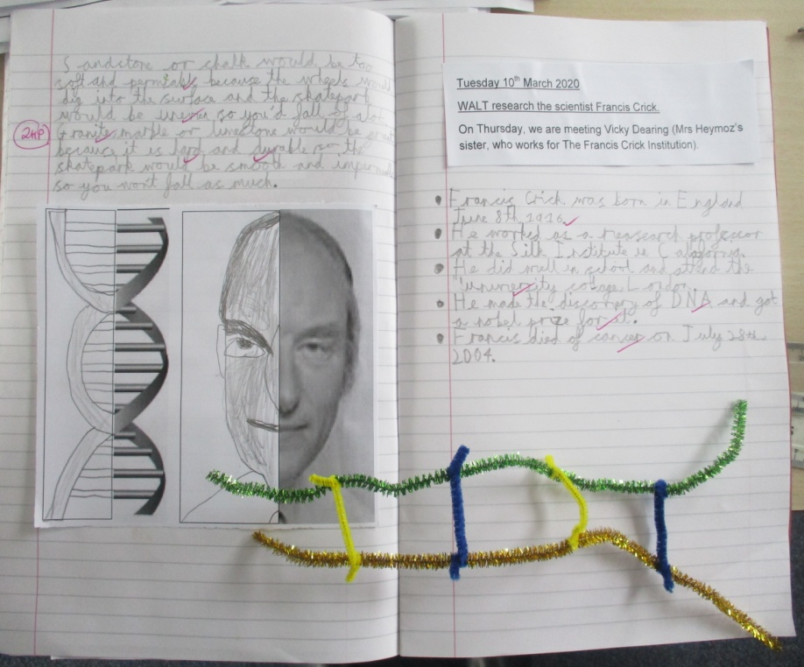
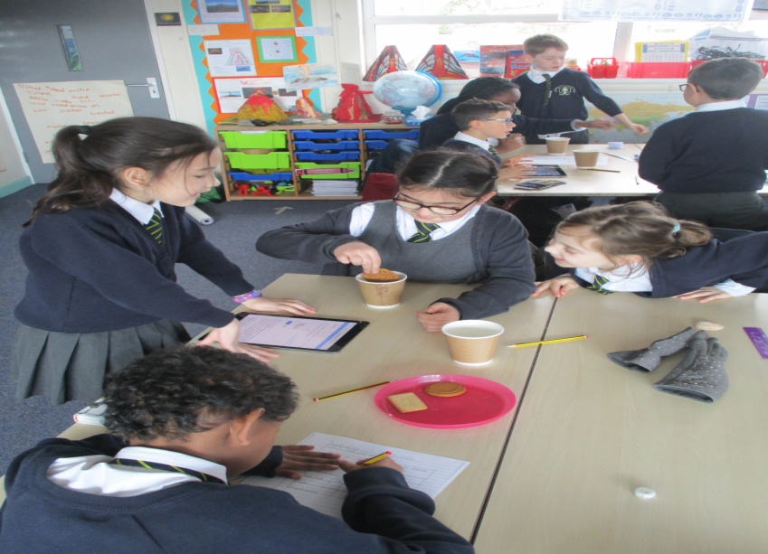
Year 3 Being scientists

Slide 16
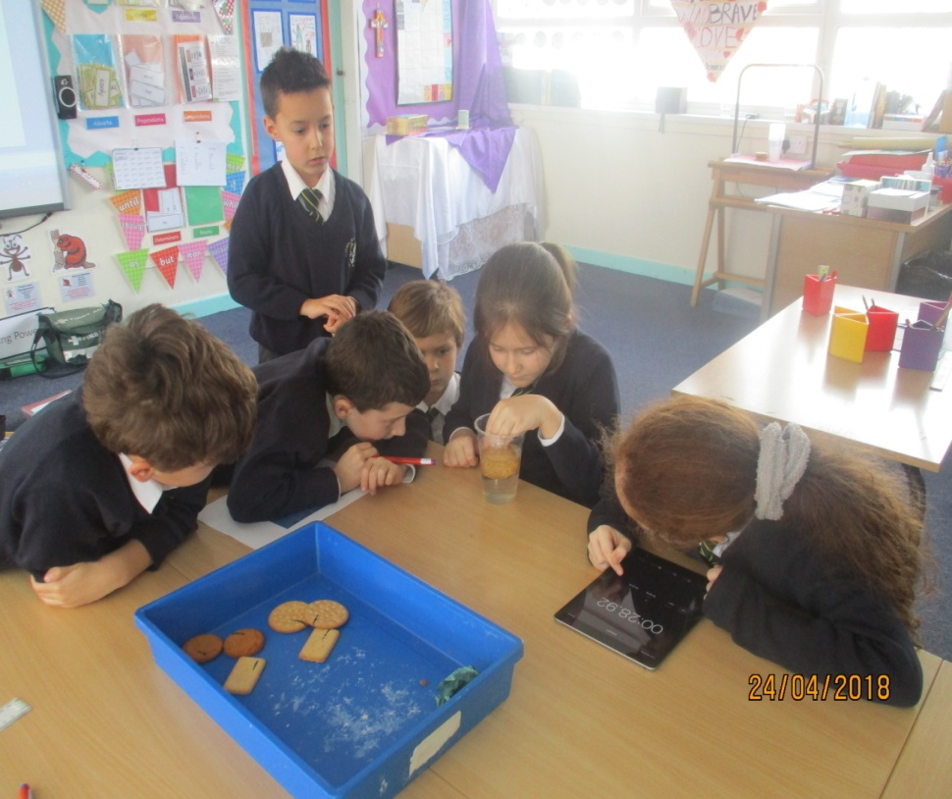
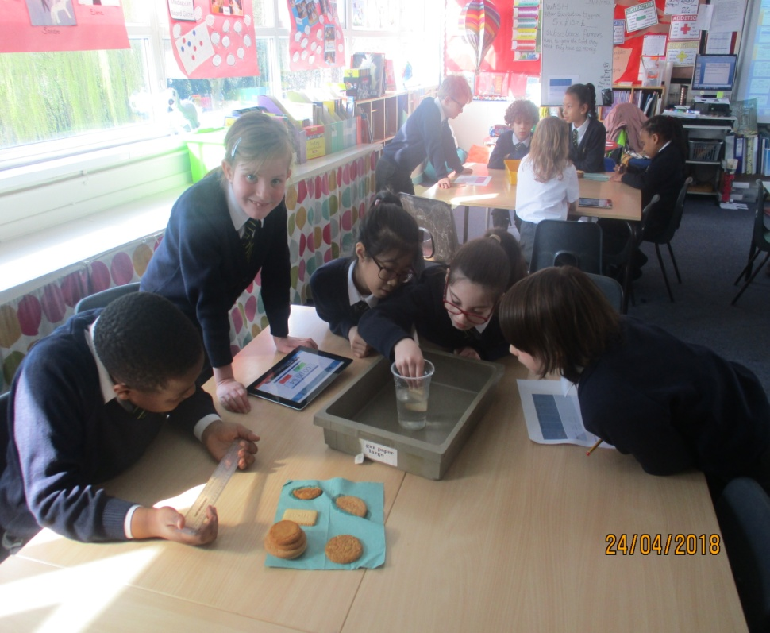
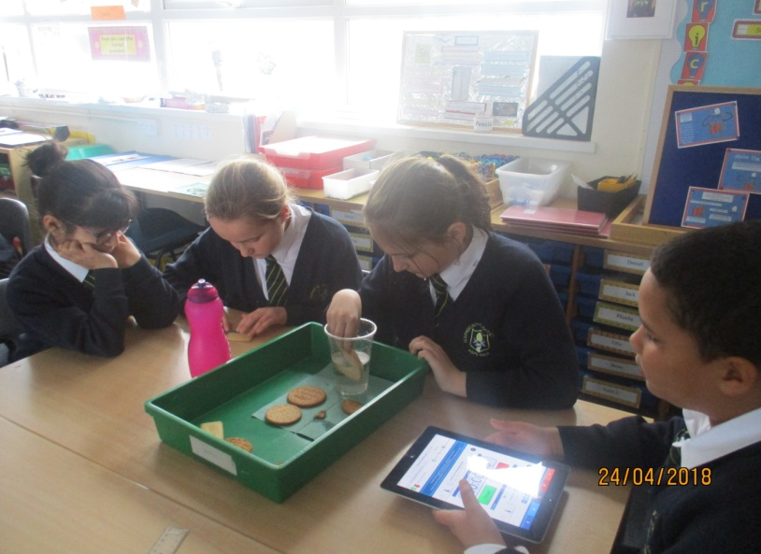
Year 4 Being scientists

Slide 17
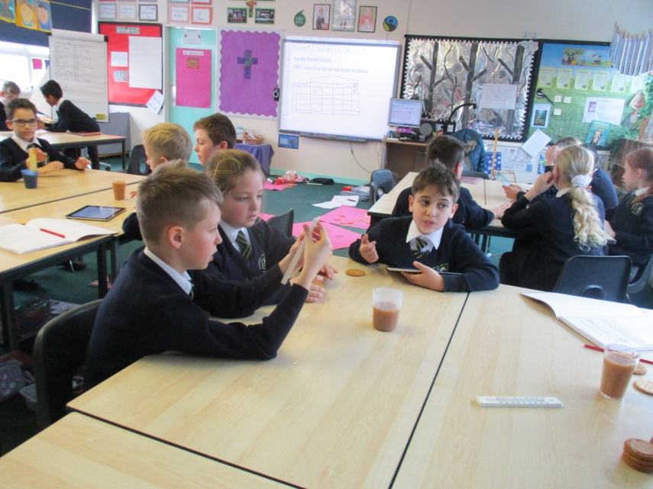
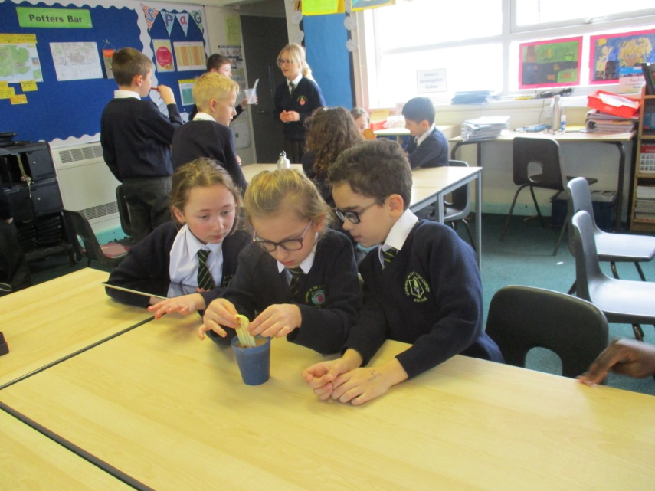
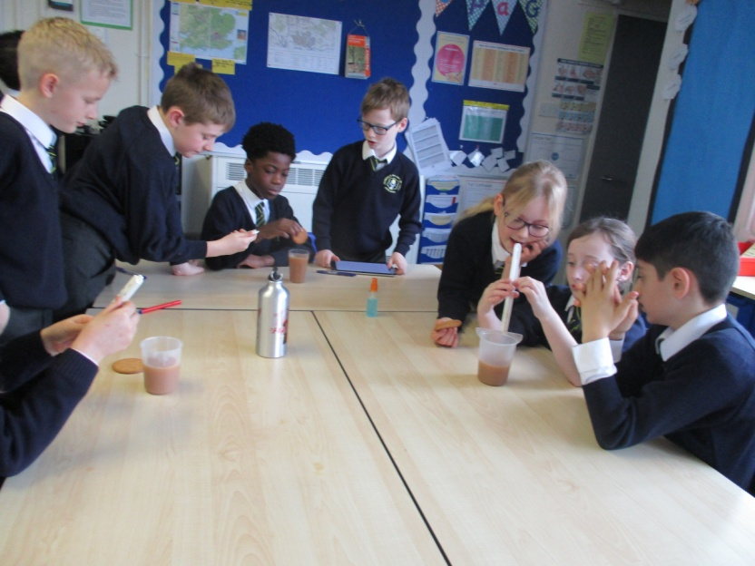
Year 5 Being scientists

Slide 18
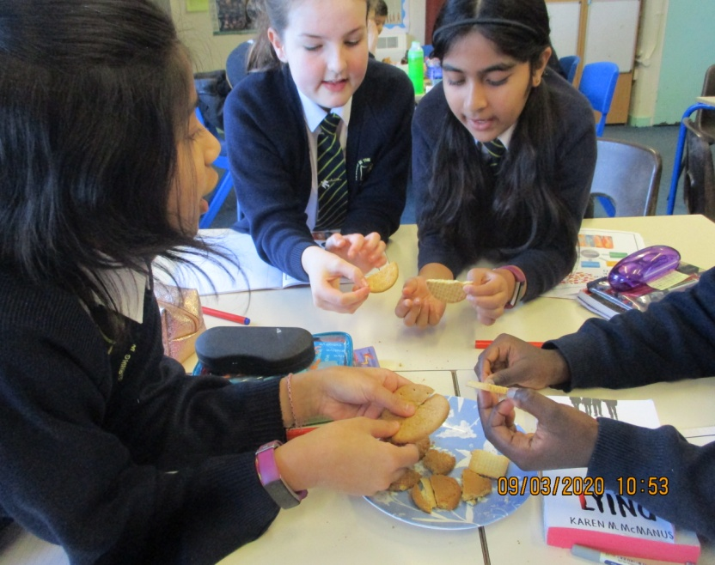
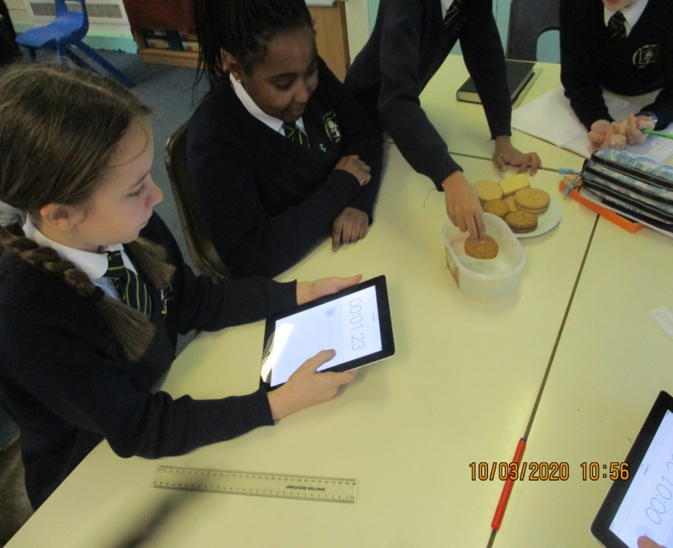
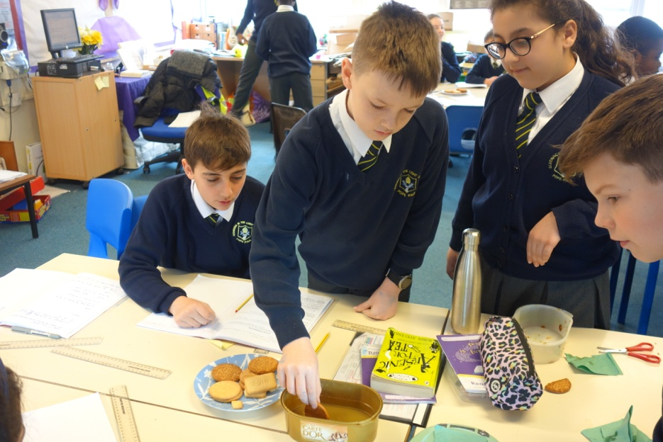
Year 6 Being scientists

Slide 19
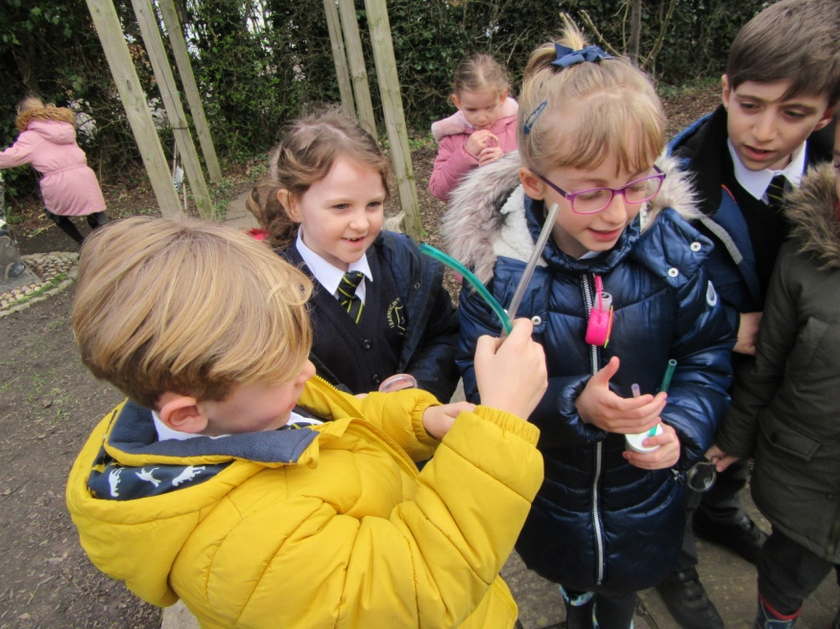
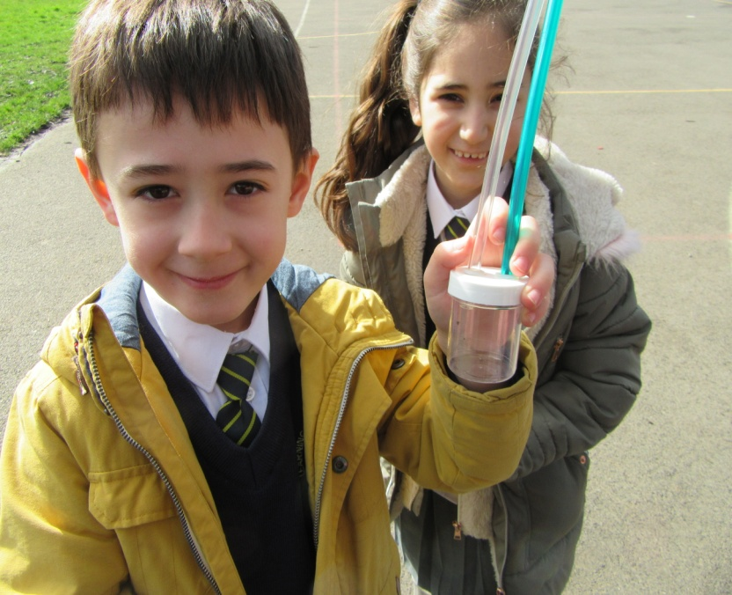
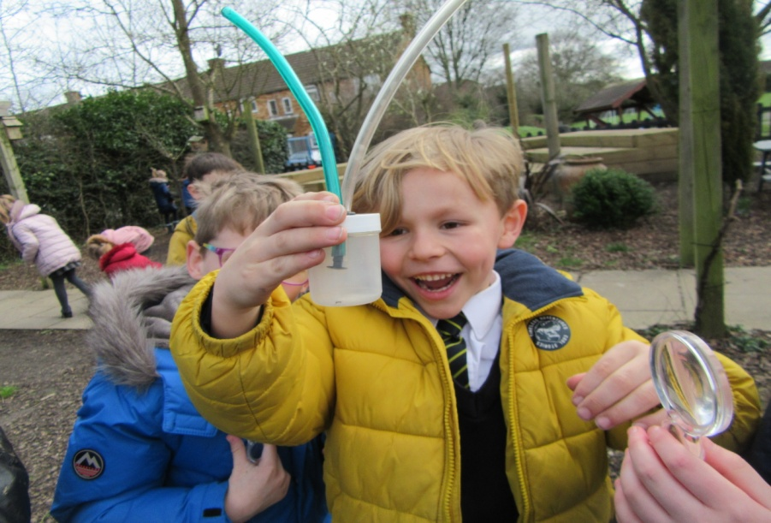
Outdoor Learning Year 2

Slide 20
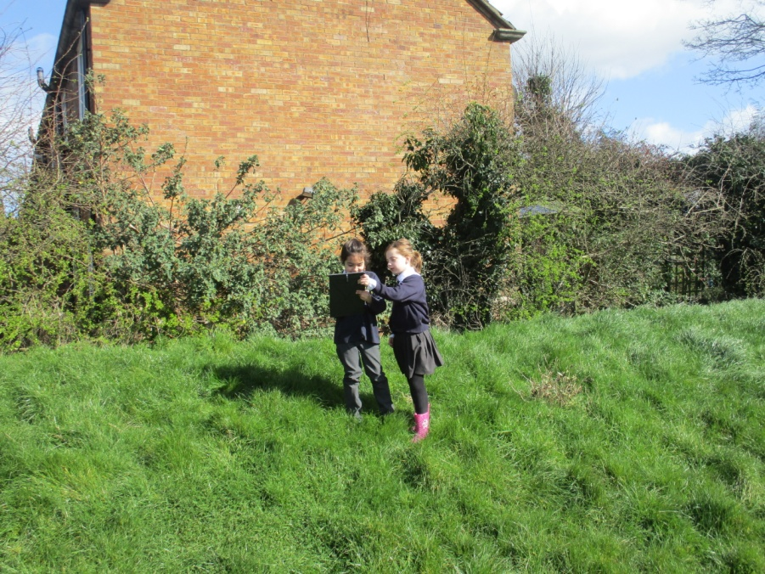
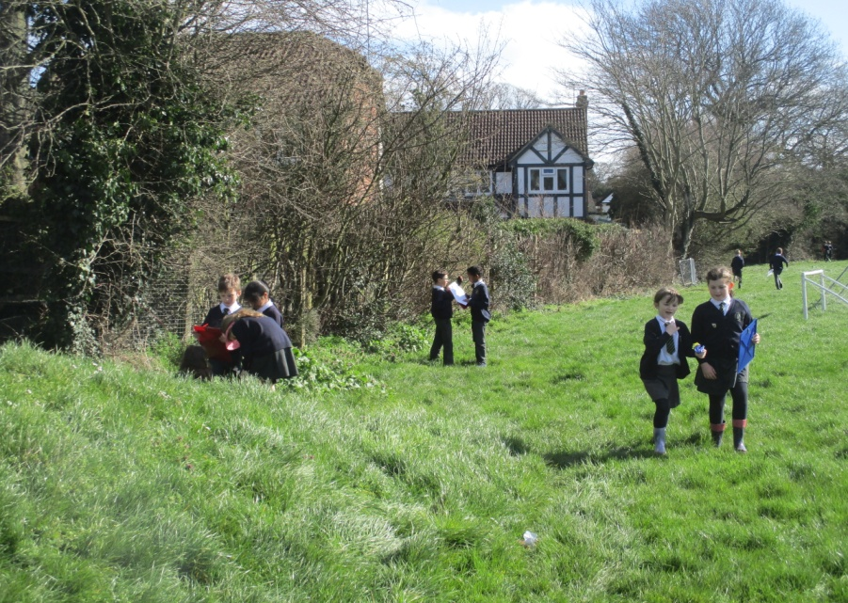
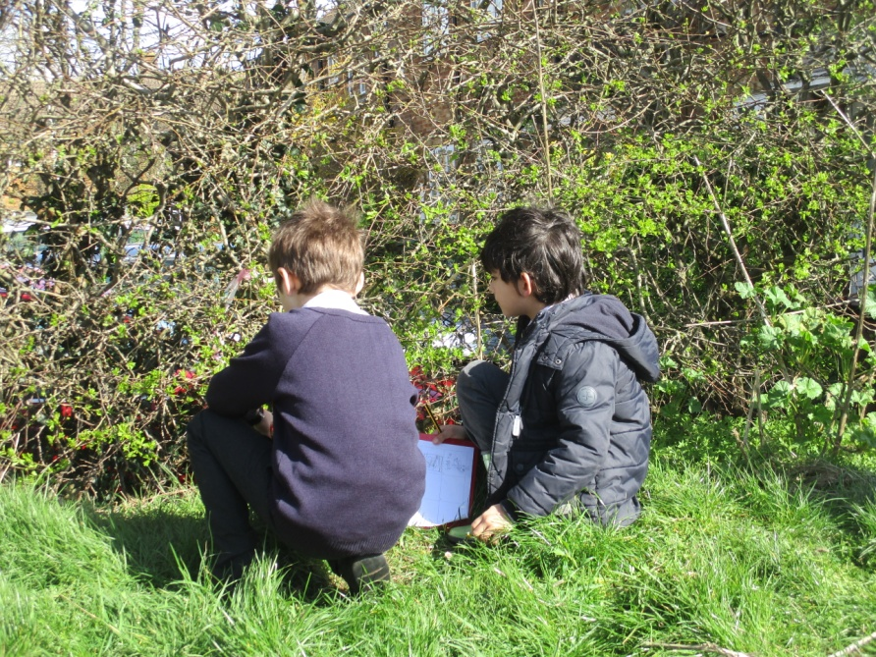
Year 3

Slide 21
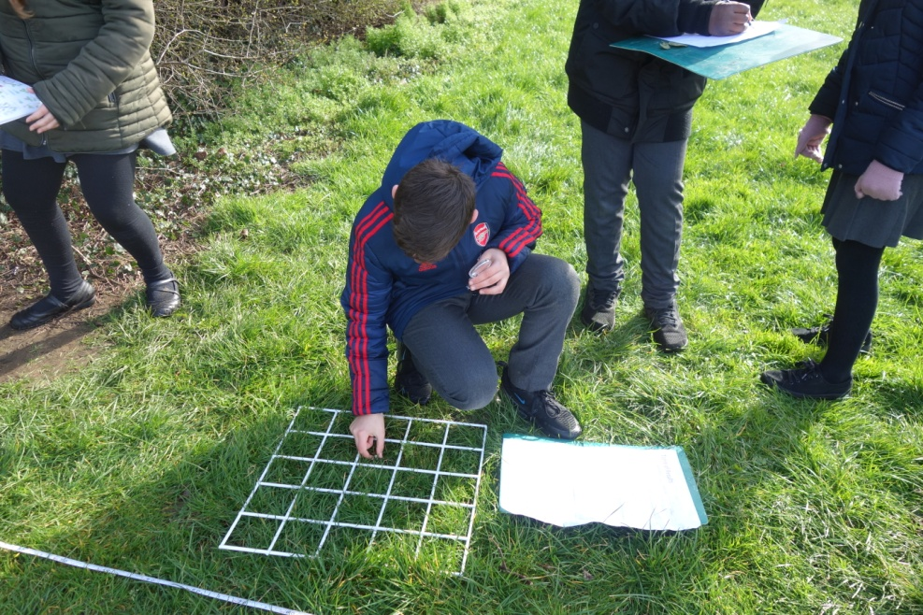
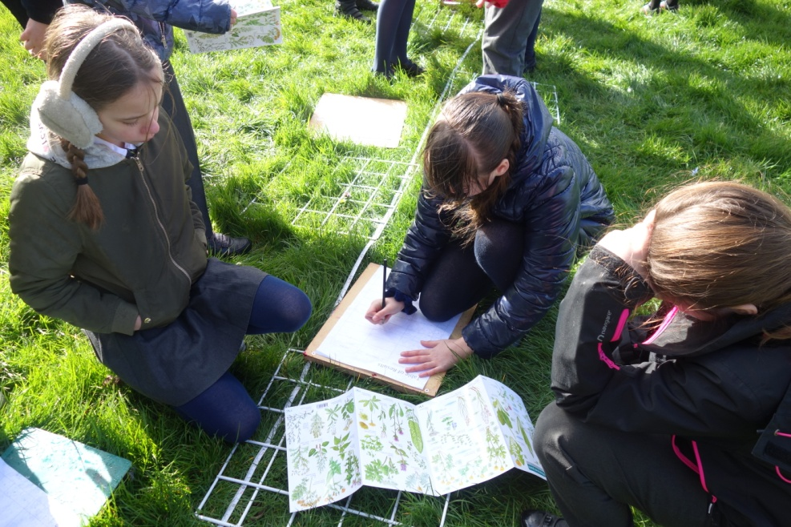
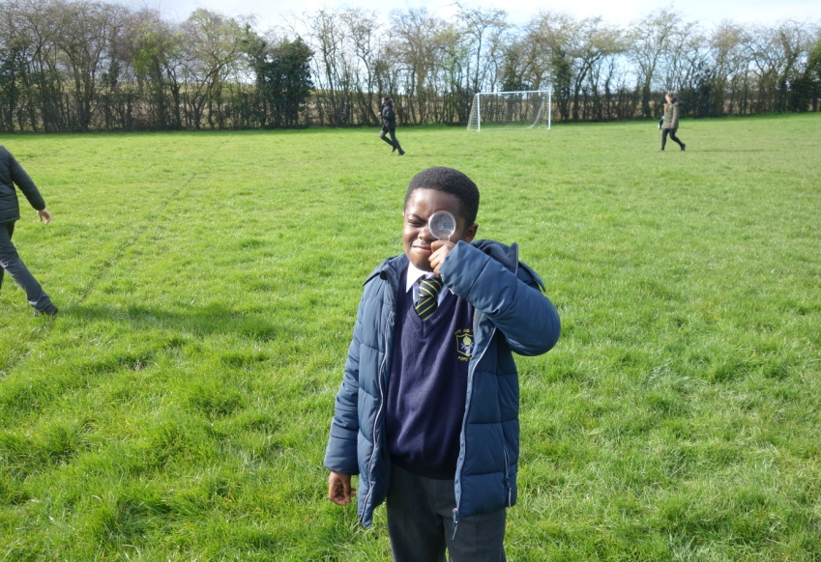
Year 6

