Slide 1
Think 100
13.10.2020

Slide 2
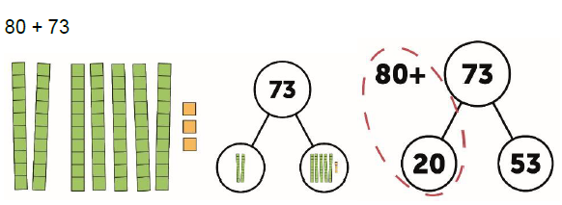
Re-grouping to form number bonds to 100

Slide 3
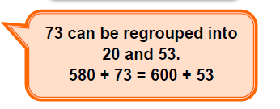
Application and sentence frames

