Slide 1
Build up paragraph
14.10.2020

Slide 2
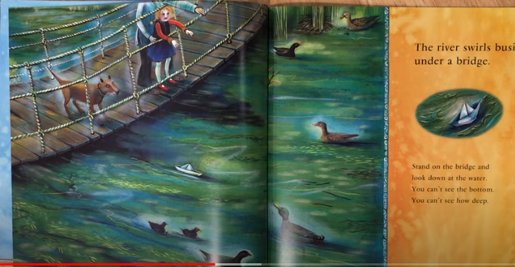
Second stage

Slide 3
My model
My water turned sapphire blue and emerald green as I slowly curved round from the field and headed towards a rickety wooden bridge. Small feet of ducks tickled my waves and the long strands of weed, like the hair of a water princess, covered my surface.
To my surprise, a sweet girl appeared on the bridge with her Mum. She was holding a precious looking paper boat in her hand and she didn’t seem to want to let go of it. Curious and brave, I splashed a bit to encourage her to send the boat to me.
“Come little girl, come. Let me know your secret”, I whispered not to frighten her.
Why was the boat so important to her?

