Slide 1
Welcome Back to Pope paul School Year 1 class of 2020
Since you left we have made some changes to make sure that the pupils and adults in our school can be kept safe.

Slide 2
WHAT WILL SCHOOL BE LIKE?
When you return to school in September some may things look the same but lots may also look different.
We’ve made these changes to make sure all the pupils and staff at our school can stay safe.
Here are some of the things that will be different…

Slide 3
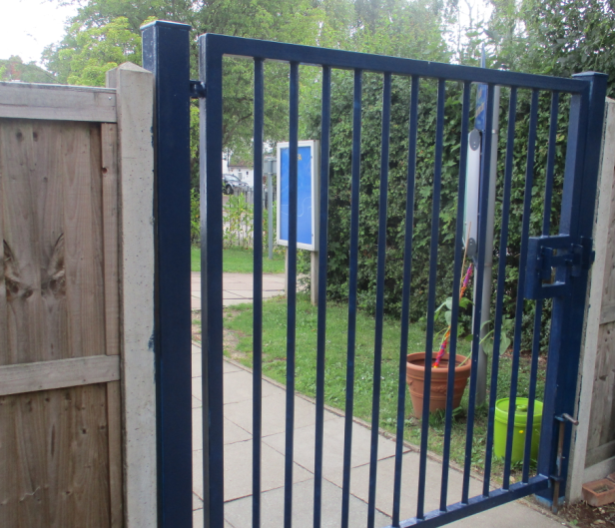
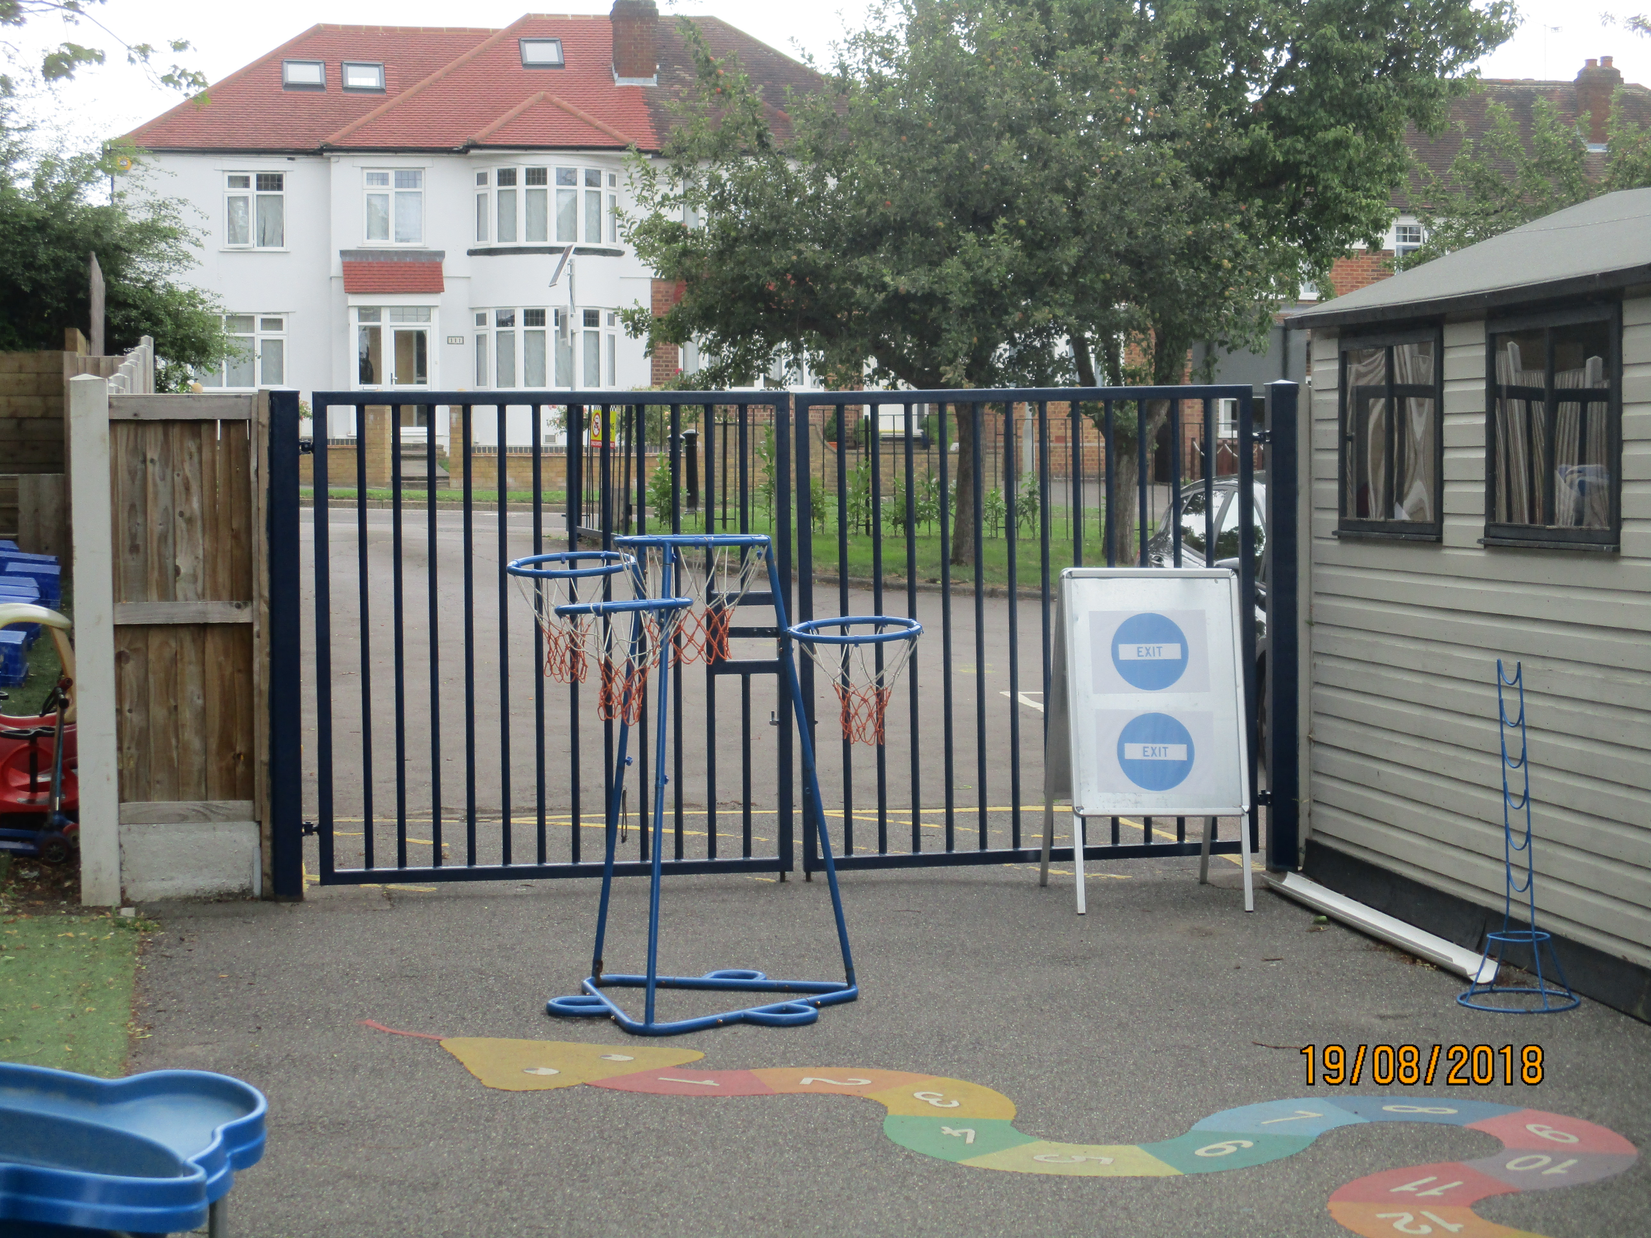
There will be a one way system for entering our school and for leaving our school.
The way IN will be through the side gate along Great Slades…
The way OUT will be through the gate by the Reception Classroom...
Don’t worry – staff will be there to help you and your parents and carers know which way to go!

Slide 4
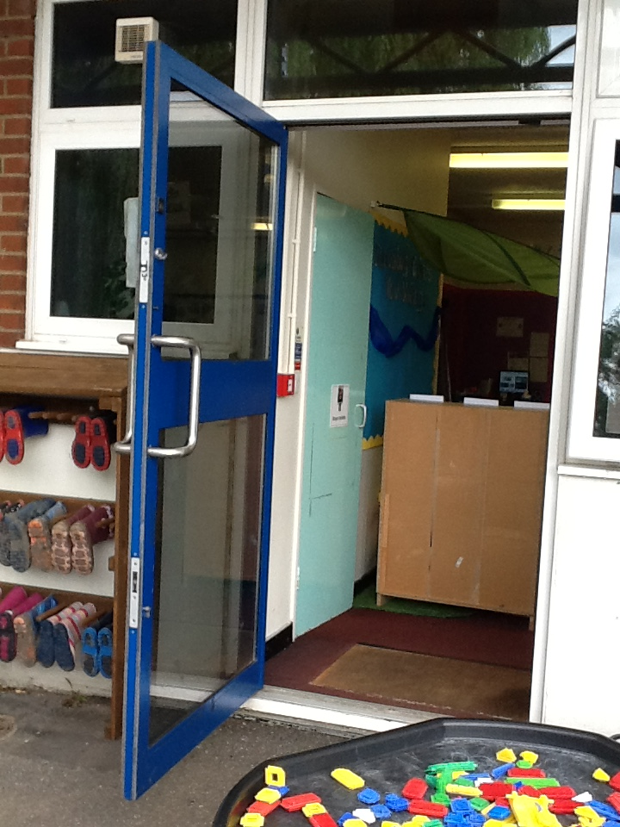
Our classroom

Slide 5
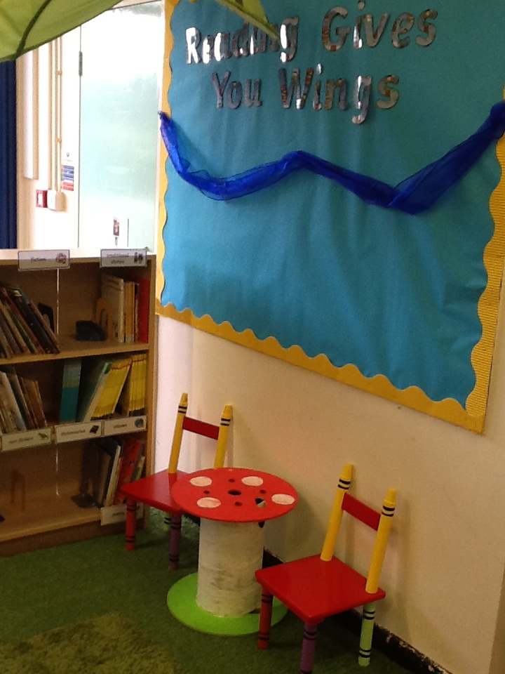
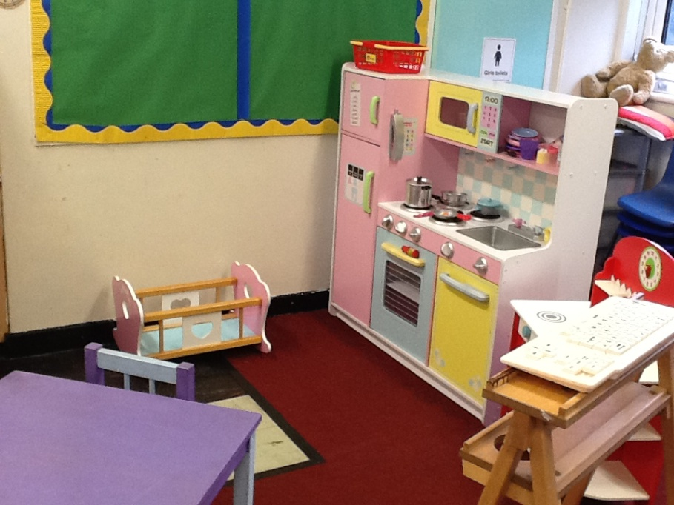
Our classroom

Slide 6
Our playground zones
Our playground have been split into zones.
My teacher or learning support assistant will let me know which zone I can play in at break time and lunchtime.
By staying in my zone, it will help us all to stay safe.

Slide 7
Our playground zones
By staying in my zone, it will help us all to stay safe.
Certain playground equipment will not be available to use

Slide 8
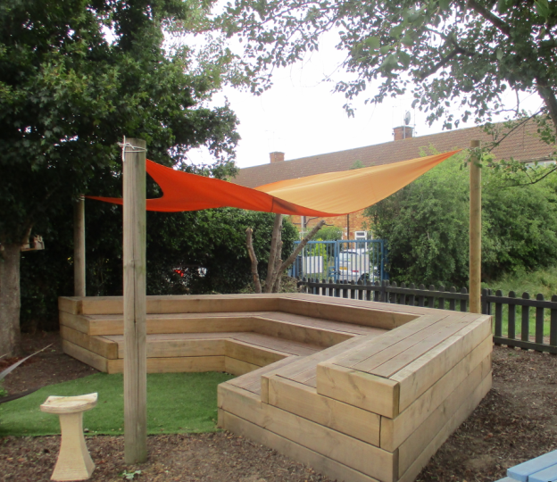
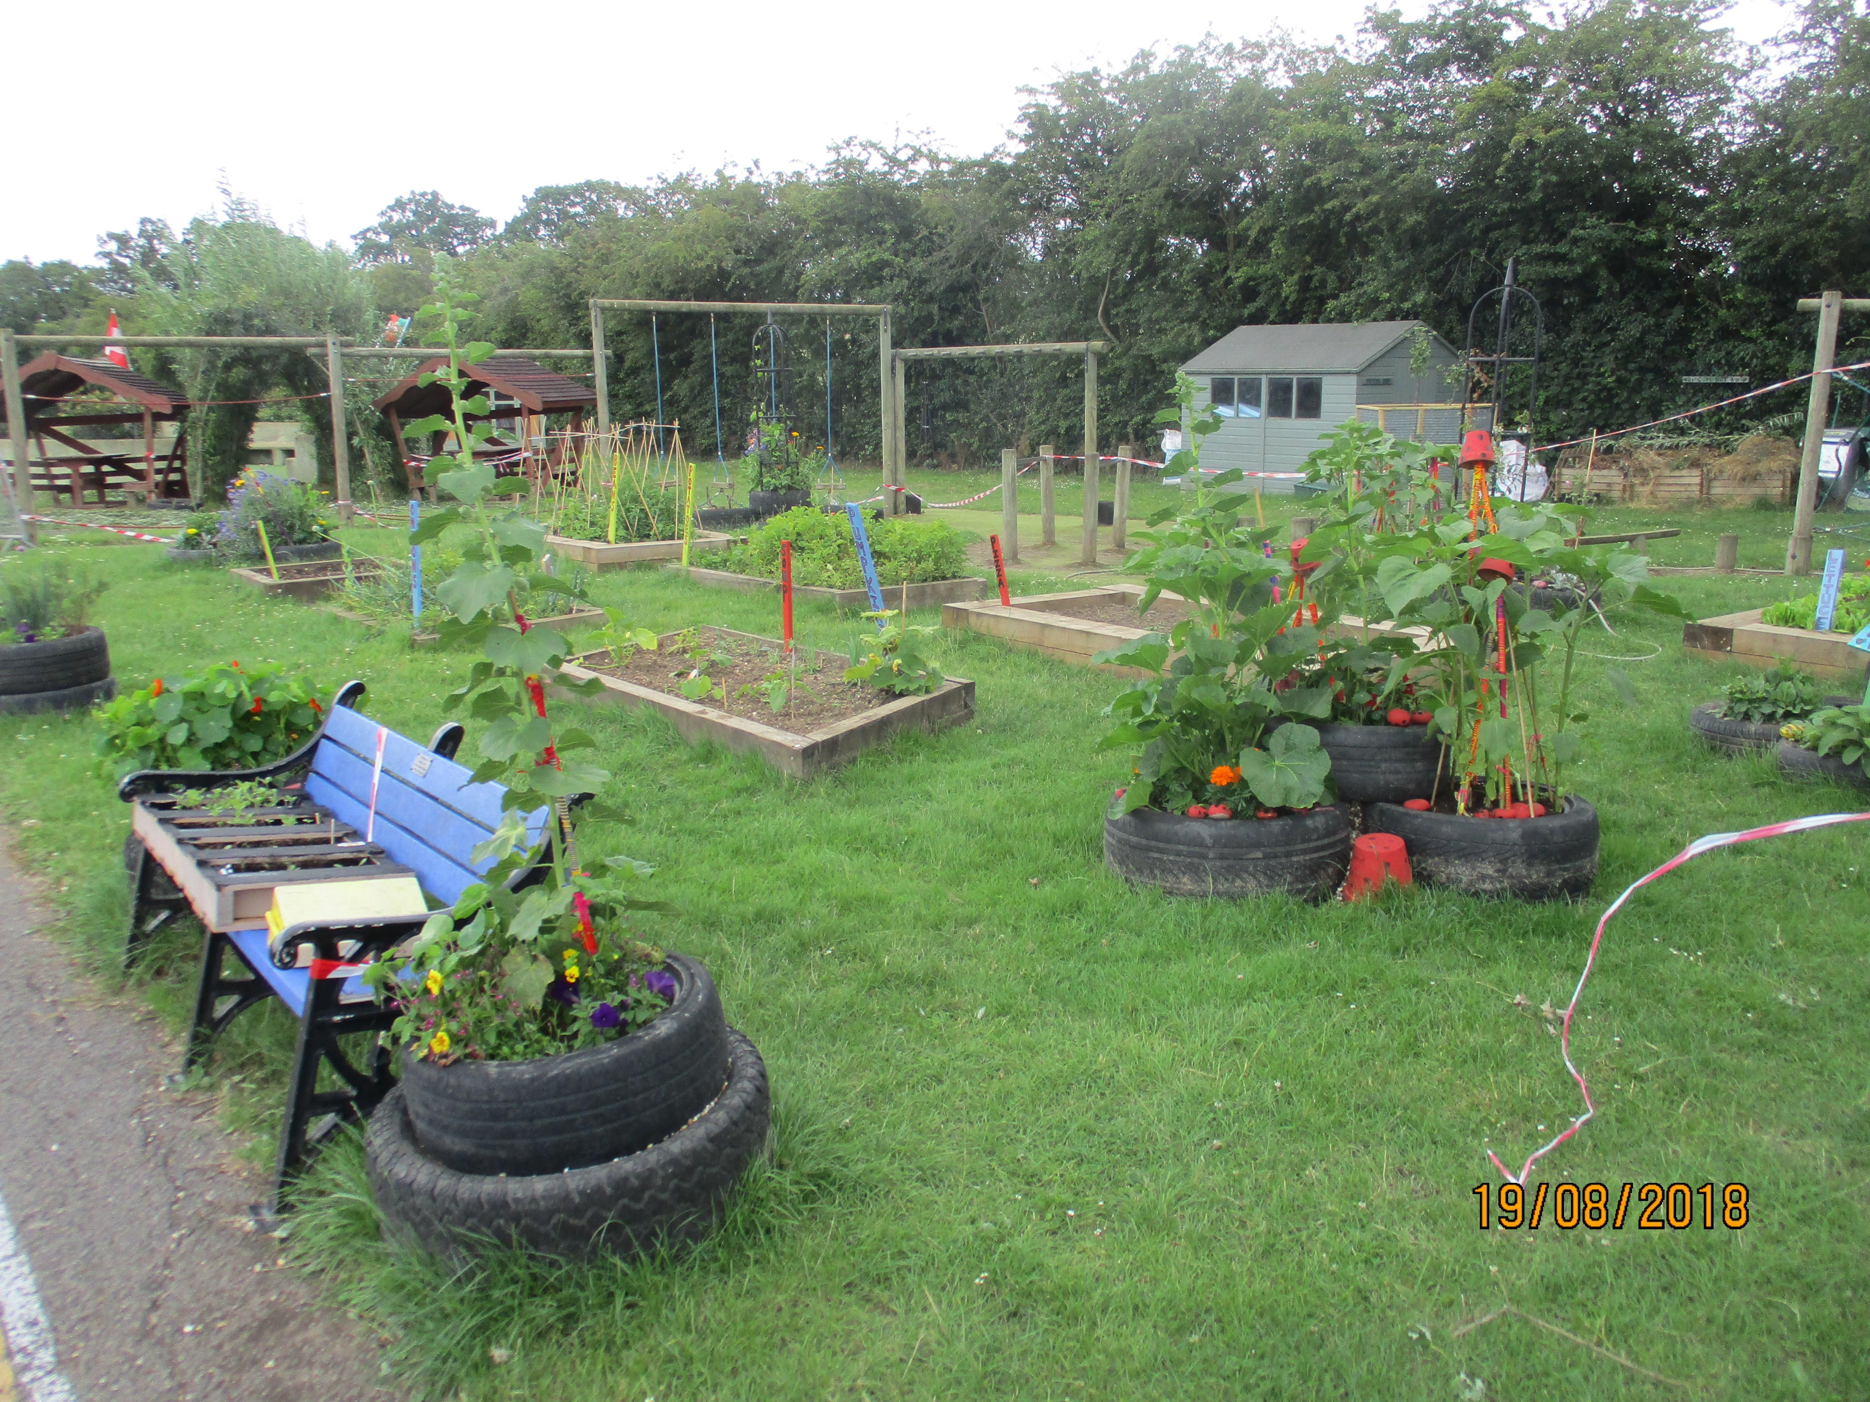
These areas have been updated and most of them will be available for you to use

Slide 9
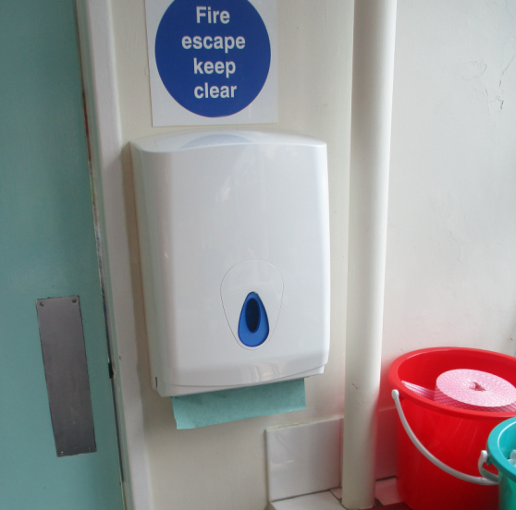
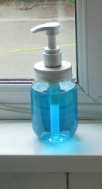
You will be expected to wash your hands throughout the day. This will help stop any germs from spreading.

Slide 10
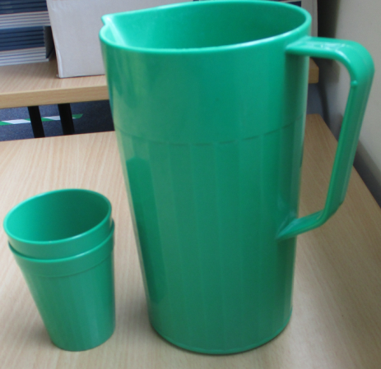
You will need to remember your water bottle everyday as the water fountains will not be in use. Additional water will be provided by Mrs carey throughout the day. Please do not buy big school bags. The children can use the book bags from reception.

Slide 11
Moving around our school
This will help us to keep a safe distance from each other.
Our class will move differently around the school.
Listen carefully to the adults in our class and look out for our helpful notices.

Slide 12
So there have been lots of changes since you were last here but there are also lots of things that will be the same – you will be seeing all your friends and lovely teachers again!
We’re really looking forward to seeing you all again and a polite reminder to our lovely parents and carers to also please maintain safe distances when dropping off and collecting your child.

Slide 13
WE are looking forward to seeing you!

