Slide 1
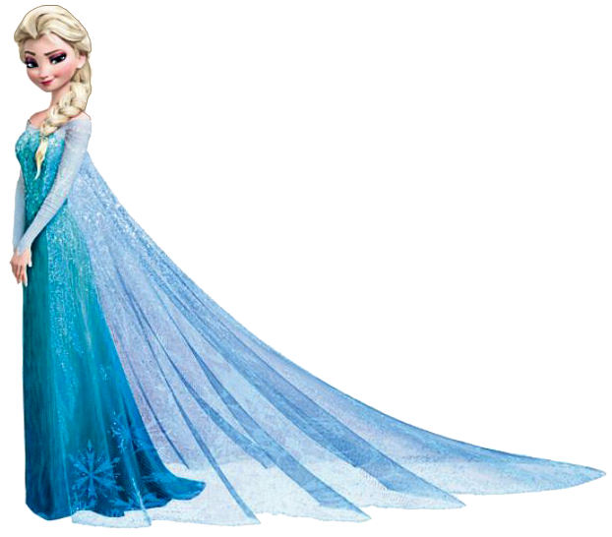
Virtual Sports Week: Olympics Edition
Monday 29TH June to Friday 3RD July
Monday 29th | Tuesday 30th | Wednesday 1st | Thursday 2nd | Friday 3rd
Standing Long Jump | Speed Bounce | Vertical Wall Jump | Target Throw | Shuttle Runs
Science | English | DT | Geography | Art
Thursday is our FANCY DRESS day! Do your activity in fancy dress and then email your teacher a photo if possible.

Slide 2
Virtual Sports Week: Olympics Edition
Welcome to the Pope Paul Olympics! Like many things this year, the Olympics has unfortunately been postponed due to the coronavirus. This, however, is not going to stop us having our very own Olympic games celebration!
Have a look at the timetable to see what we have planned and then follow the information on each slide. Each day will be made up one of a PE activity and also another subject task to complete!
This time, you are in your class teams and you will be competing against the other classes in your school. Each class has also been allocated a country that they are going to represent. Please see the next slide to see which country your class is representing.
On Thursday we are going to do a special fancy dress day! If you wear fancy dress while doing your challenge please email us a photo to show us.
Please send your scores to your teachers by Friday 3rd July. If you have any questions, please contact your class teacher.

Slide 3
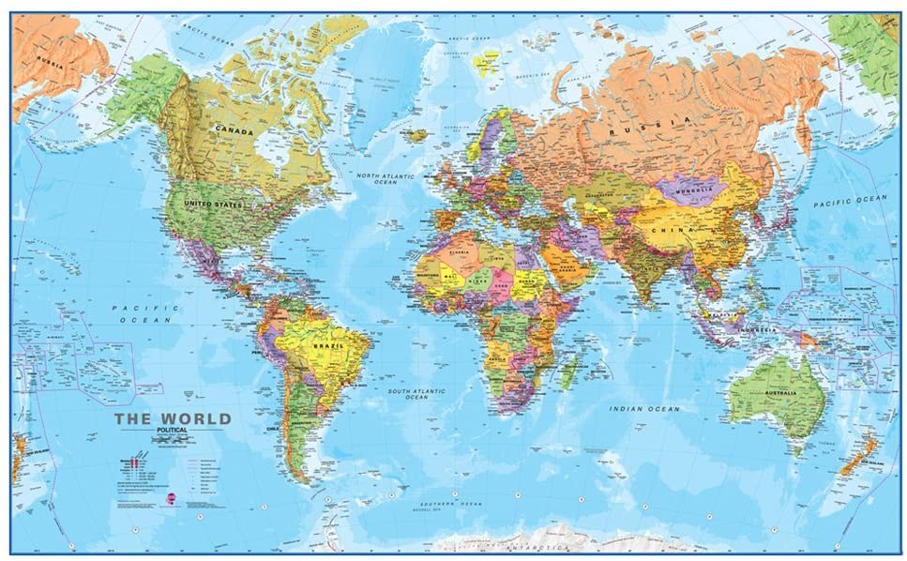
Who is who?
Reception = Japan
Y1= Peru
Y2= Bahamas
Y3= Cameroon
Y4= Finland
Y5= Samoa
Y6= Indonesia

Slide 4
This Week’s Timetable
Monday 29th
PE Activity: Standing Long Jump
Science:
Healthy Eating Plan
Tuesday 30th
PE Activity:
Speed bounce
English:
Olympic Rules
Wednesday 1st
PE Activity:
Vertical Wall Jump
DT:
Olympic flag and medal
Thursday 2nd
PE Activity:
Target Throw Challenge
Geography:
Your Country Factfile
Friday 3rd
PE Activity:
Shuttle Run Challenge
Art:
Olympic Kit Design
Fancy Dress!

Slide 5
Making It Fair and Extra Points
To make our Olympic games fair and inclusive here is how we are going to score the activities;
We are going to take the top 10 scores from each KS2 class and combine Reception and KS1 scores.
We would like the children to do all the activities. We don't want to keep choosing the same child's score each day. We will take a maximum of two high scores per child and then we will start choosing others children's scores from the class. The aim is to have as many different children from their Team contributing as much as possible.
Extra Points will be awarded If you email us a picture of you completing the non PE activity task.

Slide 6
Monday 29th
PE Activity: Standing Long Jump
Equipment: Measuring Tape
Record your score and email your class teacher.
95cm = 95 points / 1m 5cm = 105 points.
Science Activity
Can you make a healthy meal or smoothie with your family. What ingredients are in it? Why are these ingredients healthy? Did you enjoy it? Please send a photo of your meal to your teacher.

Slide 7
Tuesday 30th
PE Activity: Speed bounce.
Mark a line on the floor or find something to jump over. How many jumps can you do in one minute? Try to keep your feet together.
Each bounce is a point.
English Activity
Have a go at writing a set of rules for the Olympics. If you were to plan an Olympic games, what do you think the rules should be? Can you think of what the most important rules are and have them higher up your list? You can just say them if you like.
Watch this video on the Olympic values to give you ideas https://youtu.be/9DP6DViFmOk

Slide 8
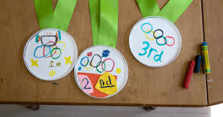
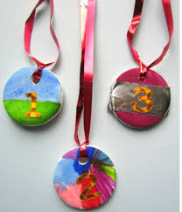
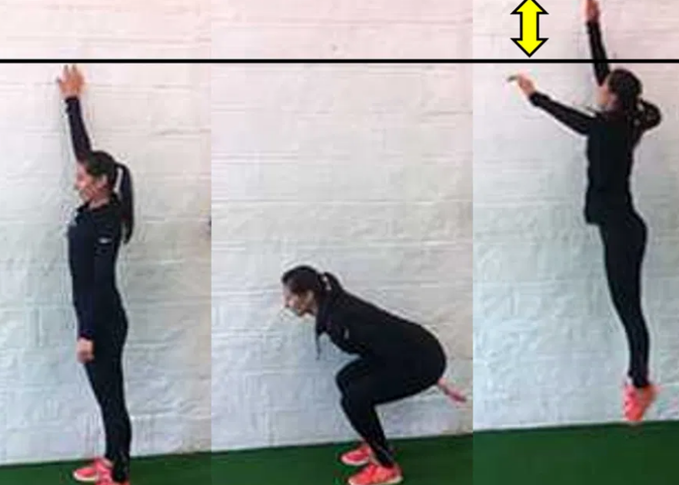
Wednesday1st
PE Activity: Vertical Wall Jump
Equipment: Measuring Tape and chalk to mark how high you can reach standing still and when jumping. Measure the difference between the 2 jumps and that will be your score.
Design Technology Activity
Using items from around your home or in school, can you design and create your own Olympic medal? E.g.

Slide 9
REMEMBER TO RECORD YOUR SCORES!!
Please remember to email your teacher with your results.

Slide 10
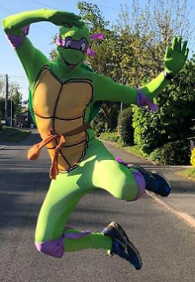
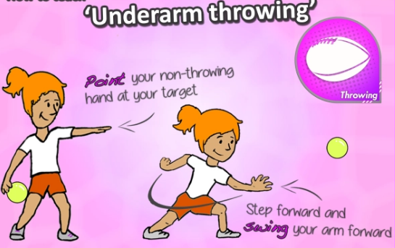
Thursday 2nd
PE Activity: Target Throw
Set up a target challenge, where you are 4 large steps away from a bin, basket or pot. How many can you get into the target in one minute?
Geography Activity
Research information about your country and create a fact file/leaflet/poster about that country.
You could include:
The country's population
The language they speak
Its currency
Its climate
Its flag
Its capital city
The country's most successful or famous Olympian
What continent the country belongs to
FANCY DRESS DAY!!! Wear any fancy dress to complete this challenge! Can you encourage your family to join in as well?

Slide 11
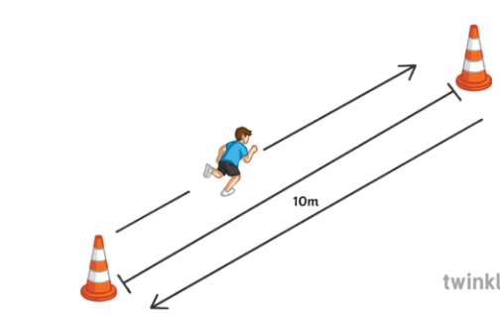
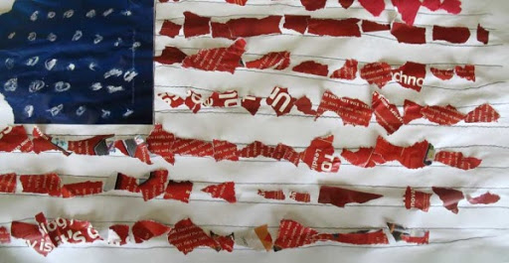
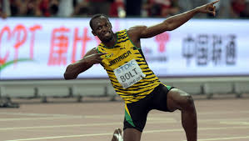
Friday 3rd
PE Activity
Equipment: Measuring tape, two objects 10m or large steps apart and a stopwatch/timer.
Each time you run to a cone it counts as one point.
Art Activity
EYFS/KS1: Using items from around your house or in school can you make a collage/paint/colour of your country’s flag?
KS2: Design and colour/paint your own kit that an Olympian from your team will wear. Look at your
country’s flag for inspiration and colours.

