Slide 1


Slide 2

This week, we are looking at words ending in –ible. It is often easy to confuse the spelling of words that end in –ible and –able.
But as always,
there are exceptions to the rules.
In general, -ible words don’t usually have an identifiable English root word before –ible is
added, e.g.
horr
+
ible
not an identifiable English root word

Slide 3
In the next ten minutes, can you sort the –ible words into two groups?
horr + ible
response + ible = responsible
poss + ible
Doesn’t have a identifiable English word before the
–ible ending.
Does have an identifiable English word before the
–ible ending.
force + ible = forcible
sense + ible = sensible
reverse + ible = reversible
vis + ible
Time’s up!
terr + ible
start
incred + ible
leg + ible

Slide 4
Look at the words in this part of your sorting diagram…
If the word before the
–ible ending ends in an ‘e’, it usually disappears when the –ible is added.
Does have an identifiable English word before the
–ible ending.
responsible
response + ible =
responseible
force + ible =
forcible
forceible
reversible
reverse + ible =
reverseible
senseible
sense + ible =
sensible

Slide 5
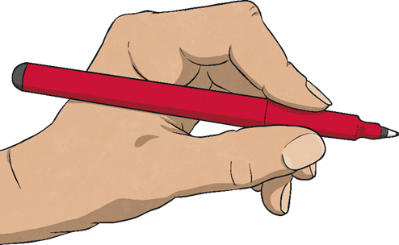
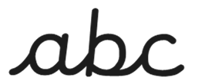
Let’s speed write!
How many times in the next minute
can you write…
accurately?
incredible
start
Try to write in a cursive style to help you write at a faster pace!

Slide 6
Let’s speed write!
How many times in the next minute
can you write…
accurately?
forcible
start
Try to write in a cursive style to help you write at a faster pace!

Slide 7
Let’s speed write!
How many times in the next minute
can you write…
accurately?
visible
start
Try to write in a cursive style to help you write at a faster pace!

Slide 8
Let’s speed write!
How many times in the next minute
can you write…
accurately?
sensible
start
Try to write in a cursive style to help you write at a faster pace!

Slide 9
Let’s speed write!
How many times in the next minute
can you write…
accurately?
responsible
start
Try to write in a cursive style to help you write at a faster pace!

Slide 10
Let’s speed write!
How many times in the next minute
can you write…
accurately?
reversible
start
Try to write in a cursive style to help you write at a faster pace!

Slide 11
Here are your spelling words for this week.
possible
horrible
terrible
visible
incredible
sensible
forcible
legible
responsible
reversible
Work hard to practise these –ible ending words.

