Slide 1
WALT make connections and draw contrast in different periods of local history.
Wednesday 20th May 2020

Slide 2
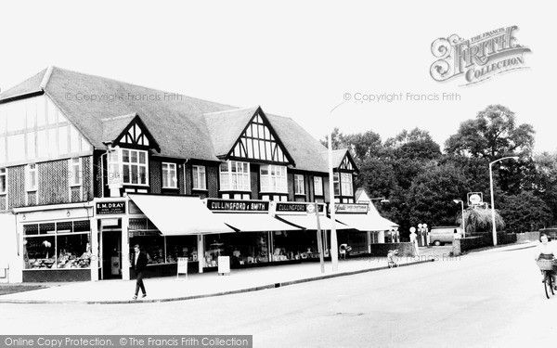

Slide 3
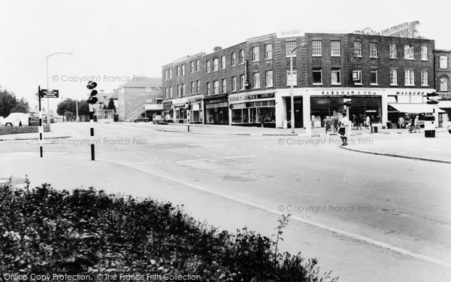

Slide 4
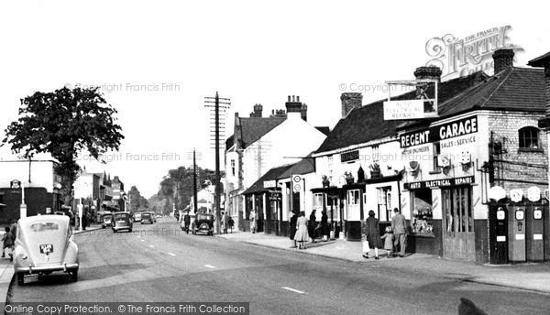

Slide 5
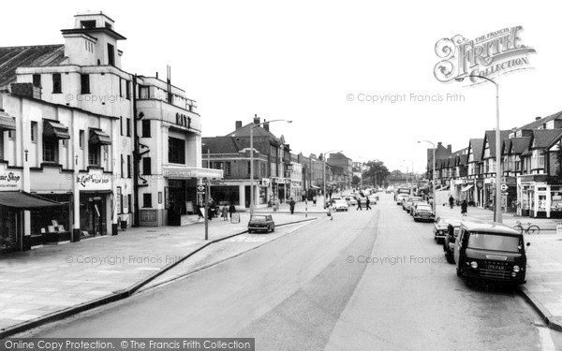

Slide 6
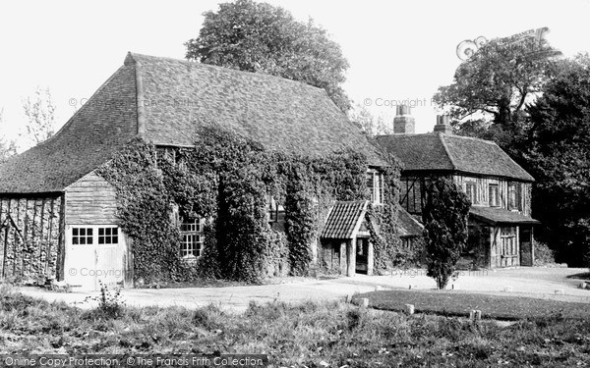

Slide 7
