Slide 1
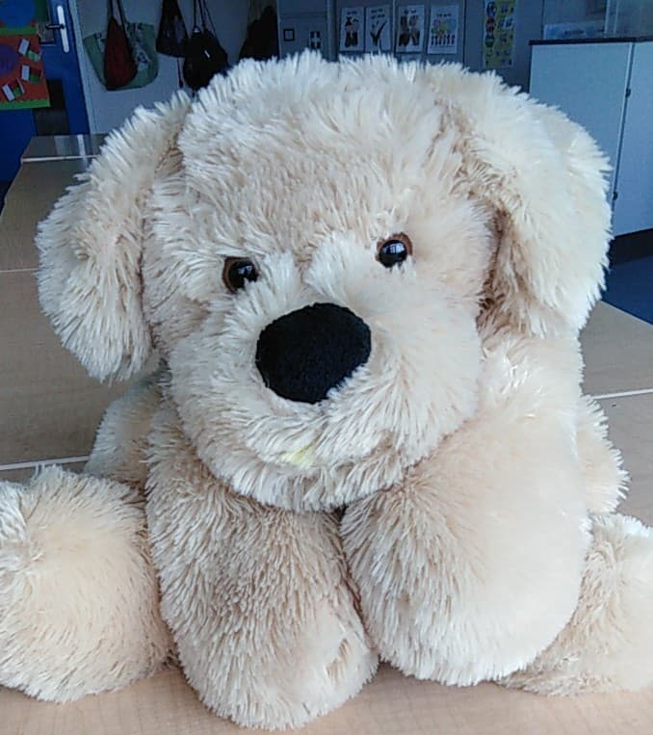
VE Day Adventure
At Home Street Party!
Have an “stay at home” VE day party on Friday 8th May.
Put up your flags and wear you hat.
Have a picnic in the garden.
This week’s tasks will help you prepare!

Slide 2
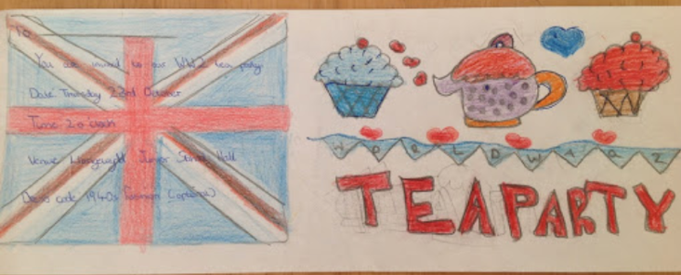
VE Day Adventure
Wednesday: Wonderful Writing!
Who will you invite?
VE day was celebrated with a street party. People decorated the street with flags and bunting. They took tables and chairs into the streets and all brought party food to share.
Design a street party invitation.

Slide 3
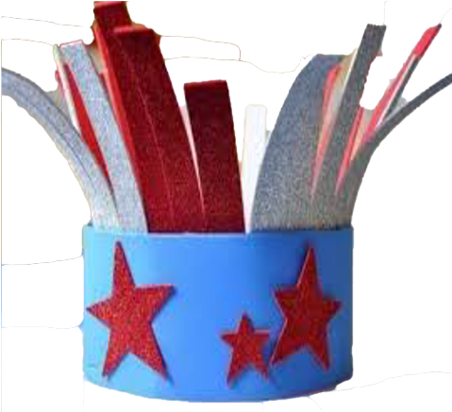
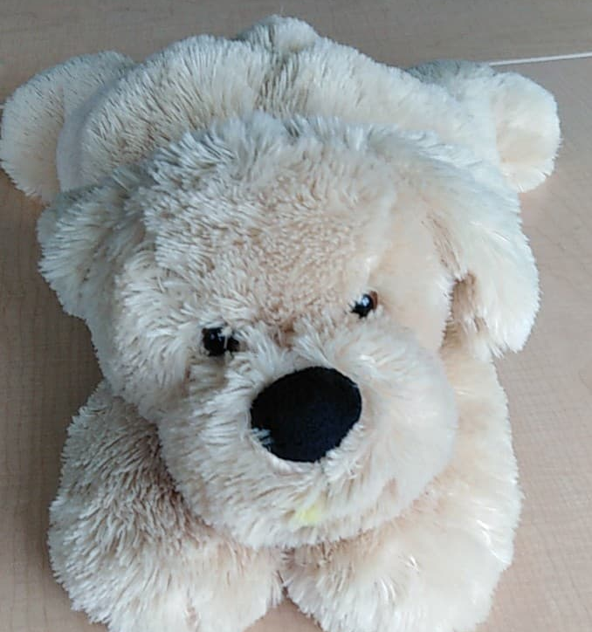
VE Day Adventure
Make some decorations and a party hat.
Don’t forget to send your photos to Mrs. Carey!

Slide 4
Don’t forget a crown or fancy hat!
VE day Adventure
Thursday: Royal Fashion Designer
Queen Elizabeth will be making a VE day speech on Friday.
The King gave a speech on VE day.
Design a fancy outfit for the Queen to wear.

Slide 5
VE Day Adventure
Friday: Bake Off
Enjoy a party!
Bake something for the VE day party!
Don’t forget to send your photo to Mrs. Carey!

