Slide 1
Converting Millilitres and Litres

Slide 2
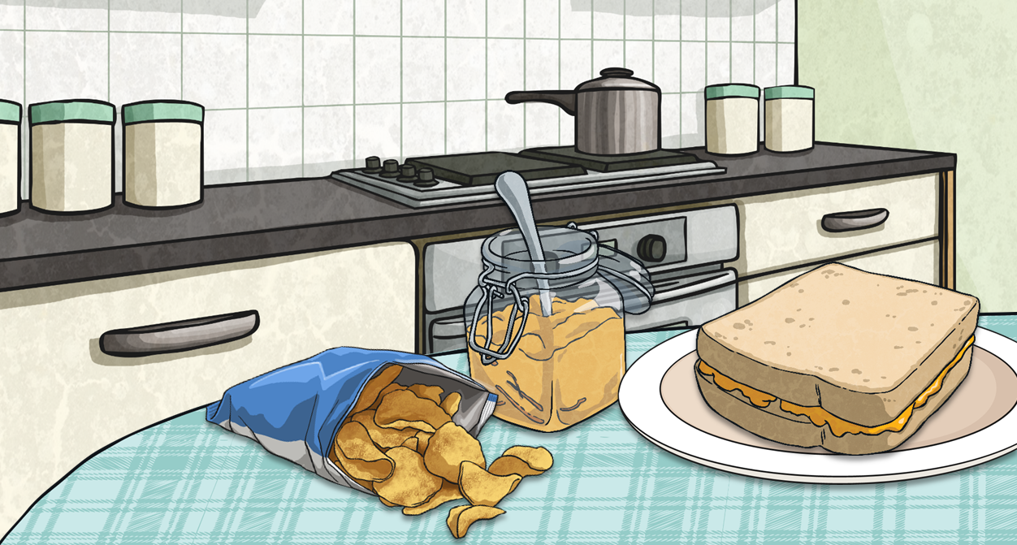
Make One Litre
How many millilitres are in one litre?
Complete the table:
1000ml
100ml is one tenth of 1000ml. This means it is one tenth of 1 litre. How could we write one tenth of 1 litre as a decimal number?
Millilitres | Litres
100ml | 0.1l
200ml
400ml
 | 0.6l
 | 0.9l
0.1l
Your teacher will give each person a Volume Card with a measurement on it. When your teacher says ‘Go!’, you have one minute to walk around the room and make a group in which the measurements on all your cards add up to exactly one litre. There should be at least three people in a group.
0.2l
0.4l
Sandwich Surprise
600ml
900ml

Slide 3
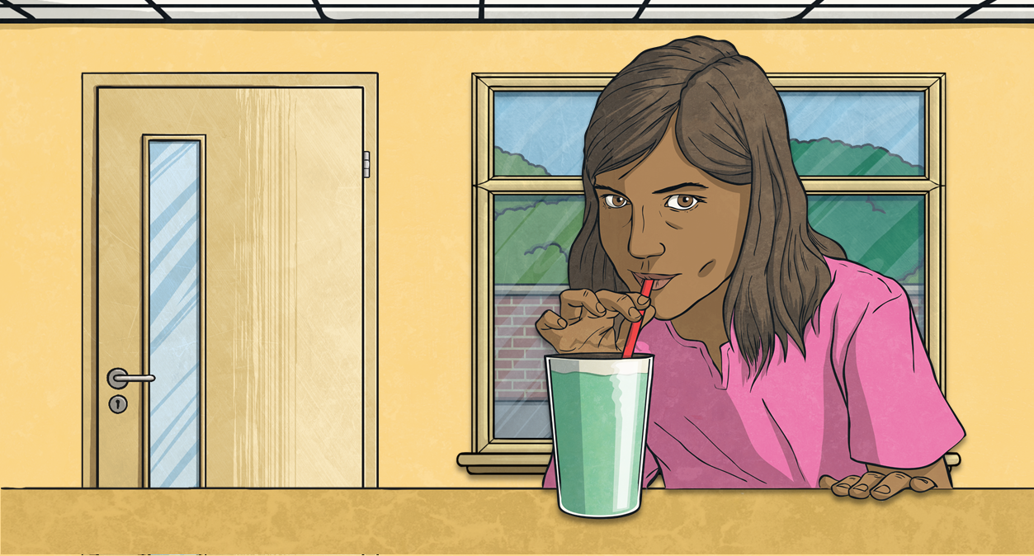
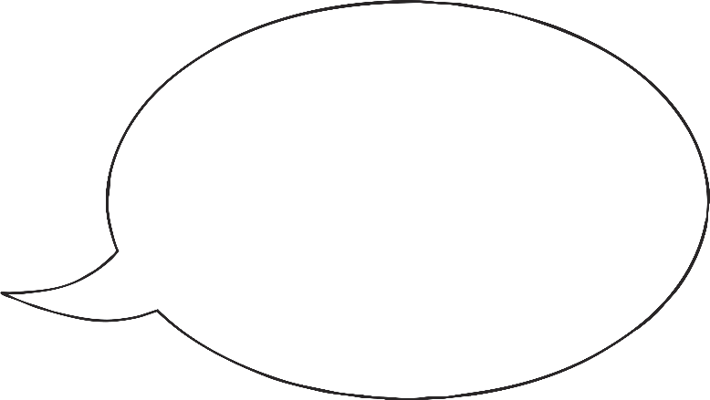
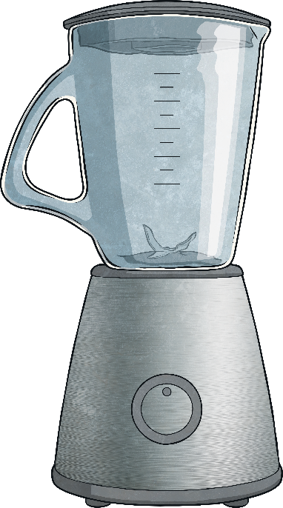
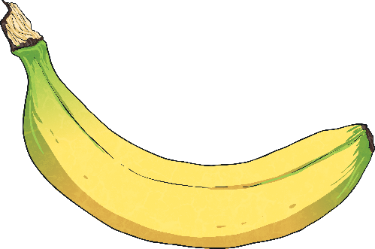
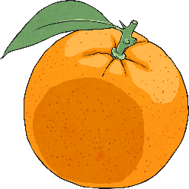
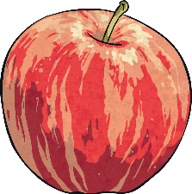
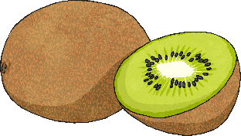
Converting from Litres to Millilitres
How many millilitres (ml) are in one litre (l)?
Class 5 are making fruit smoothies for their class party.
1000ml = 1l
Which operations do you think we use to convert between litres and millilitres?
Their teacher has challenged them to use what they know about converting measurements by giving them some measurements written in litres and others in millilitres.

Slide 4
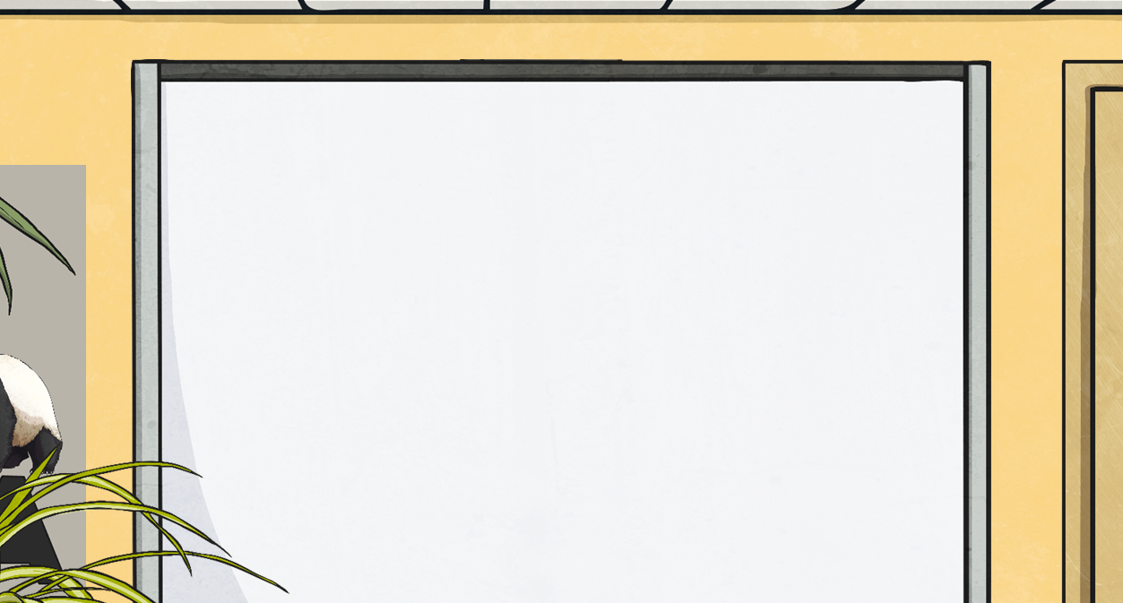
Converting from Litres to Millilitres
4l = 4000ml
What calculation did we do to convert from litres to millilitres?
What happens to a decimal number when it is multiplied by 1000?
What happens to this decimal number when it is multiplied by 1000?
If there are any empty places before the decimal point, we must write in a zero to show the place value of the number. If we did not, it would look like this number said 32.
To multiply by 1000, we move each digit three places to the left. The zeros stay in the same position.
To convert from litres to millilitres, we multiply by 1000. This is because there are 1000ml in 1 litre.
4 × 1000 = 4000
Thousands | Hundreds | Tens | Ones | tenths | hundredths | thousandths
0
0
6
3
4
2
0
5

Slide 5
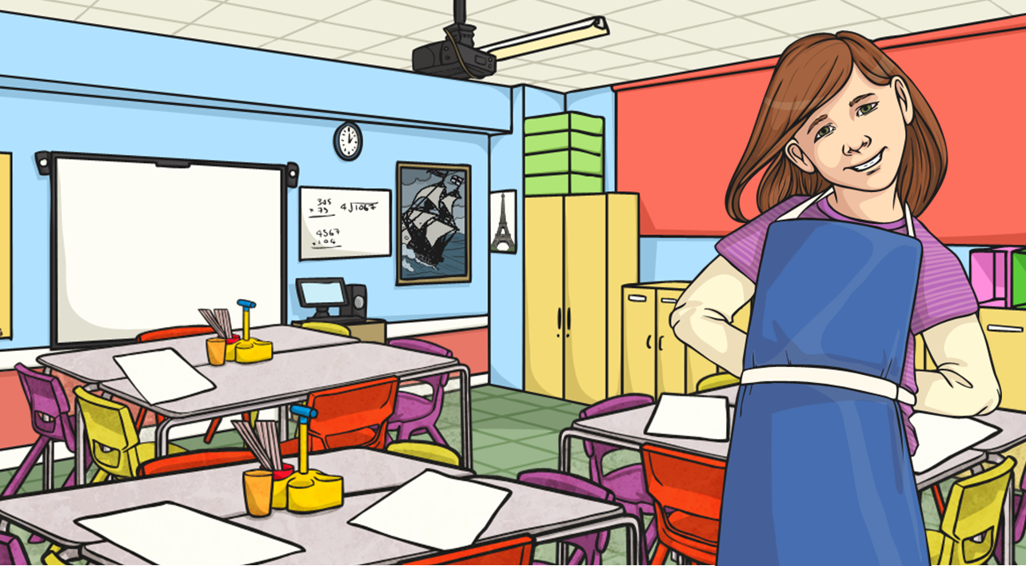
Converting from Litres to Millilitres
Here are some of the measurements Class 5 used while they were making smoothies.
Practise converting these measurements from litres to millilitres. If the numbers include any zeros, pay attention to their position.
Litres | Millilitres
3.802l
6.24l
5.9l
3.75l
2.09l
4.001l
3802ml
6240ml
5900ml
3750ml
2090ml
4001ml

Slide 6
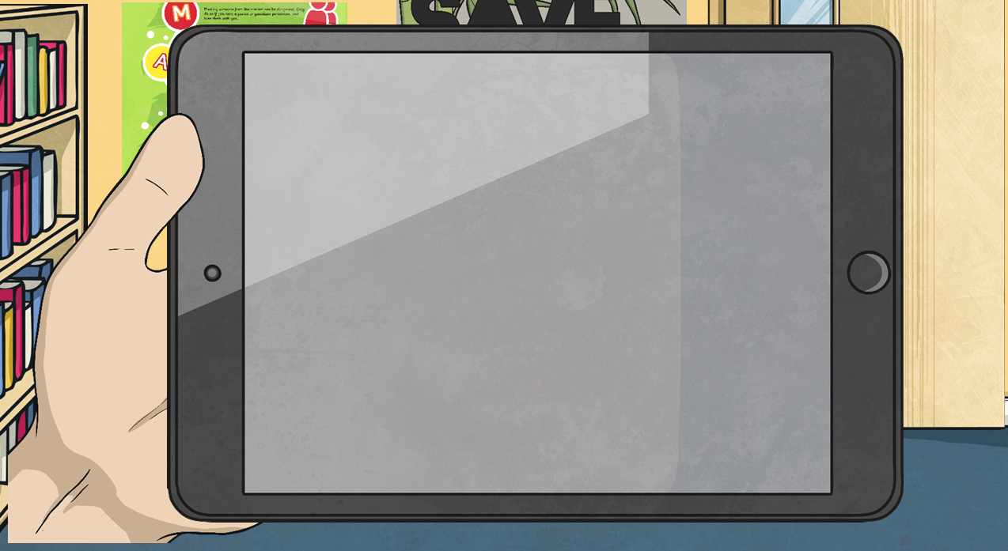
Converting from Millilitres to Litres
9000ml = 9l
What calculation did we do to convert from millilitres to litres?
What happens to a number when it is divided by 1000?
What happens to this number when it is divided by 1000?
To divide by 1000, we move each digit three places to the left. Zeros that are after the decimal place, but are not at the end of the number, stay in the same position.
To convert from millilitres to litres, we divide by 1000. This is because there are 1000ml in 1 litre.
Zeros that are after the decimal place and at the end of the number have no value, so we do not need to write them.
Thousands | Hundreds | Tens | Ones | tenths | hundredths | thousandths
9000 ÷ 1000 = 9
7
3
0
5
0
6
0
2

Slide 7
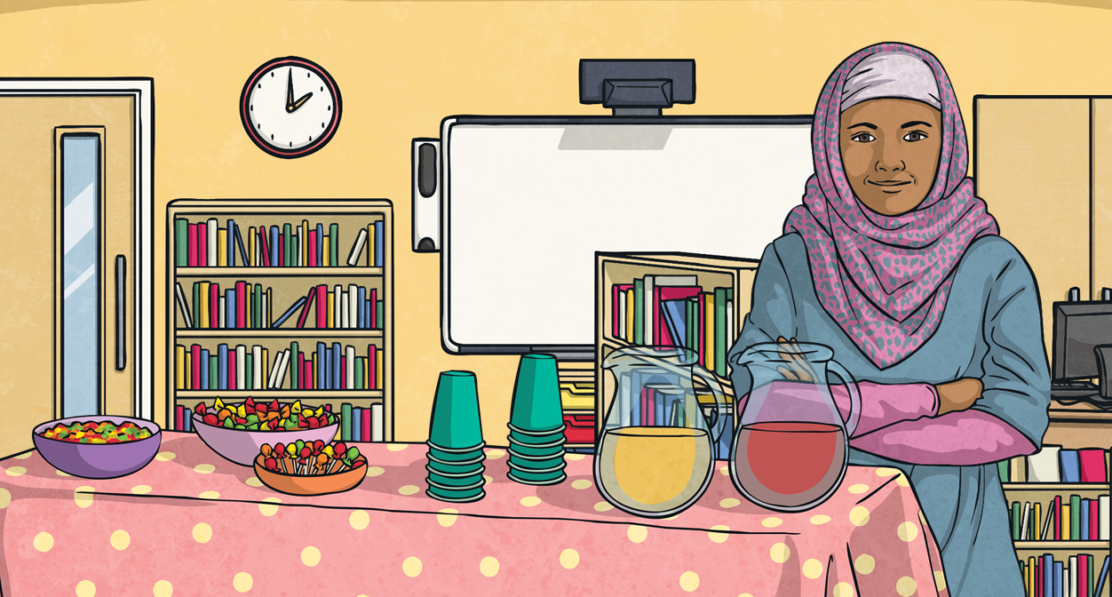
Converting from Millilitres to Litres
Class 5 also followed some recipes with measurements given in millilitres.
Practise converting these measurements from millilitres to litres. If the numbers include any zeros, pay attention to their position.
Millilitres | Litres
5692ml
3460ml
6150ml
2800ml
3060ml
4006ml
5.692l
3.46l
6.15l
2.8l
3.06l
4.006l

Slide 8
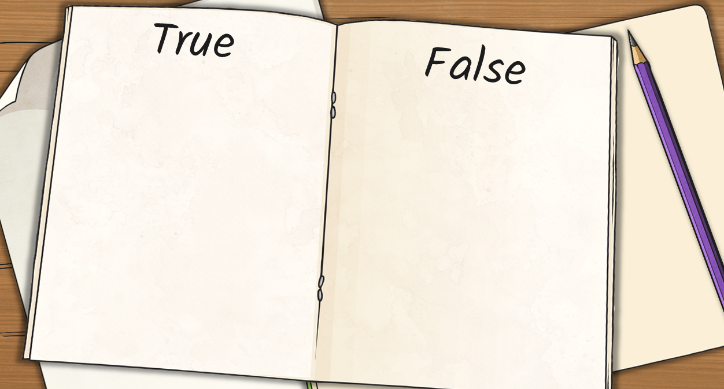
True or False?
Sort these cards onto the correct page?
6700ml = 6.7l
3020ml = 3.02l
2010ml = 2.1l
8300ml = 83l
7540ml = 7.540l
7540ml = 7.54l (the zero can be removed as it’s not necessary)
8300ml = 8.3l
2010ml = 2.01l

