Slide 1
WALT know some of the titles dedicated to Mary and said in the Litany of the Blessed Virgin Mary.
Tuesday 5th May 2020

Slide 2
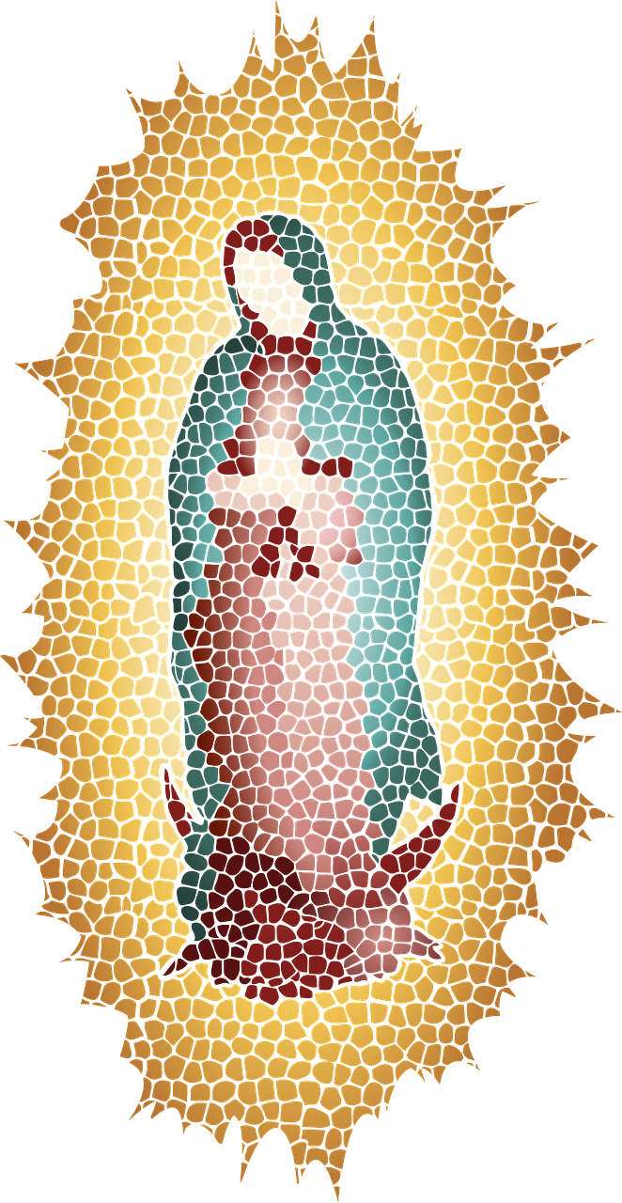
Litany
A litany is a type of prayer that contains lots of petitions and responses. The Litany of the Blessed Virgin Mary has lots of petitions to Mary, and used lots of different titles for her.

Slide 3
Litany of the Blessed Virgin Mary
Watch this video which prays the Litany of the Blessed Virgin Mary
https://www.youtube.com/watch?v=jxIVh5SCn50
Which titles for Mary particularly stand out to you?

Slide 4
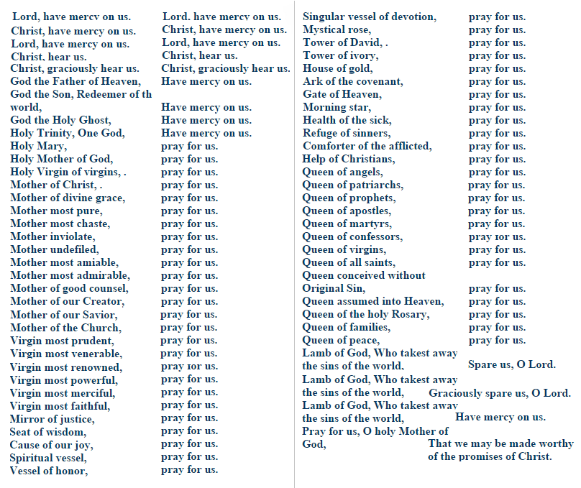

Slide 5
Your task
Choose 3 titles of Mary used in the prayer and explain what you think they mean.
Which is your favourite one?
Create a piece of artwork to match the title you have chosen.

