Slide 1
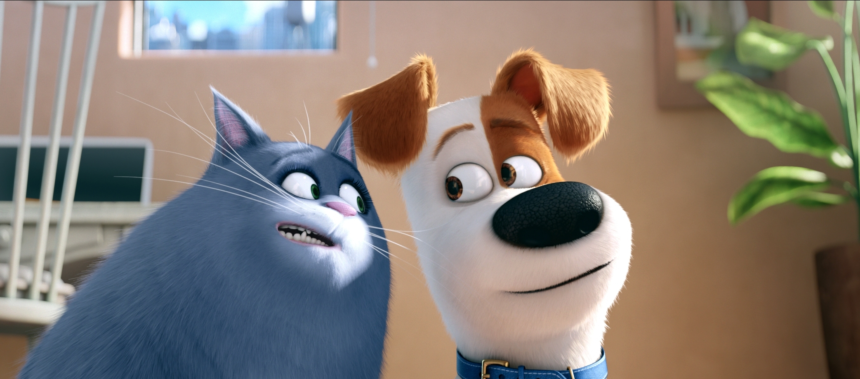
FILM DISCUSSION GUIDE
The Secret Life of Pets 2
US | 2019 | 86 mins | Dir: Chris Renaud | Cert. U | Engaging for ages 5-11
Curriculum links: PSHE, Art & Design
Universal Pictures © All rights reserved
MGM © (1959) All rights reserved.
Notes:
Please note:
You may see a Security Warning near the top of this page when first opening the file which says ‘References to external media objects have been blocked’.
This refers to the trailer on slide four which has been imported from YouTube, but is safe to play.
In order to make the video available, you will need to click ‘Enable content’ and then ‘Yes’ when the prompt asks if you want to make the file a trusted document.

Slide 2
Talk about it before the film
Do any of you have pets at home or in your family?
Do you look after your pets? What ways do they look after you?
Universal Pictures © All rights reserved
MGM © (1959) All rights reserved.
The Secret Life of Pets 2
Notes:
Teaching Notes:
Here the children can have a discussion about what pets they have at home (or a friend/family member’s pet). It gives them a chance to have a discussion about what having a pet means to them and how they look after it. This can lead to a discussion on responsibility, care and friendship.
It might also be good to talk about the steps that children take to look after their pets, such as walking their dogs, feeding their cats/hamsters, playing with their rabbits etc. Why do you do these things? Why are they important?

Slide 3
Discussion points
How many different animals did you spot in the film? Were all of them pets?
In the film, what is the biggest difference between the dog characters and the cat characters? What do you think are the differences in real life?
Max, the dog, has to wear a cone in the film. Do you remember why? Is he wearing a cone by the end of the film?
Snowball the Rabbit, Gidget the dog and Max the dog all have different stories in the film which come together at the end. Which story was your favourite and why?
Notes:
Teacher Notes:
(WATCH VIDEO/TRAILER FIRST) In the film the pets are dogs (a Jack Russell, a Pomeranian, a Newfoundland, a Shih Tzu, a Basset Hound, a Daschund, a Welsh Sheepdog and a Pug), cats, a rabbit, a hamster, a guinea pig and a parakeet. There is a white tiger which is wild but is stolen by the circus. There are also wolves that work for the circus. On the farm there are cows, sheep, chickens, a turkey and pigs. The pets are all trained and looked after by their owners whilst the farm animals are what we call ‘livestock’ as they are used for various things such as eggs (chickens), milk (cows) and cotton (sheep). They are also used for meat. The wolves and the tiger are wild and do not suit living in the city, they belong in their natural habitat or maybe in the zoo.
In the film, all of the dog characters, such as Max, Duke and Gidget, are excitable and friendly. The cat characters are mostly more relaxed/laid back and maybe lazy but can suddenly get excited or energetic. At one point in the film, Gidget must learn how to act more like a cat in order to infiltrate the apartment where all the cats live to get her ball back. She walks differently and wears cat ears on her head.
The film begins with Max’s owners having a baby and bringing it back home. Max soon learns to love the child, named Liam, and they get along very well. However, due to Max’s overprotective nature, he becomes anxious wondering what could happen to Liam and his nerves result in him scratching all the time (typical behaviour for stressed dogs). The cone is to stop Max from itching. With help from the Sheepdog Duke he learns to face his fears and not be scared of everything. This helps him come to terms with letting Liam grow up on his own without constantly having to look after him and he does not need the cone anymore.
Snowball the Rabbit has an owner who dresses him up like her favourite superhero. He believes he is a superhero himself and is recruited by a plucky dog to help rescue a tiger from the circus. Gidget, meanwhile, is asked by Max to look after his ball but loses it in an apartment full of kittens and cats. She must ask for help in learning how to be a cat so she can go undercover to get the ball back. Max’s story is about his trip to the farm and learning to come to terms with a new environment. He meets a scary Turkey, a brave dog and a lazy pig and learns to be brave and overcome his fears. At the end of the film, they all come together and use their newfound skills or friends to rescue the tiger and find him a new home.

Slide 4
The Secret Life of Pets 2

Slide 5
Extension activities
Take an animal from this film and list all of the characteristics that the animals are known for.
What secret life would this animal lead? You can write these down or draw pictures to show what they get up to when there are no owners around.

Slide 6
Write about it
Bring your ideas together in a review and share it on our Into Film clubs’ website. You could include a summary of the story, mention other films that it’s similar to, describe what you particularly liked or disliked and give it your star rating.
Notes:
Teacher Notes:
You may wish to refer to our resource on Creating Effective Film Reviews for Primary audiences:
https://www.intofilm.org/resources/108

Slide 7
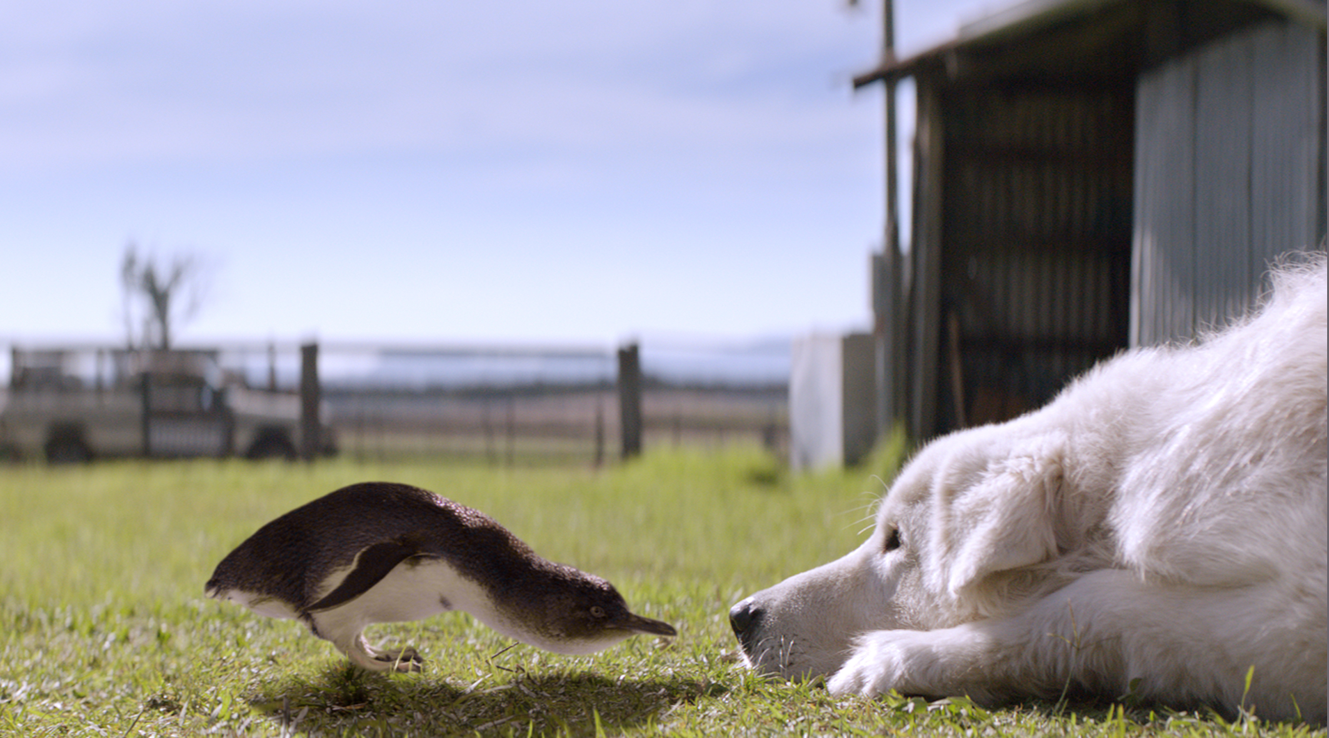
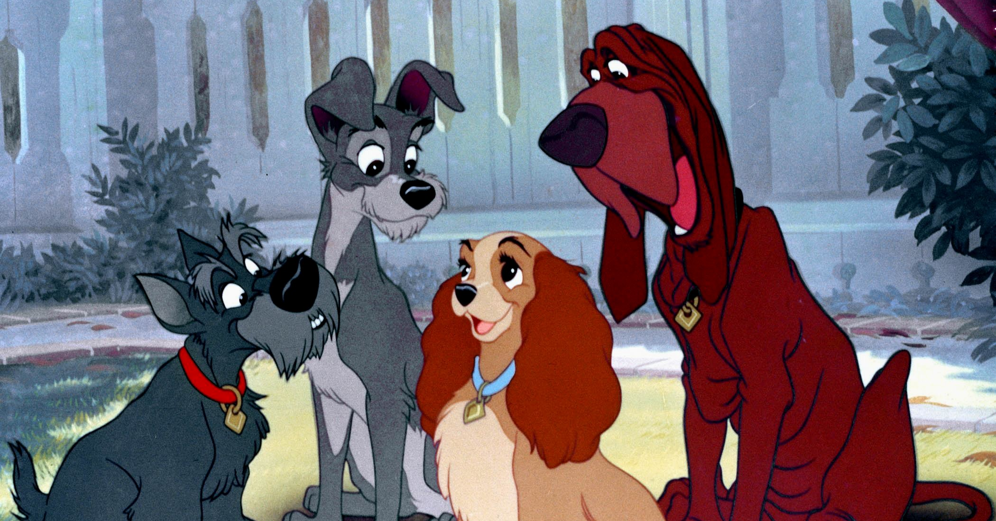
Watch next
Oddball and the Penguins
2012 | Cert. U | Engaging for ages 5-11
Charming adventure about an eccentric farmer and his wayward dog who come up with a plan to help protect their town’s endangered penguins.
Icon Film Distribution © (2012) All rights reserved.
Lady and the Tramp
1955 | Cert. U | Engaging for ages 5-11
Classic Disney animation that sees scruffy mongrel Tramp and a wealthy cocker spaniel called Lady go on an unlikely and fulfilling adventure.
Disney © (1955) All rights reserved.

