Slide 1
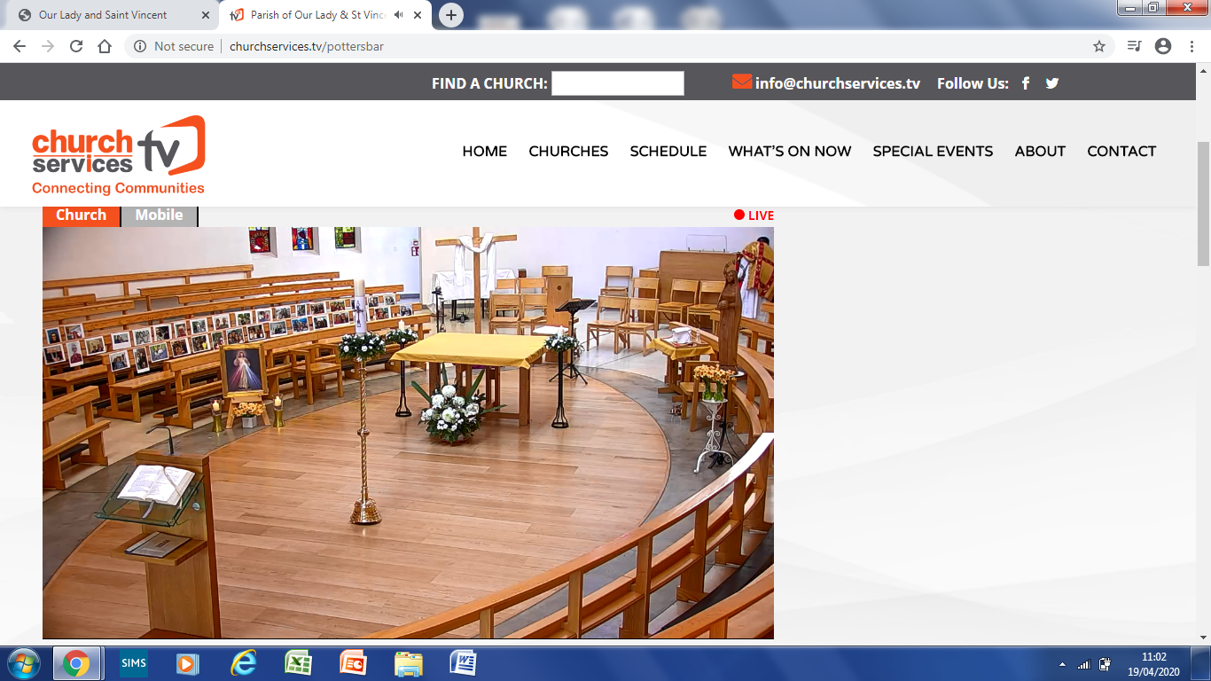
What signs of the Resurrection can you see in our church today?

Slide 2
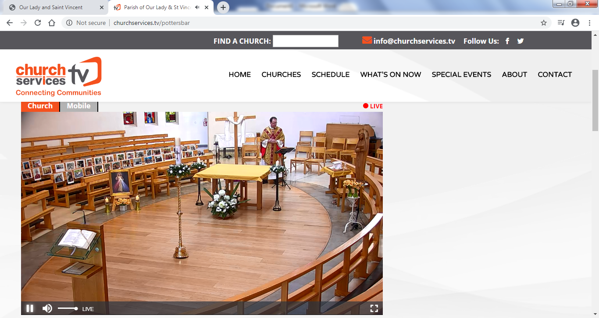
What signs of the Resurrection can you see in our church today?

Slide 3
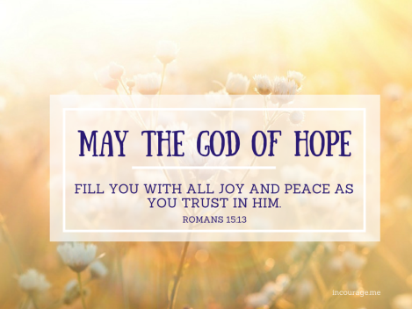
Write a Easter poem with the title “What Easter means to me? ”
Here are some thoughts:
A fresh start, a clean heart, forgiven pasts, True love that lasts...That’s what Easter means to me
No longer blind, now Christ I see....That’s what Easter means to me.

Slide 4
Paintings of the Resurrection?
What can you see?
What do you like/dislike about each painting?
What colours/shapes can you see?
What title would you give this painting?
Which is your favourite and why?

Slide 5
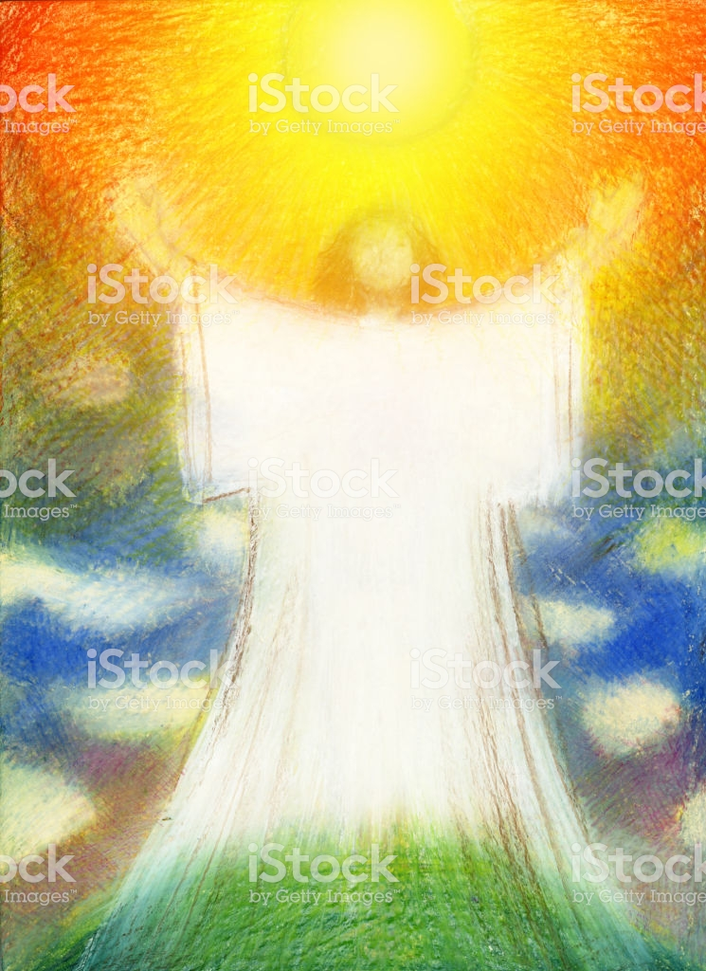

Slide 6
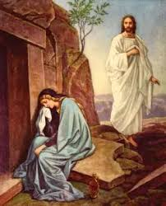

Slide 7
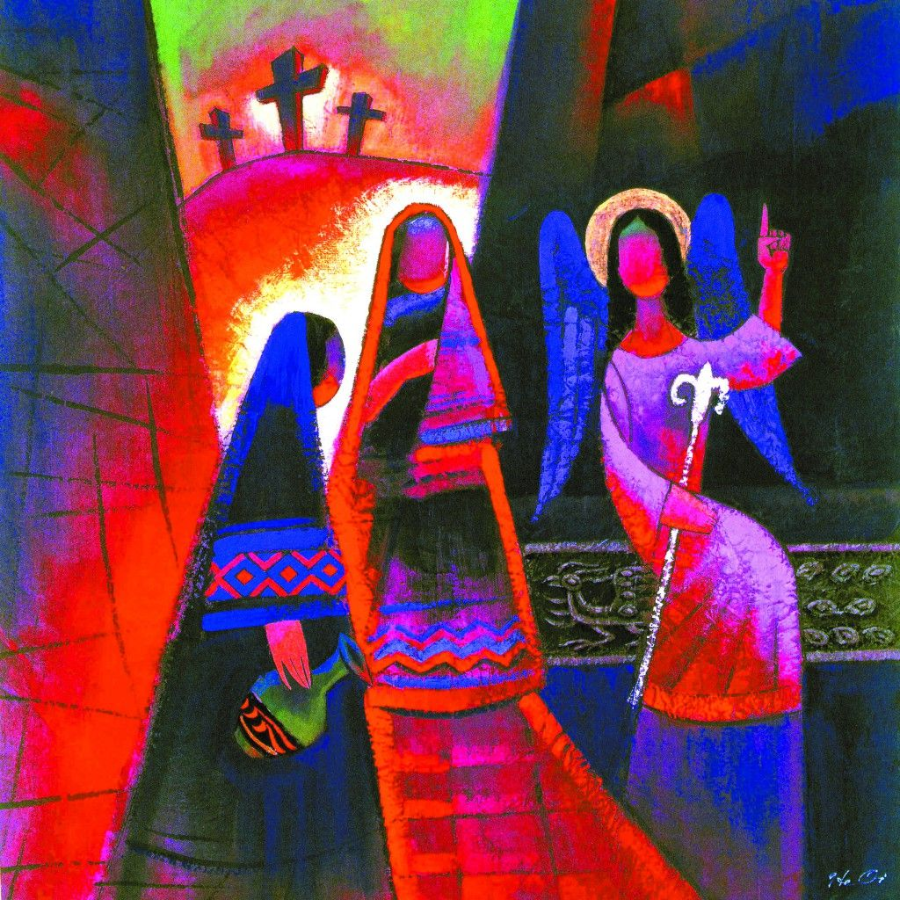

Slide 8
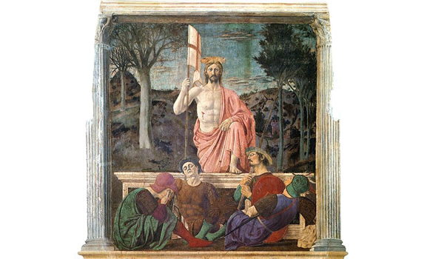

Slide 10
