Slide 1
WALT interpret the story of the Resurrection through art.
Thursday 23rd 2020

Slide 2
Read Matthew’s account of the Resurrection

Slide 3
Look at the paintings on the following slides, all depicting the Resurrection.

Slide 4
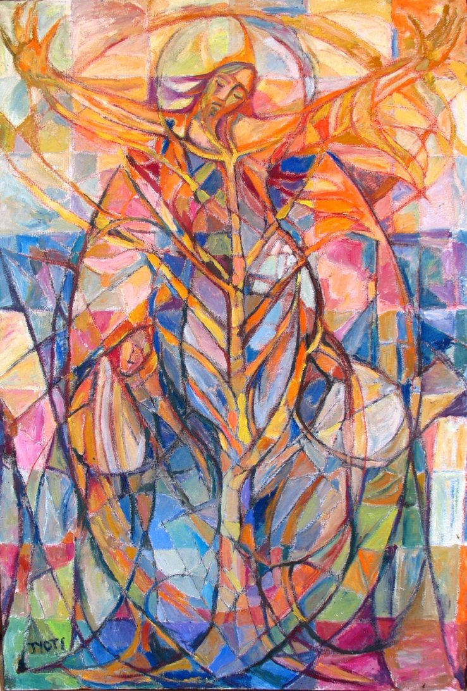

Slide 5
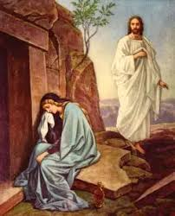

Slide 6
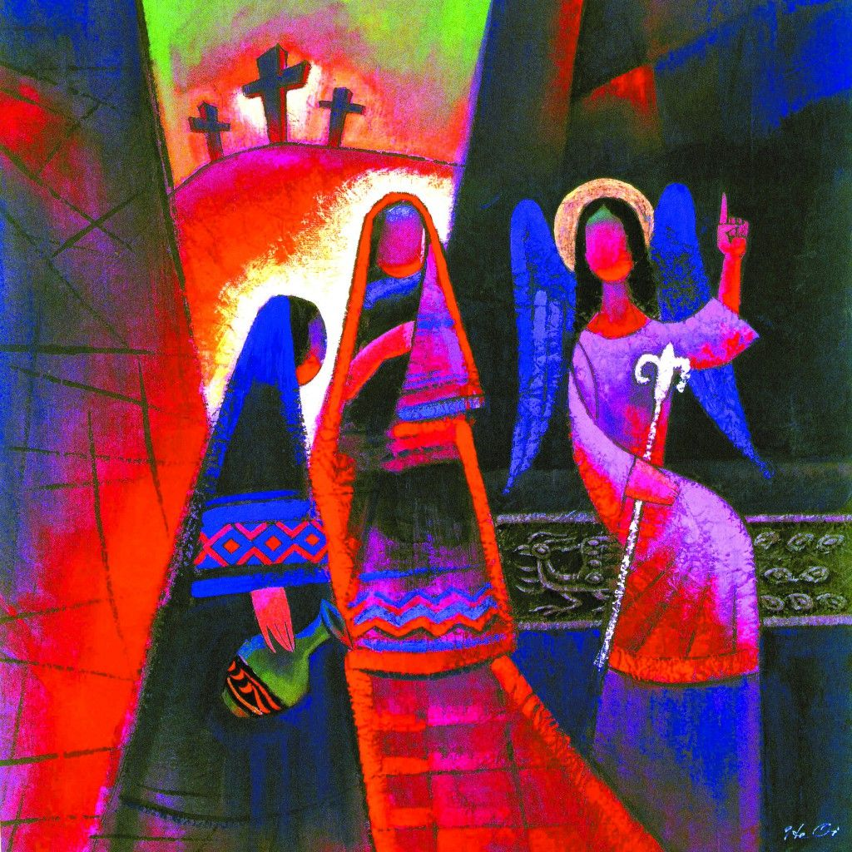

Slide 7
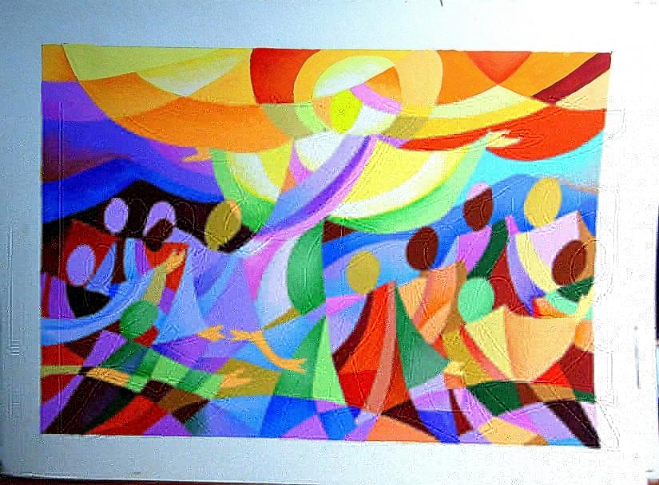

Slide 8
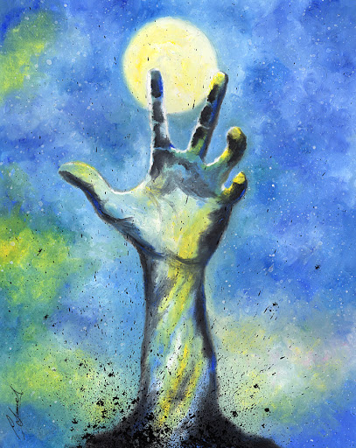

Slide 9
Paintings of the Resurrection?
Write answers to the following questions in your books for each painting:
What can you see?
What do you like/dislike about each painting?
What colours/shapes can you see?
What title would you give each painting?
Which is your favourite and why?
How do you think Matthew would react to each painting?

Slide 10
Finally…
Combining your favourite aspects from all the paintings you just looked at, and adding any symbolism or ideas of your own, create your own piece of art depicting the Resurrection of Jesus.

