Slide 1
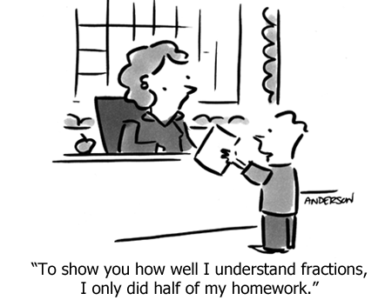
WALT multiply simple pairs of proper fractions.
31/03/20 XXXI/III/MMXX

Slide 2
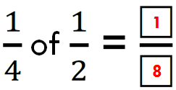
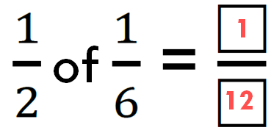
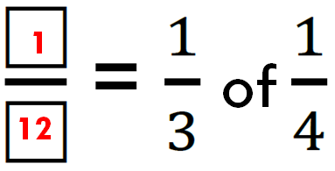
Look at yesterday’s examples. What do you notice about the product (answer) in relation to the pair of fractions being multiplied?

Slide 3
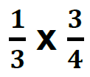
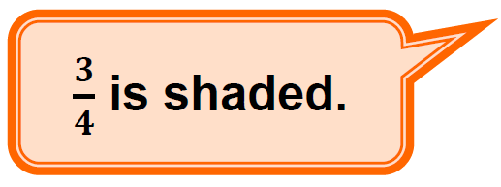
Let’s look at an example where the numerators are not both 1.
of

Slide 4
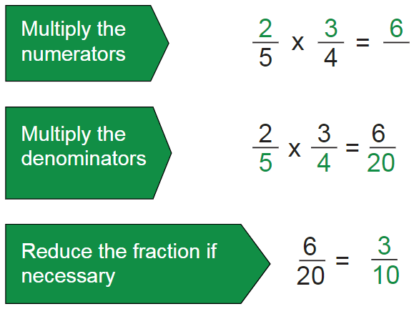
When multiplying pairs of proper fractions, numerators can be multiplied together to create the product numerator. Similarly, denominators can be multiplied for their product.
So, unlike when adding or subtracting fractions, we DON’T need to find a common denominator to multiply them.
Remember to simplify your answer if it can be simplified.

Slide 5
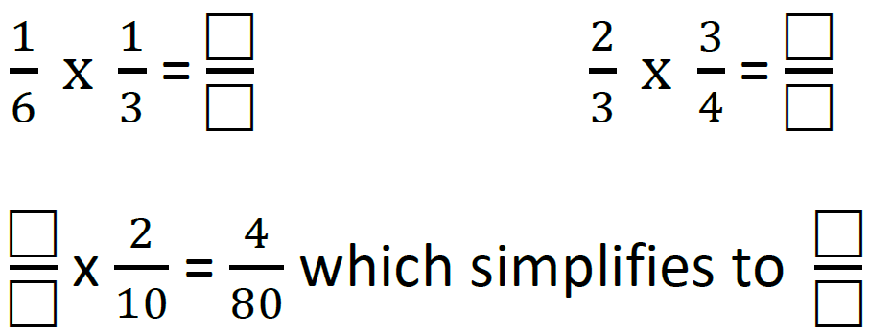
Time to practise...

Slide 6
Time to practise...
1
6
1
18
12
2
2
1
8
20

Slide 7
Time to practise...

Slide 8
Time to practise...
1
2
1
3
1
4
5
2

Slide 9
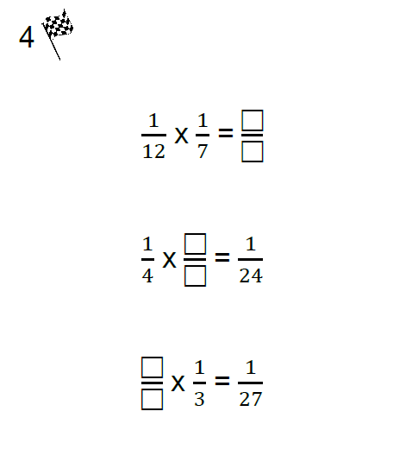

Slide 10
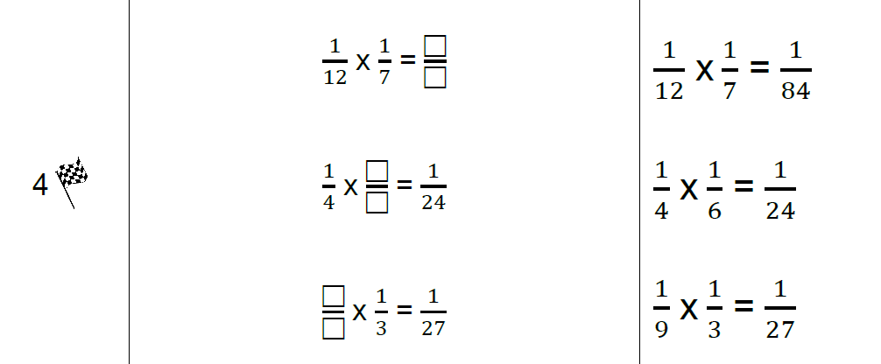
Answers...

Slide 11
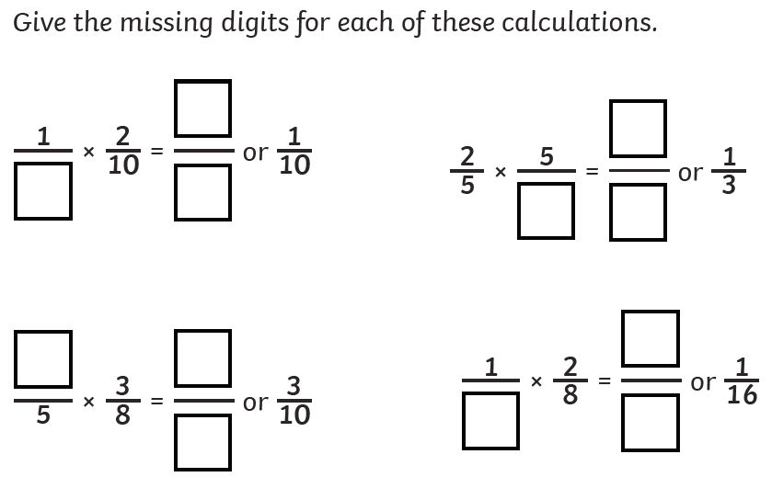
Further questions...

Slide 12
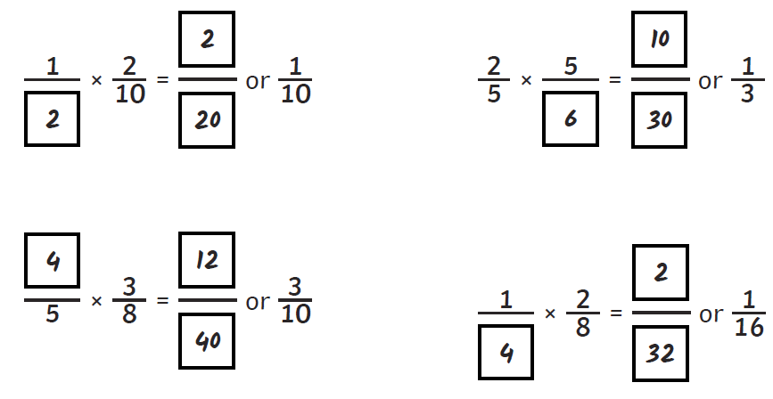
Answers

Slide 13
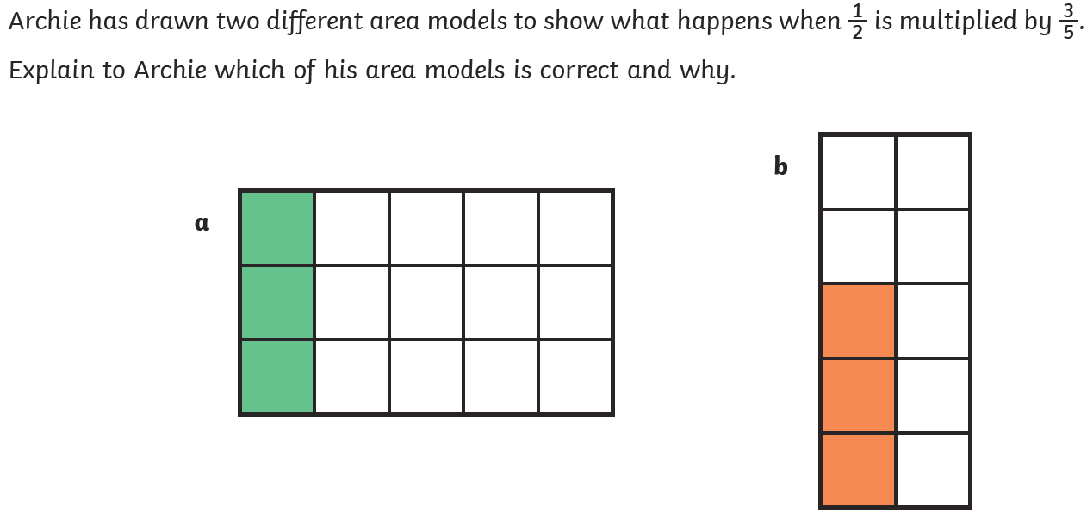
Reasoning

Slide 14
Reasoning

Slide 15
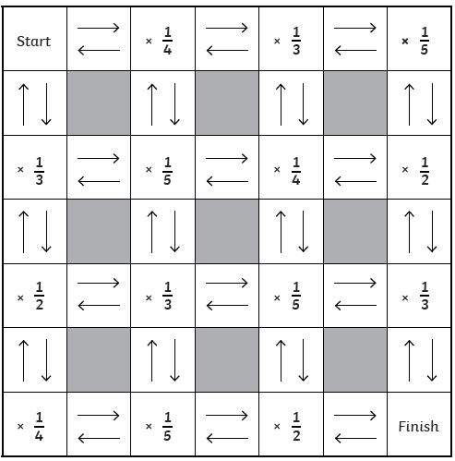
Start with any fraction. Take a route through the maze, writing down the calculations as you go. What fraction do you finish with?

