Slide 1
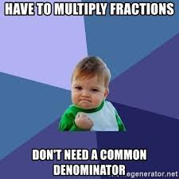
WALT represent multiplication with simple pairs of proper fractions.
31/03/20

Slide 3
Imagine that this strip measures ½ metre in length.
½ metre = 50cm

Slide 4
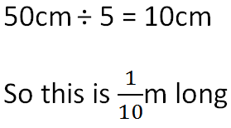
Now let’s fold it into 5 equal parts
½ metre = 50cm

Slide 5
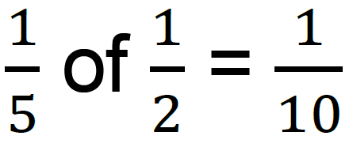
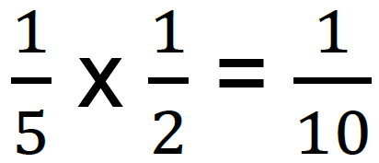
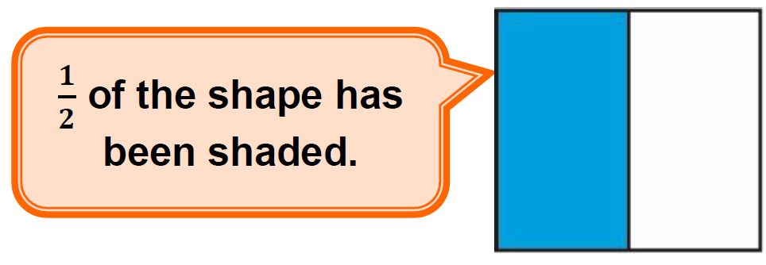
We can write that calculation as
or

Slide 6
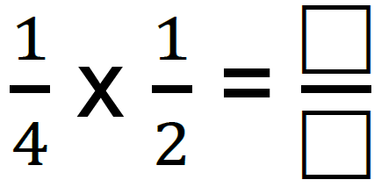
Have a go...
of
(remember that ‘x’ means ‘of’)
½
½

Slide 7
Have a go...
1
of
(remember that ‘x’ means ‘of’)
8
1/8 | 1/8 | 1/8 | 1/8
1/8 | 1/8 | 1/8 | 1/8

Slide 8
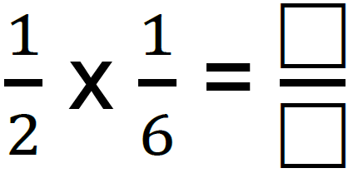
Have a go...
of
(remember that ‘x’ means ‘of’)
1/6 | 1/6 | 1/6 | 1/6 | 1/6 | 1/6

Slide 9
Have a go...
1
of
(remember that ‘x’ means ‘of’)
12
1/12 | 1/12 | 1/12 | 1/12 | 1/12 | 1/12
1/12 | 1/12 | 1/12 | 1/12 | 1/12 | 1/12

Slide 10
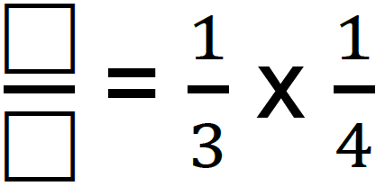
Have a go...
of
(remember that ‘x’ means ‘of’)
¼ | ¼ | ¼ | ¼

Slide 11
Have a go...
1
of
(remember that ‘x’ means ‘of’)
12
1/12 | 1/12 | 1/12 | 1/12
1/12 | 1/12 | 1/12 | 1/12
1/12 | 1/12 | 1/12 | 1/12

Slide 13
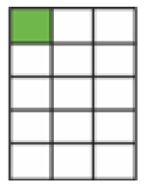
Answers...

