Slide 1
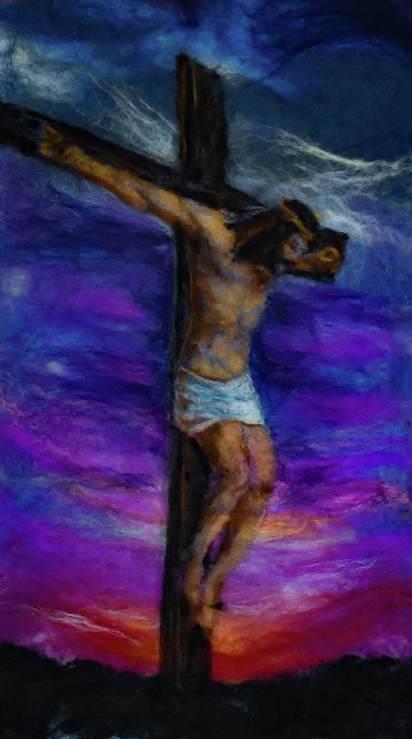
WALT understand why Good Friday is ‘Good’.
Monday 30th March 2020

Slide 2
Holy Week
Palm Sunday: Entry into Jerusalem
Maundy Thursday: Last Supper,
Garden of Gethsemane
Good Friday: Jesus’ Crucifixion
Easter Saturday
Easter Sunday

Slide 3
Holy Week
Palm Sunday: Entry into Jerusalem
Maundy Thursday: Last Supper,
Garden of Gethsemane
Good Friday: Jesus’ Crucifixion
Easter Saturday
Easter Sunday

Slide 4
Holy Week
Palm Sunday: Entry into Jerusalem
Maundy Thursday: Last Supper,
Garden of Gethsemane
Good Friday: Jesus’ Crucifixion
Easter Saturday
Easter Sunday

Slide 5
Holy Week
Palm Sunday: Entry into Jerusalem
Maundy Thursday: Last Supper,
Garden of Gethsemane
Good Friday: Jesus’ Crucifixion
Easter Saturday
Easter Sunday

Slide 6
Here is what the missal says about the Good Friday Liturgy.
We have our liturgy at three o’clock to remember the time that Jesus died. Our liturgy has three parts: Liturgy of the Word, the Adoration of the Cross, and Holy Communion.
The Priest wears red vestments. When he enters the church he does so in silence. He walks to the altar and lies in front of it to pray.
After the Prayers of Intercessions, Adoration of the Cross takes place. In some parishes, the cross comes into the Church covered in a violet veil and is uncovered as part of the liturgy. In others, it comes into the Church uncovered. Candles are placed at each side of the cross and the congregation are invited to come forward and genuflect in front of it or to touch or kiss it.

Slide 7
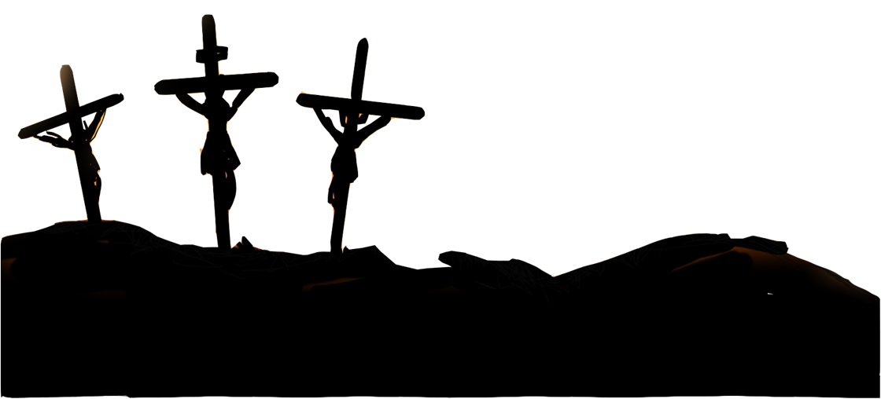
Watch the video, then answer the questions below: https://www.youtube.com/watch?v=vO37DRIGgw0
What is Good Friday?
What do we remember about Jesus on this day?
What actions did you see?
What is the veneration?
Why do Catholics do this?
Why is there no Eucharistic
celebration?
7. Why is Good Friday important
to Christians?

Slide 8
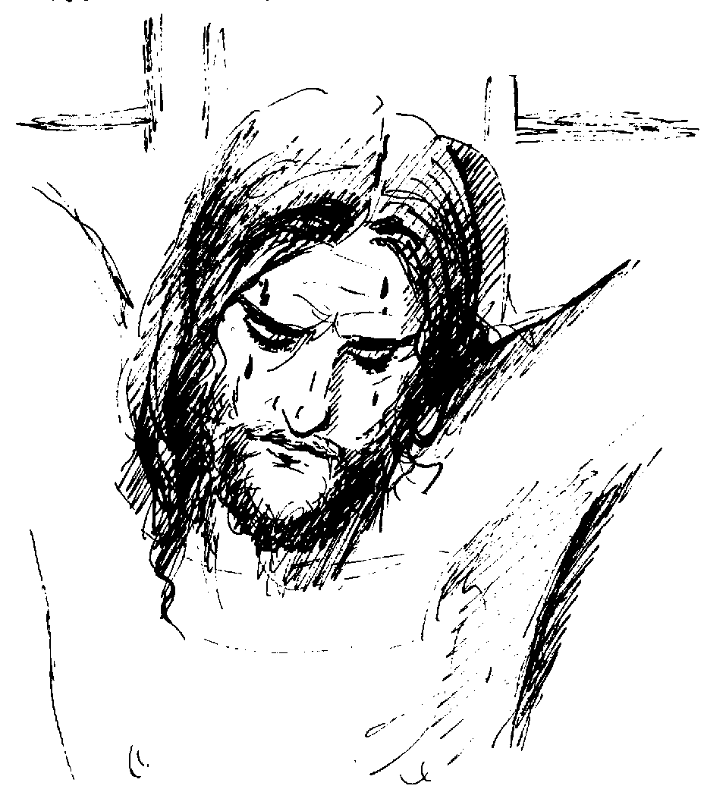
Good Friday shows us the extent to which Jesus was prepared to sacrifice himself so that we might know and love God.

Slide 9
Watch this powerful video demonstrating that when Jesus died for us on Good Friday, his love conquered all evil.
https://www.youtube.com/watch?v=FzxXvEtf9D0

Slide 10
Your task...
Draw a large cross (ideally on card).
Go into your garden and collect several leaves.
On the leaves, write what is good about Good Friday and about forgiveness.
Stick the leaves onto your cross, thus transforming the cross of death into a plant of new life.

