Slide 1
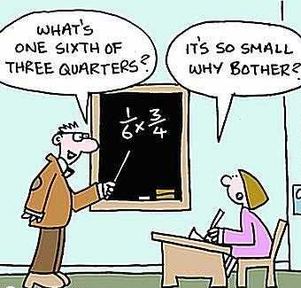
WALT Understand the effect of multiplying with proper fractions
30/03/20

Slide 4
Sort the products (answers to a multiplication question) greater than, equal to or less than 1
>1 | =1 | <1
Calculations to sort:

Slide 5
Sort the products (answers to a multiplication question) greater than, equal to or less than 1
>1 | =1 | <1

Slide 6
Sort the products (answers to a multiplication question) greater than, equal to or less than 1
>1 | =1 | <1

Slide 7
Sort the products (answers to a multiplication question) greater than, equal to or less than 1
>1 | =1 | <1

Slide 8
Sort the products (answers to a multiplication question) greater than, equal to or less than 1
>1 | =1 | <1

Slide 9
Sort the products (answers to a multiplication question) greater than, equal to or less than 1
>1 | =1 | <1

Slide 10
Sort the products (answers to a multiplication question) greater than, equal to or less than 1
>1 | =1 | <1

Slide 11
Sort the products (answers to a multiplication question) greater than, equal to or less than 1
>1 | =1 | <1

Slide 12
Sort the products (answers to a multiplication question) greater than, equal to or less than 1
>1 | =1 | <1

Slide 14
Answer = Sometimes

Slide 15
Watch this video
https://www.youtube.com/watch?v=mJUvxRy-flQ

Slide 16
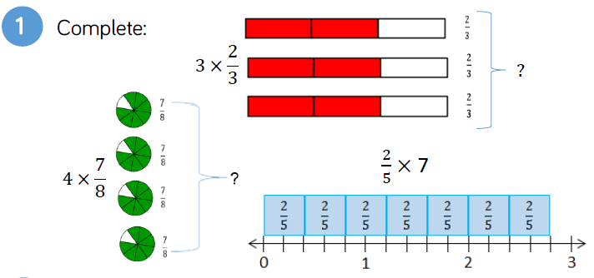

Slide 18
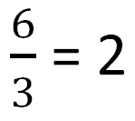
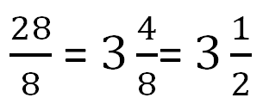
Answers

Slide 19
5 bars

Slide 20
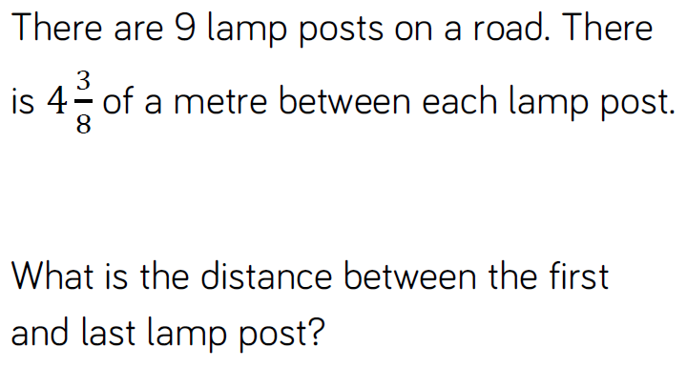

Slide 21
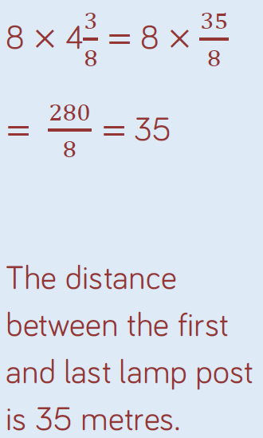

Slide 22
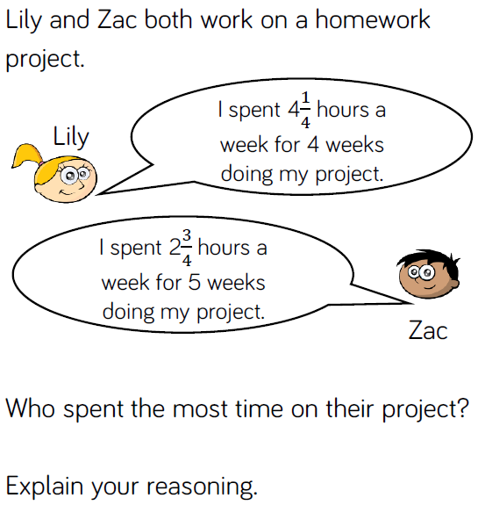

Slide 23
